Slide 1

“Making a difference in Atlanta’s Westside community for over 20 years.”

Slide 2
Vision
ITCDC envisions a new Vine City/English Avenue community; a community that is safe, attractive, and affordable. Transformation will happen through empowered individuals, economic options and affordable housing opportunities.

Slide 3
Project Wraparound
2010
Beautification/Restoration
Employment
Home Ownership
Public Safety

Slide 4
Activity Report—October 2010 to June 2014
Total Registered Clients 2043
Clients self-identifying as felons 31%
Felons hired in any capacity via ITCDC 150
Residents referred to AWDA’s Wal-Mart Program 287 (45 were hired)
Residents placed in full-time employment 472

Slide 5






WESTSIDE WORKS
Managing Partner

Slide 6

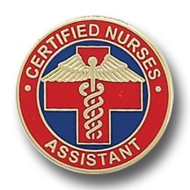



Residents Trained by Program
= 20 Residents
503
Residents Trained
CNA | Construction | Culinary | Information Technology
404
Residents Placed in
Full-Time Positions
$13.76
Average Resident Wages Per Hour
78%
Of Residents Retain Living Wage Jobs After 1 Year

Slide 8
Westside NET
Networking, Employment and Training
Core program areas include:
Personal Development focused on motivation to complete a potentially long job search, goal setting, and completion of both an individual and employment development plan.
Soft Skills training which include communications, conflict resolution, teamwork time management, customer service and professionalism skill development.
Job Readiness training which includes effective resume development, online and offline job search training, contacting employers, and interviewing.
Digital Literacy which includes the development of basic computer skills, including use of email, online job boards, computer search functions, file management and business related word processing.
Job Placement and Follow-up Services using community contacts, partnerships, and knowledge of specific job openings, participants will be supported with job placement assistance.

Slide 9
Westside BRIDGE
Bringing Re-entering Individuals Directly to Great Employment
With no jobs, no money, no foreseeable avenues of gaining sustainable employment and no hope, many former offenders often find themselves in the same situations that initially landed them in prison. Westside BRIDGE offers solutions to this pressing problem providing the following services:
Workshops to change attitudes of returning citizens toward their likelihood of finding employment, their ability to be self-employed entrepreneurs, to increase job readiness knowledge and skills and other necessary wrap around services;
Literacy interventions to include: basic skills development, GED attainment, college readiness, digital and credential attainment;
Increase knowledge of services available to returning citizens and individuals with criminal backgrounds; and
Access to knowledgeable second chance employers through career fairs and direct hire events.

Slide 10
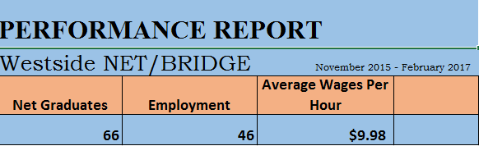

Slide 11
Westside Neighborhoods Beautification Project
Clean-up and landscape visible sites important to the community
Trimming vacant lots, cleaning sidewalks
Deconstructing small properties
Senior citizens yard beautification projects
Accessibility ramps for senior citizens
Create and place Trash Barrels throughout the community and remove the trash weekly
Work with neighborhood associations to plan community clean-up efforts
Partner with other non-profit organizations to develop clean-up efforts (i.e. Habitat for Humanity)
Provide basic leadership training and to designate “team leaders”
Provide weekly status update reports on projects progress

Slide 12

Future Plans:
Training partnership with The YMCA
Logistics/warehousing
Workforce housing

