Slide 1
THE MISSION CONTINUES IN ATLANTA
STEWART WILLIAMS – THE MISSION CONTINUES
CITY IMPACT MANAGER - ATLANTA
Notes:
Good Morning! My name is SDW and I am the CIM with TMC. I am a Marine Corps Veteran and served in the Gulf War. I have been in Atlanta since 2007 where I started my career here at the CEO of the Butler Street YMCA. I’ve worked for the Annie E. Casey Foundation with the Atlanta Civic Site and prior to joining TMC served as VP of Operation with the Boys and Girls Clubs of Metro Atlanta.
What I’m here to speak with you about today is how our current generation of Veterans continue to serve in a way that is making a difference in the day-to-day lives of residents on the west side and other major cities throughout the US.
Just by show of hands how many of you in the audience are Veterans?

Slide 2
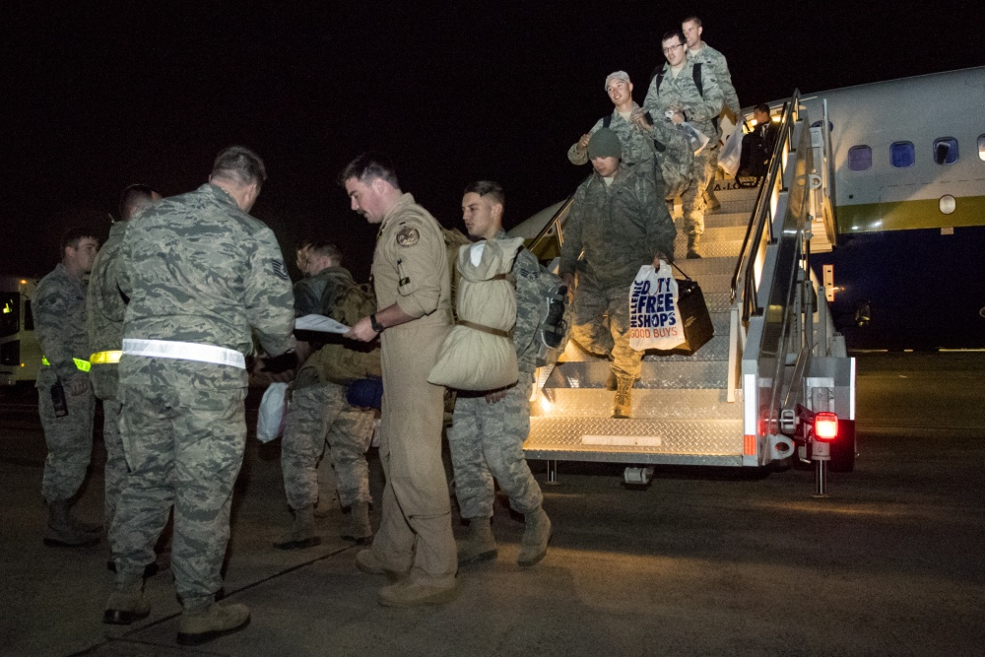
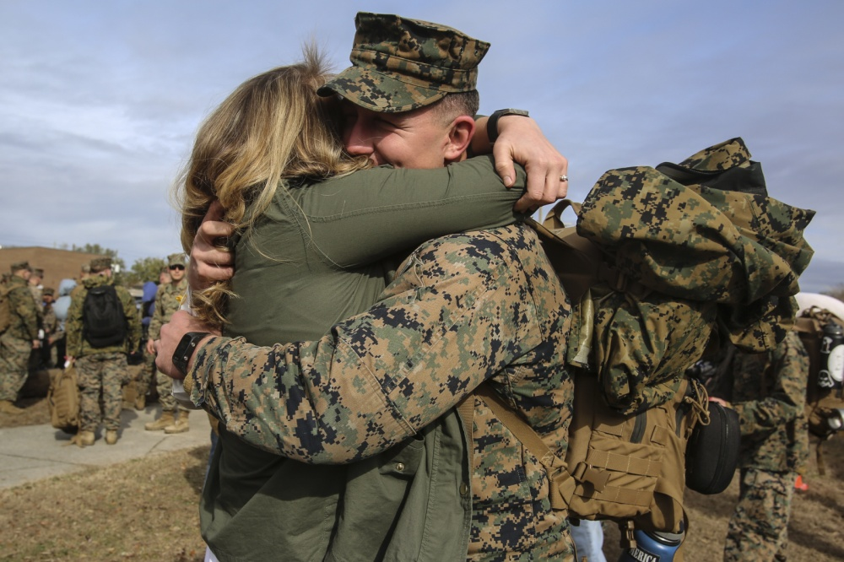
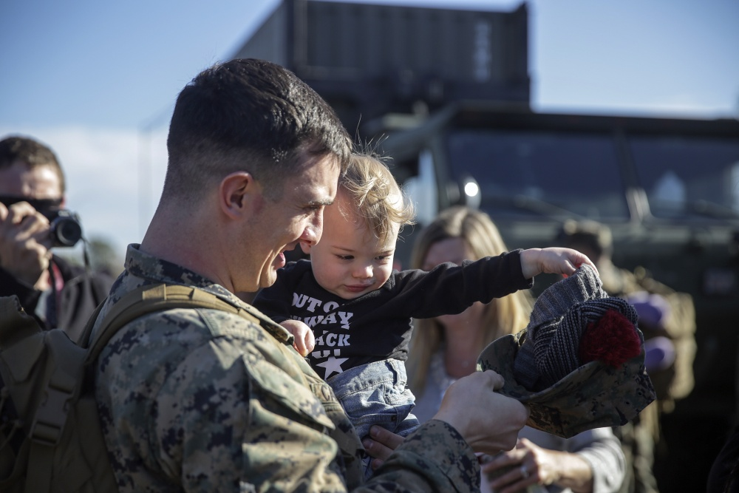
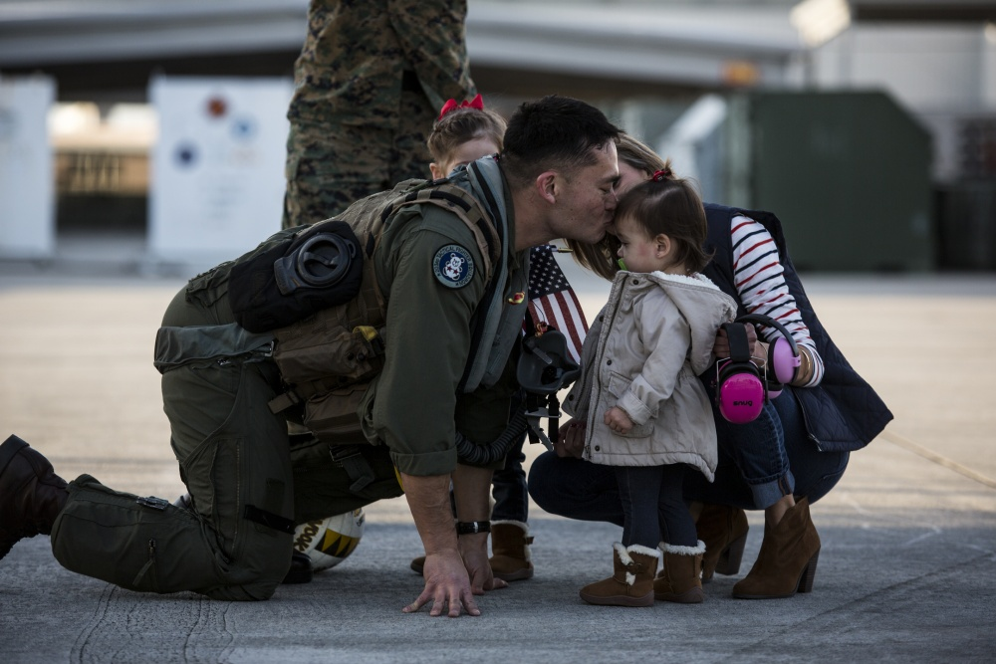
Notes:
Sebastian Junger, in his book called Tribe, talks about how throughout the centuries that Tribalism has a gravitational pull on our society and that our modern example is that of Combat Veterans who come home to find themselves missing the incredibly intimate bonds of Platoon Life. It explains that the irony of life for many veterans is that war feels better than peace, adversity can turn out to be a blessing and disasters are sometimes remembered more fondly than weddings or tropical vacations. It highlights why we are so much stronger when we come together, and how our work at TMC helps us achieve that in what often times is a divided world.
He further goes on to write “ We have a strong instinct to belong to small groups defined by clear purpose and understanding – Tribes This tribal connection has been lost in Modern Society but regaining it may be the key to our psychological survival.”

Slide 3
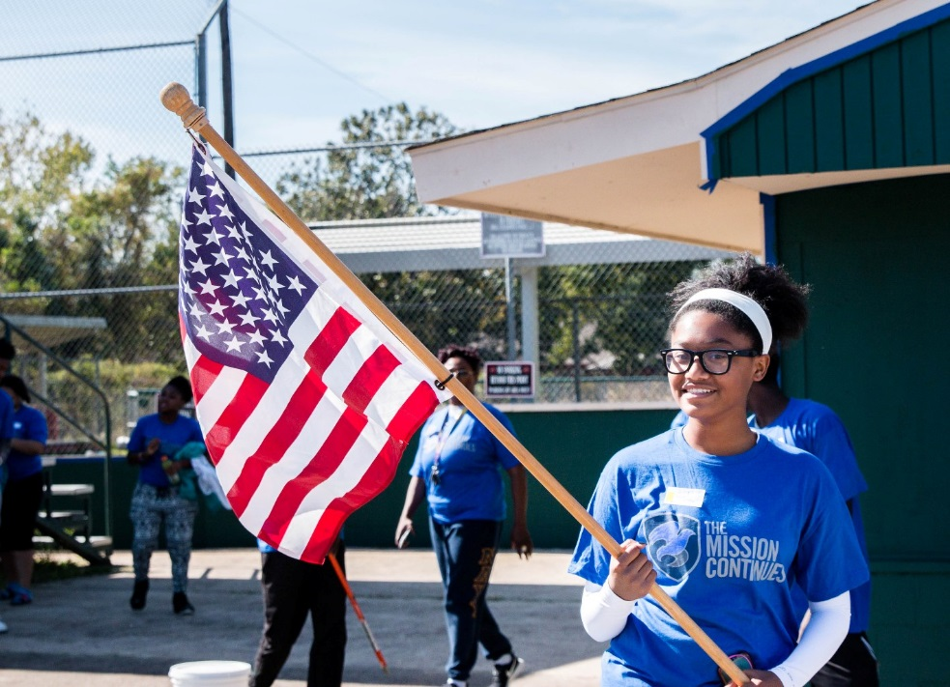
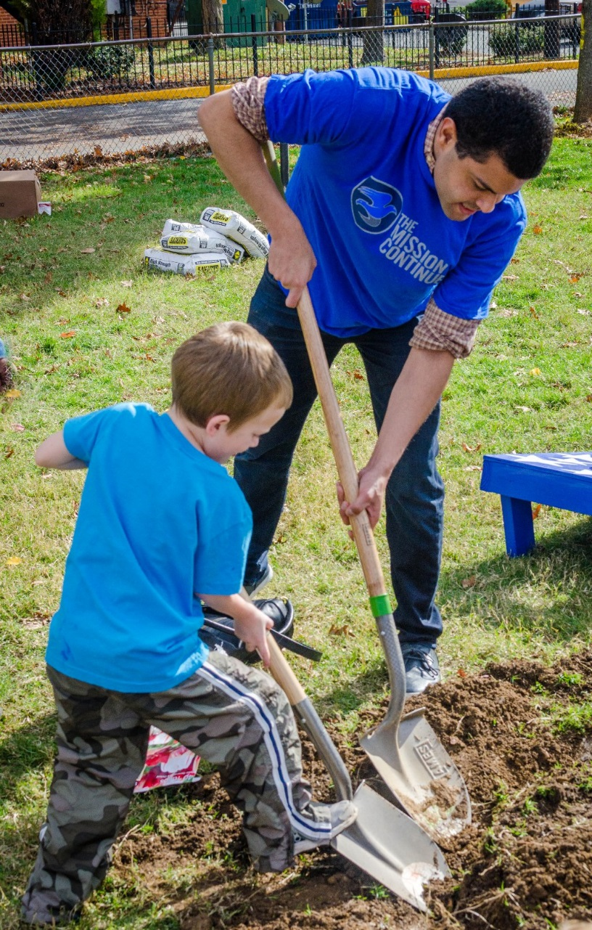
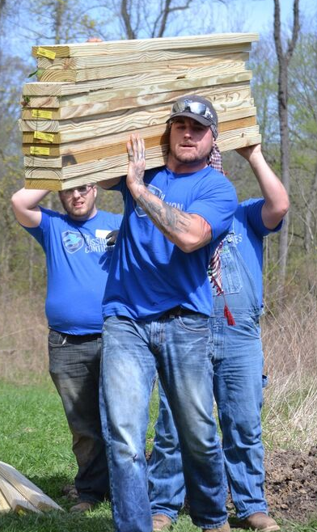
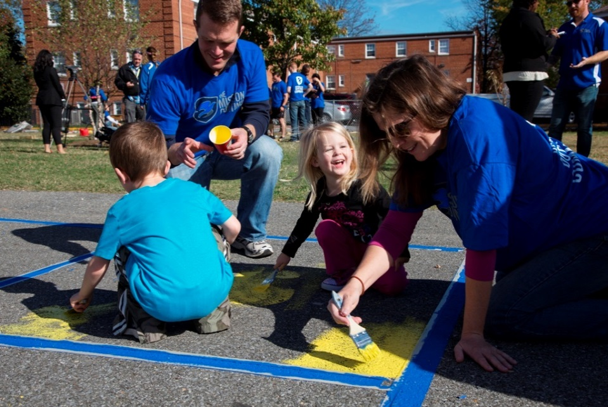
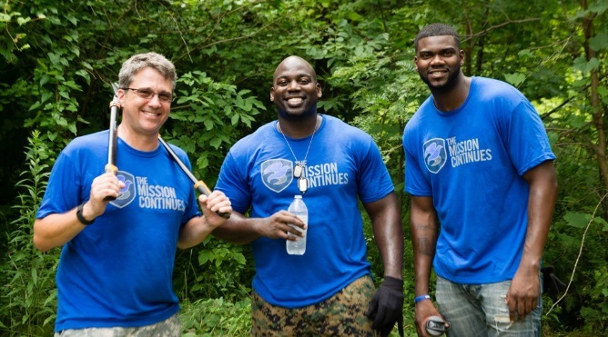
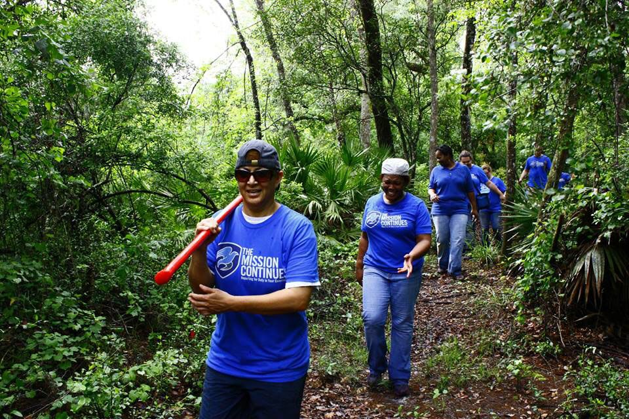
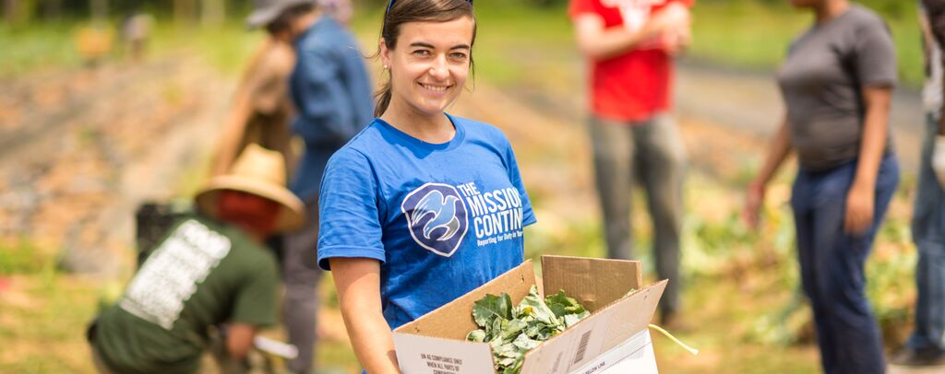
Notes:
The Mission Continues was founded in 2007 by a Navy Seal Eric Greitens. The Mission Continues empowers veterans who are adjusting to life at home to find purpose through community impact. We deploy veterans on new missions in their communities, so that their actions will inspire future generations to serv

Slide 4

Notes:
What do we Believe at the Mission Continues:
Work Hard-because our work changes lives and shapes communities
Trust-Be honest with each other and follow through on our promises
Learn & Grow- We don’t stand still growth comes operating beyond our comfort zone
Respect-We believe everyone deserves to be treated with dignity
Have Fun-We are passionate about our work

Slide 5
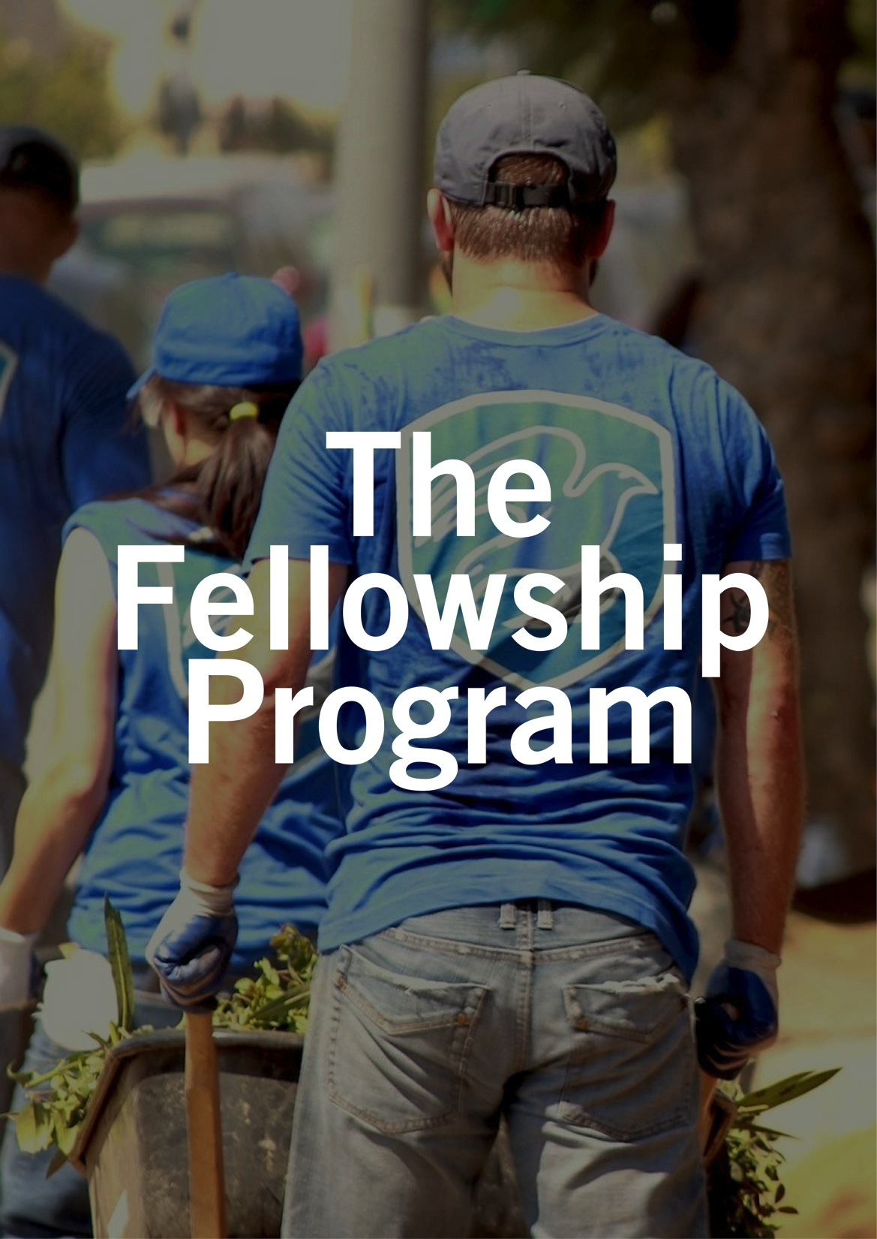
Open to post-9/11 veterans with an honorable discharge after a minimum of 24 months of military service.
20 hours of service per week for 26 weeks at a local nonprofit organization.
Fellows are encouraged to choose a nonprofit organization to serve with based on their own personal passions. Host organizations include Bellwood Boys & Girls Club, Quest Community Dev. MLK Center for Non-violent social Change, The Mayors Office
Notes:
First is our Fellowship Program – this is our flagship program

Slide 6
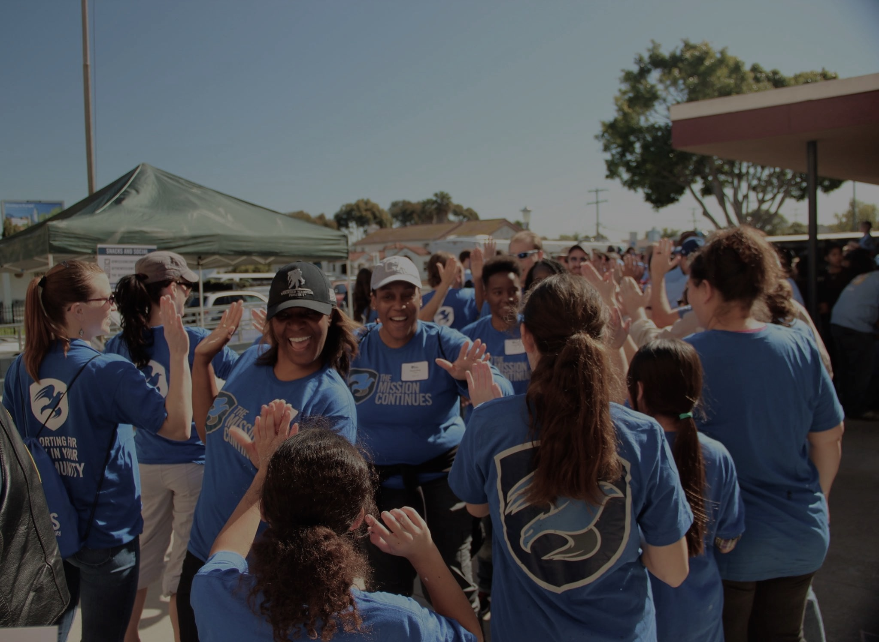
1,898
Fellowships awarded in 49 states and Washington, DC
52
Fellowships awarded in the Atlanta area since 2007

Slide 7
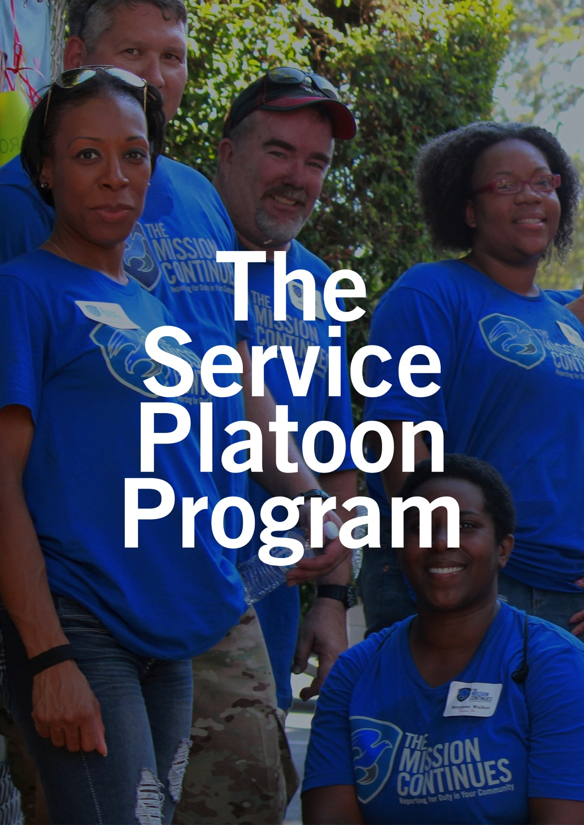
Veteran-led teams of 30-100 volunteers living in the same community.
Each platoon operates with a specific mission, coordinated across Mission Continues programs.
Service Platoons collaborate with local nonprofits, civic organizations and businesses to ensure community support and engagement.
Members have opportunities to take on leadership positions and learn new skills.

Slide 8
MAURICE HENDERSON | ATLANTA, GA
INFANTRYMAN
United States Army
Iraq, 2005
FELLOW
U.S. Department of
Veterans Affairs
PLATOON LEADER
Atlanta 2nd
Service Platoon
Notes:
Fellow Story

Slide 9
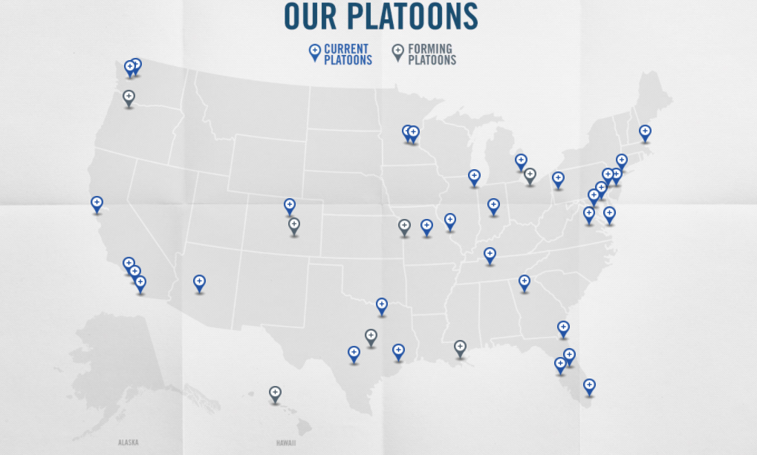

Slide 10
69
Service Platoons in 21 states, plus DC
10,000+
Veteran volunteers engaged

Slide 11

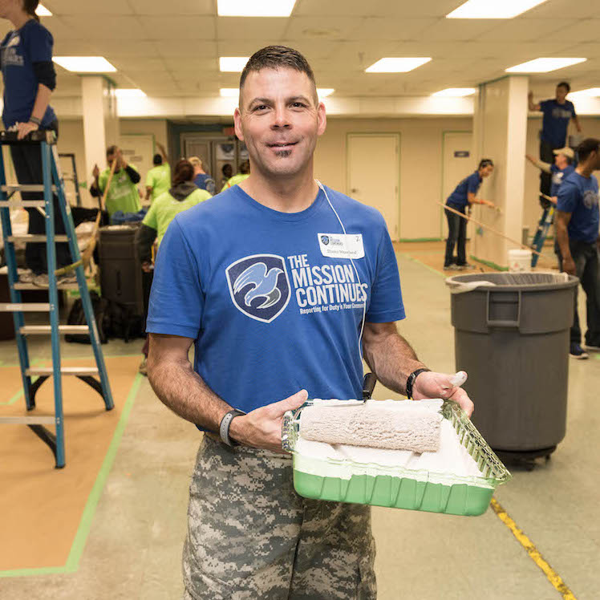
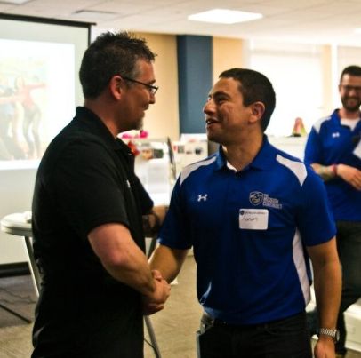
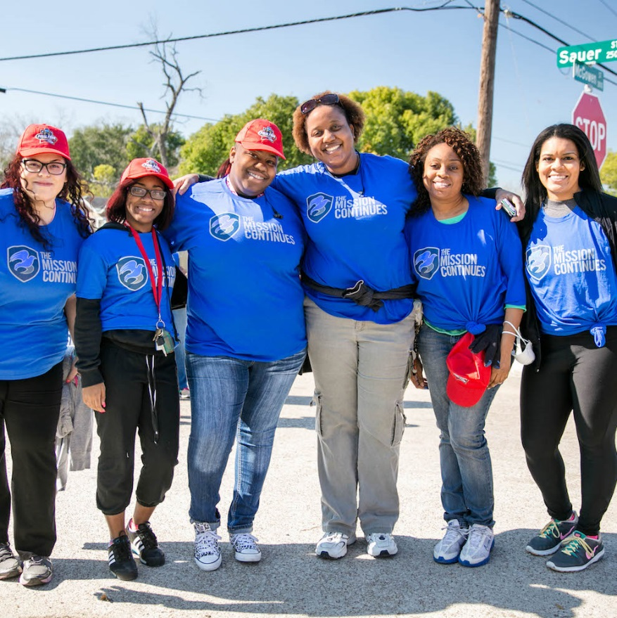
FELLOWS
COMMUNITY
SERVICE PLATOONS
Notes:
Operations-Bellwood Operation started with a fellow..transitioned in identifying longer-term needs through the work of the Service Platoon..
Because of our success and growth with our operations here in Atlanta we were able to present the case for our next program opportunity called a Mass Deployment. Before I get further into MD let me show this brief video.

Slide 12
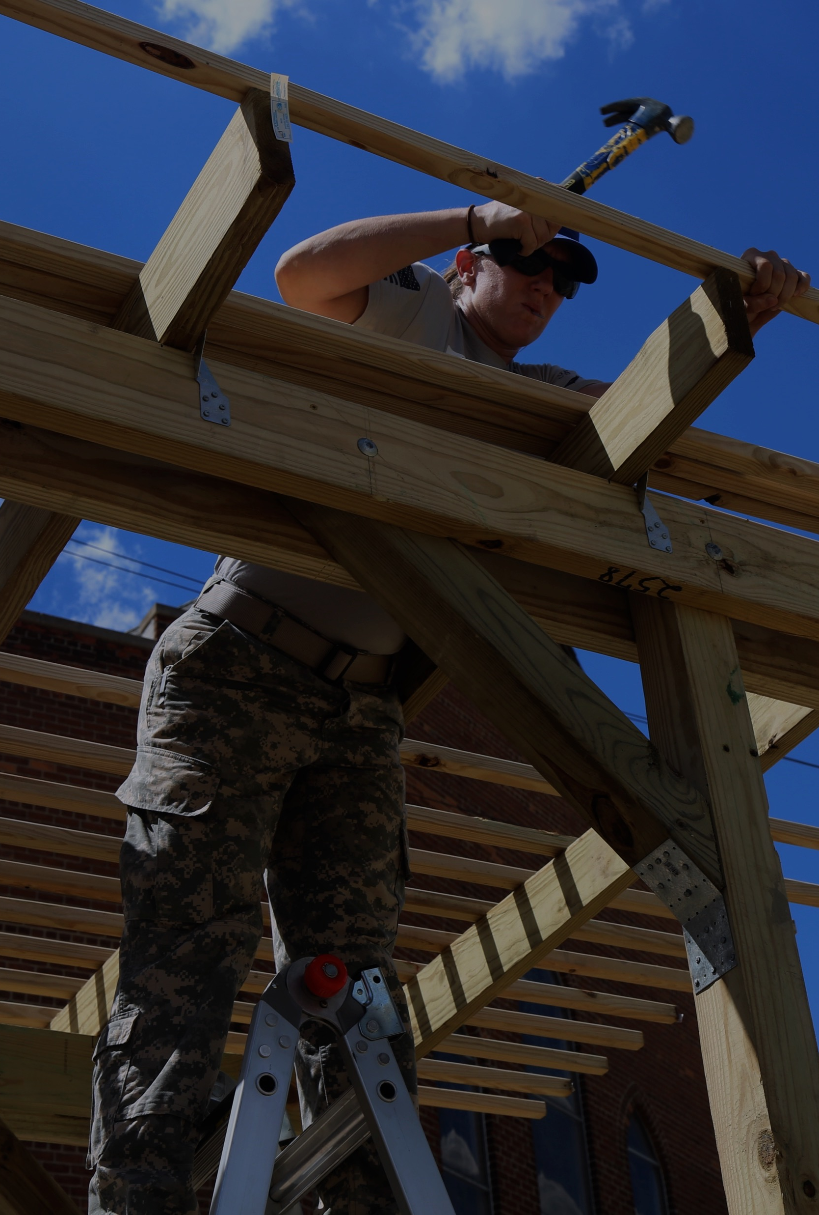
Team-based program of ~75 veterans that “deploy” to a specific city for a week-long project.
Volunteers mobilize with local partners and organizations to achieve maximum community impact.
Goal of the program is to continue impact after the week is over through additional partnerships, fellowships, and service platoons.
THE MASS DEPLOYMENT PROGRAM

Slide 13
COMMUNITY IMPACT
“The veterans involved in Motown Muster left a very positive mark in our neighborhood, as their work exceeded our expectations. The new community garden will help Recovery Park provide fresh produce for neighbors without easy access to healthy foods, and riders use the bus stop shelters built on Chene Street on a daily basis.”
94% OF COMMUNITY RESPONDENTS REPORTED FEELING PRIDEFUL OF THEIR COMMUNITY AFTER PARTICIPATING IN MOTOWN MUSTER

Slide 14


Slide 15





PRESENTING SPONSORS
LEGACY IMPACT SPONSORS
DAILY SPONSORS
THE MARCUS FOUNDATION

Slide 16
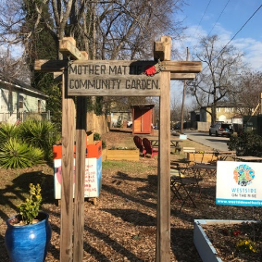
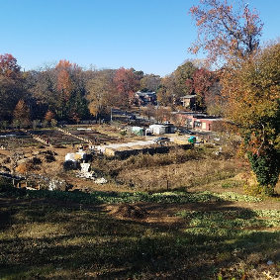
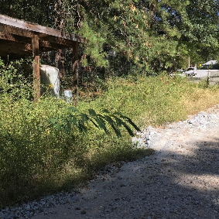
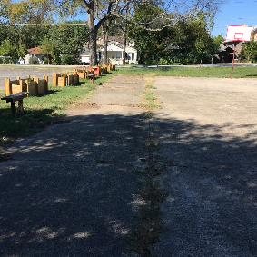
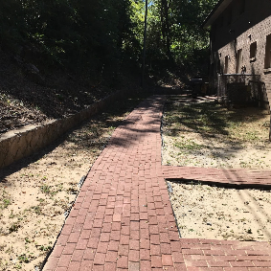
OPERATION SCHEDULE
JUNE 10
JUNE 11
JUNE 12
JUNE 13
JUNE 14
MATTIE FREELAND PARK
TRULY LIVING WELL
ATLANTA BELTLINE
ENGLISH AVENUE CAMPUS
QUEST VETERANS VILLAGE
+ 75 Veteran Volunteers
+ Community Volunteers
+ Sponsor Volunteers
+ ToolBank USA
+ Atlanta Community ToolBank
+ Team Depot

Slide 17
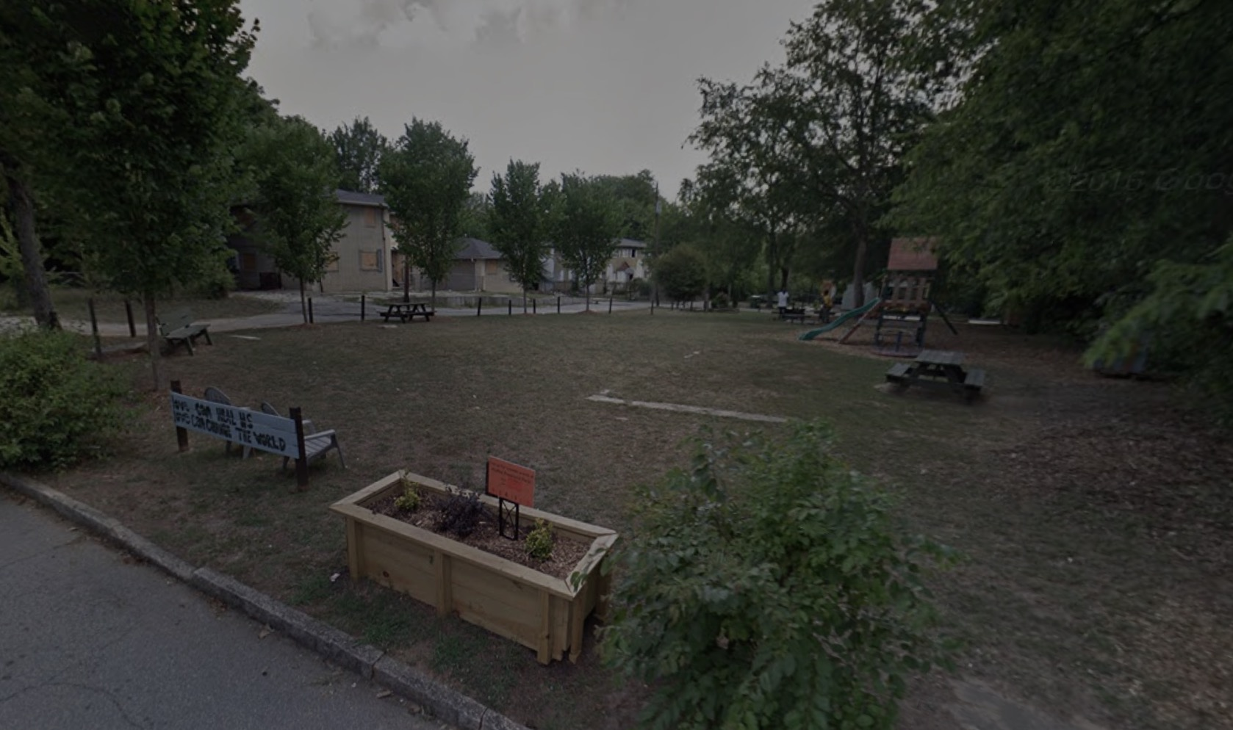
+ Create a picnic area for local gatherings including tables and a community grill.
+ Install a horseshoe pit and a new basketball court complete with bench seating.
+ Lay new sod, landscape low lush plants and evergreens throughout the grounds, and install bamboo fencing for some curb appeal.
+ Build pergola’s, picnic tables, benches, and concrete seating throughout the park.
+ Demolish an old shed and tear out the fencing to make way for new play spaces and updated materials.
MATTIE FREELAND PARK
SATURDAY, JUNE 10, 2017

Slide 18
OPPORTUNITIES TO SUPPORT OPERATION WESTSIDE SURGE
+ PARAMEDICS
+ FOOD
+ FUNDING
Notes:
These are some of the bigger “events” for us here in Missouri for 2017

Slide 19
WHAT HAPPENS AFTER OPERATION WESTSIDE SURGE?
FELLOWS
Truly Living Well
Quest
SERVICE PLATOONS
Atlanta 1st
Atlanta 2nd
Atlanta 3rd
Bellwood BGC

Slide 20
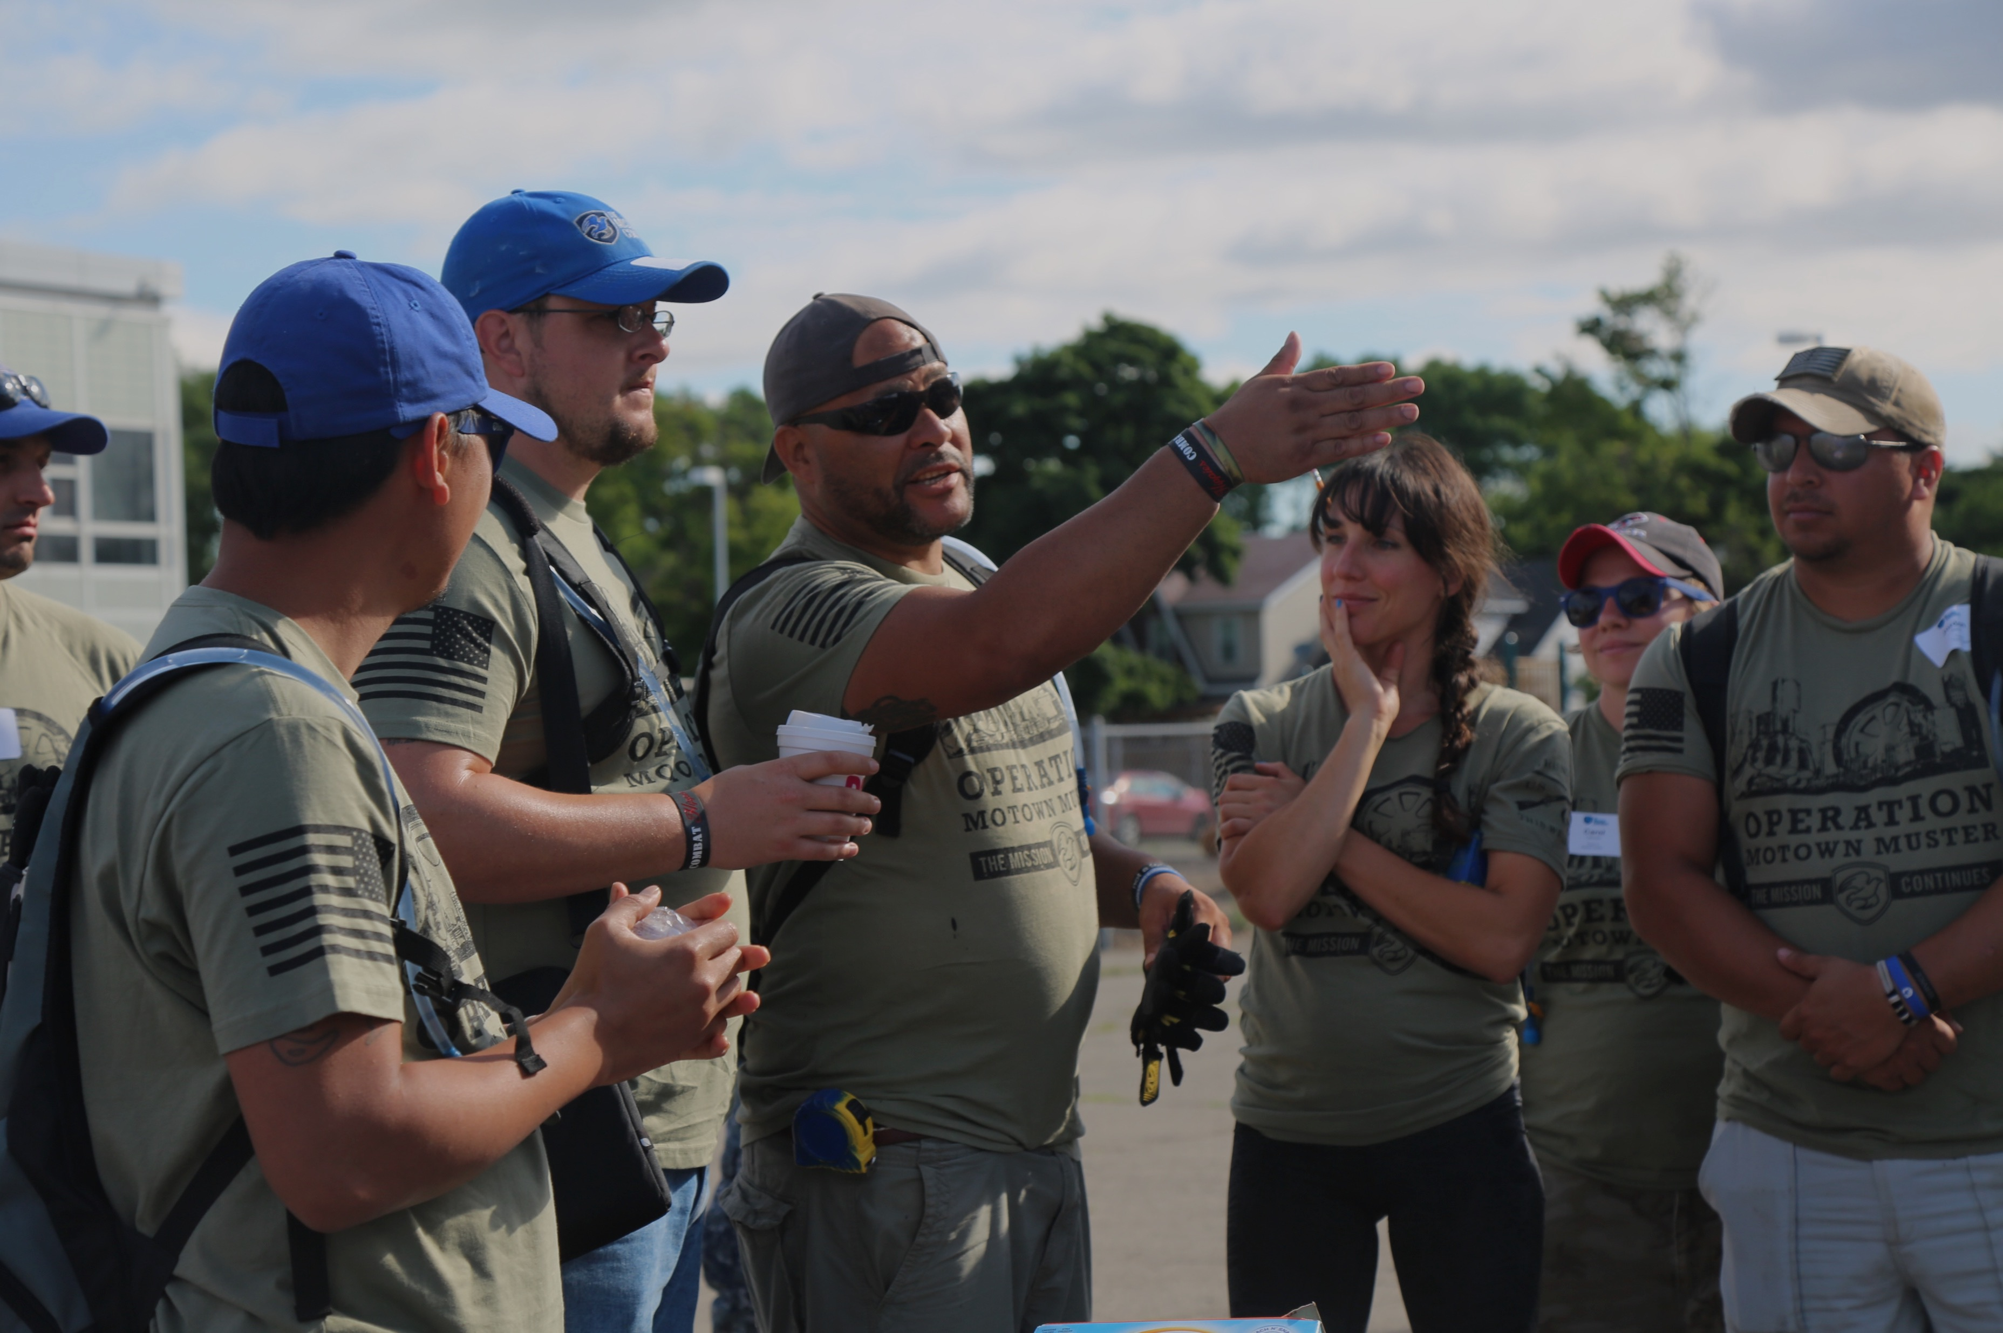
REPORT FOR DUTY WITH US
SERVE
INVEST
CONNECT

Slide 21
CONNECT WITH US
Website: www.missioncontinues.org
Event Link: www.missioncontinues.org/deployments
Social Media
  Facebook: facebook.com/themissioncontinues
  Twitter: @missioncontinue
My Email: swilliams@missioncontinues.org
Notes:
Thank you for your time –
Thank you for your support –
And I would love to answer any questions you have at this time – or discuss other ways that you can Report For Duty with The Mission Continues –
THANK YOU

