Slide 1

Date Received: ___________
Anti-Displacement Tax Fund
Program Pre-Registration Form
Personal Information
Name of Applicant: Phone Number:
Name of Property Owner(s): Phone Number:
What is your date of birth (M/D/Y)? / / Email Address:
What was your total household’s income in the previous year?
How long have you lived in the home? How many people live in the home?
How did you hear about this program?
Property Information
Street Address: Zip:
Are your property taxes paid through your mortgage payment? (Please circle: Yes / No / I don’t know)
Eligibility Criteria
Y
N
◻ ◻ I live in English Avenue, Vine City, Atlanta University Center, Ashview Heights, Booker T. Washington, or Just Us.
◻ ◻ I can prove that I own my home.
◻ ◻ I was living in this home prior to March 2017.
◻ ◻ My household income meets the income guidelines (see Fact Sheet on reverse side).
Submittal Instructions
Information submitted as part of this Pre-Registration Form will be kept confidential and only used by the Program Manager to determine initial eligibility for the fund.
Submit this completed form to any of the addresses below to receive an application.
By Fax 678-705-1944 | By Email info@westsidefuturefund.org | Mail P.O. Box 92273, Atlanta, GA 30314 In Person Call for appointment at (678) 902-7889
If you have additional questions, please contact us at (678) 902-7889

Slide 2
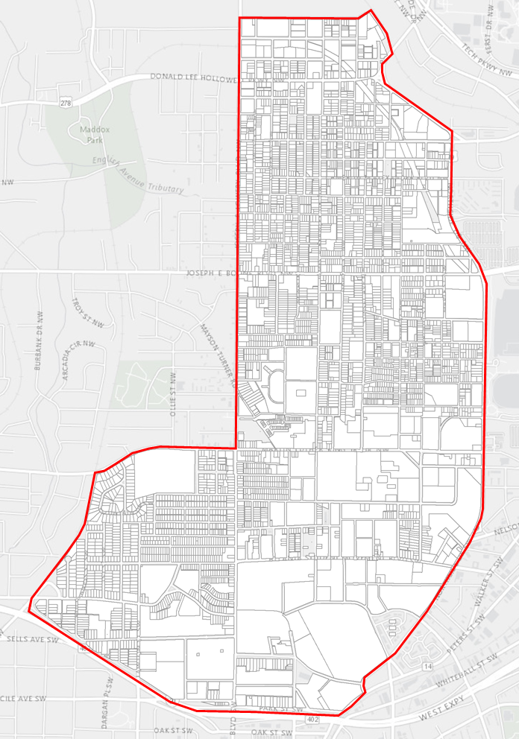
Anti-Displacement Tax Fund
Fact Sheet
About
Situation
Current English Avenue, Vine City, Atlanta University Center, Ashview Heights, Just Us, and Booker T. Washington homeowners fear displacement in anticipation of community revitalization efforts driving higher home appraisals, property appreciation and ultimately higher property taxes.
Program Goal
No current homeowners will be displaced due to the inability to pay a rise in property taxes.
Program Function
The Anti-Displacement Tax Fund Program will help pay for increases to homeowners' existing property tax bills. The fund will operate as a grant to individuals and will not require participants to pay back any funds received. Fund payment will begin in the 2018 tax year.
Funding Source
As part of its mission to ensure that current residents are able to stay in their communities for generations to come, the Westside Future Fund will provide all funding for the program, sourced from philanthropic contributions.
Application Period
Application for the program will begin in October of each year, and be available until March of the following year.
Eligibility
Income
Participants must have a annual household income below 100% of the area median income (AMI) to participate. Please reference the Income Eligibility table.
Location
Participants must reside in a home within the Program Boundaries, found on the map to right. Only homeowners within English Avenue, Vine City, Atlanta University Center, and Ashview Heights, Just Us, or Booker T. Washington are eligible to apply.
Occupancy
Participants must have lived in their home prior to March 15, 2017 and have Homestead Exemption. If you do not have Homestead Exemption, please still apply and we may be able to help.
Ownership
Existing homeowners are eligible for the program. New homeowners are only eligible if the purchased property had previously been enrolled in the program at the time of purchase.
Heirs
Heirs of property are eligible, as long as they meet all other qualifications.
Lien/Property Taxes
If homeowners presently have any encumbrance attached to or binding upon their property, continue to submit a Pre-Registration Form and someone from office will contact you. Encumbrances include back taxes, pending legal action, or easement disputes.
About the Westside Future Fund
The Westside Future Fund is a not-for-profit organization founded with the mission to reinvigorate community growth by coordinating and accelerating efforts that elevate the quality of life in Atlanta's historic Westside neighborhoods.
V2- September 2018
Program Contacts
Program Coordinator
Westside Future Fund
Phone Number
678-902-7889
Email
info@westsidefuturefund.org
Website
www.westsidefuturefund.org
Address
1300 Joseph E. Boone Blvd., Suite 16, Atlanta, GA 30318
Income Eligibility*
Household Size | 100% AMI
1 | $52,400
2 | $59,900
3 | $67,400
4 | $74,800
5 | $80,800
6 | $86,800
7 | $92,800
8+ | $98,800
*Amounts applicable to 2018, subject to annual change
Program Boundary =
Jefferson St.
English Avenue
Northside Dr.
Joseph E. Lowery Blvd.
Vine City
MLK Jr. Dr.
Beltline
Atlanta University Center
Ashview Heights
Northside Dr.
I-20

