Slide 1
Building Community
& Green Infrastructure
in the Westside’s New Parks
Transform Westside Summit - July 7, 2017
Darryl Haddock Westside Atlanta Watershed Alliance
Jay Wozniak The Trust for Public Land
Andrew White Park Pride

Slide 2
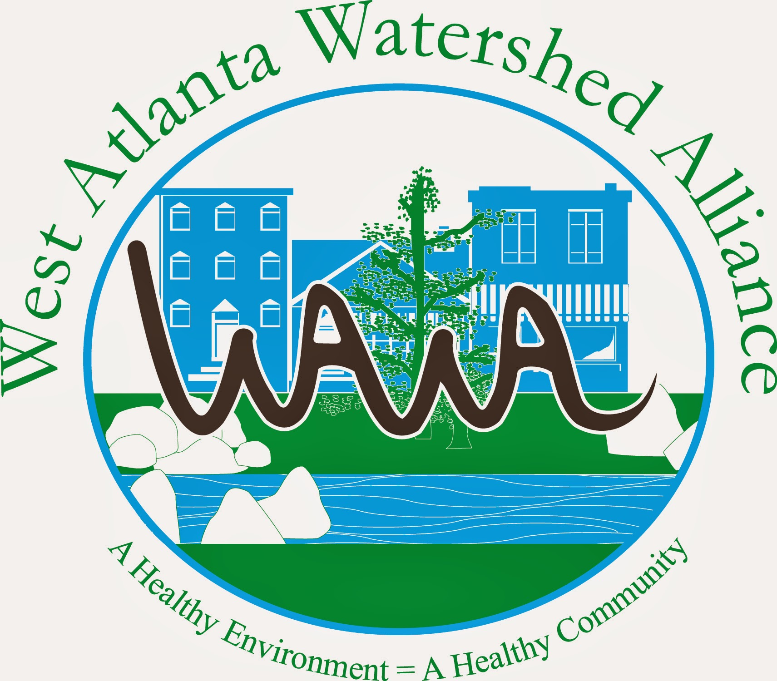
Darryl Haddock
West Atlanta Watershed Alliance
404-752-5385
darryl@wawa-online.org
WAWA-ONLINE.ORG
Our Mission is to preserve and restore ecological balance of the West Atlanta Watershed through the elimination of environmental health disparities and advocate for environmental justice for all residents.
We are dedicated to improving our quality of life by facilitating public access to clean and healthy green space. To that end we promote and highlight the importance of protecting community forest, water and quality of life.

Slide 3
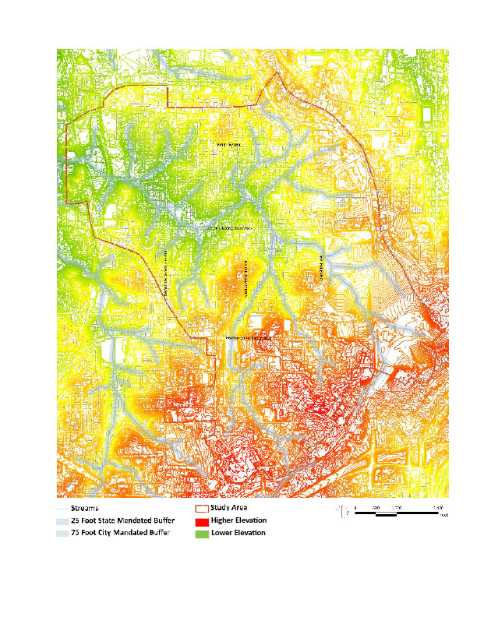
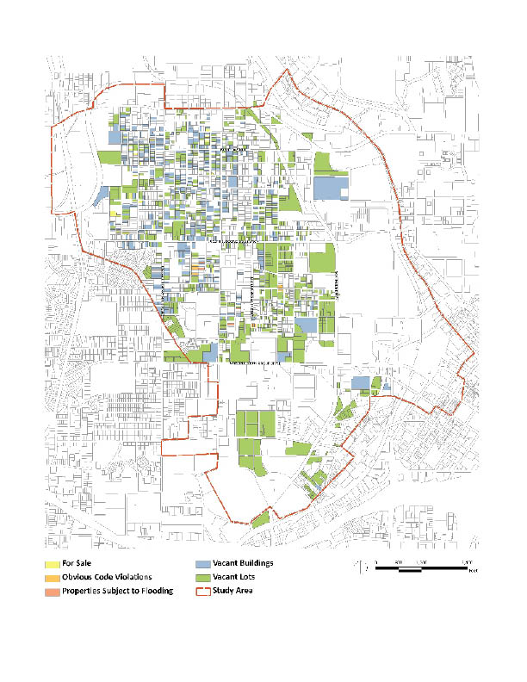
NORTH AVE
JOSEPH E. BOONE BLVD
NORTHSIDE DR
JOSEPH LOWERY BLVD
MARTIN LUTHER KING, JR. DRIVE
JAMES P. BRAWLEY DR
Topography

Slide 4
NORTH AVE
JOSEPH E. BOONE BLVD
NORTHSIDE DR
JOSEPH LOWERY BLVD
MARTIN LUTHER KING, JR. DRIVE
JAMES P. BRAWLEY DR
Property Status

Slide 5
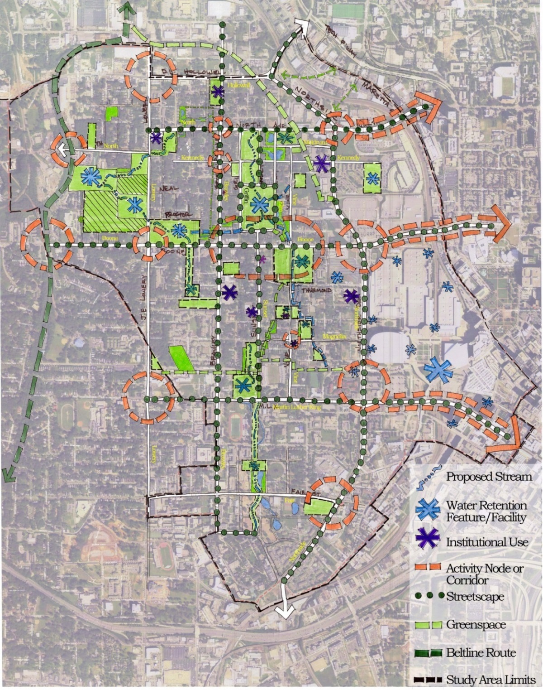
NORTH AVE
JOSEPH E. BOONE BLVD
NORTHSIDE DR
JOSEPH LOWERY BLVD
MARTIN LUTHER KING, JR. DR
JAMES P. BRAWLEY DR
Proctor Creek North Avenue Study

Slide 6
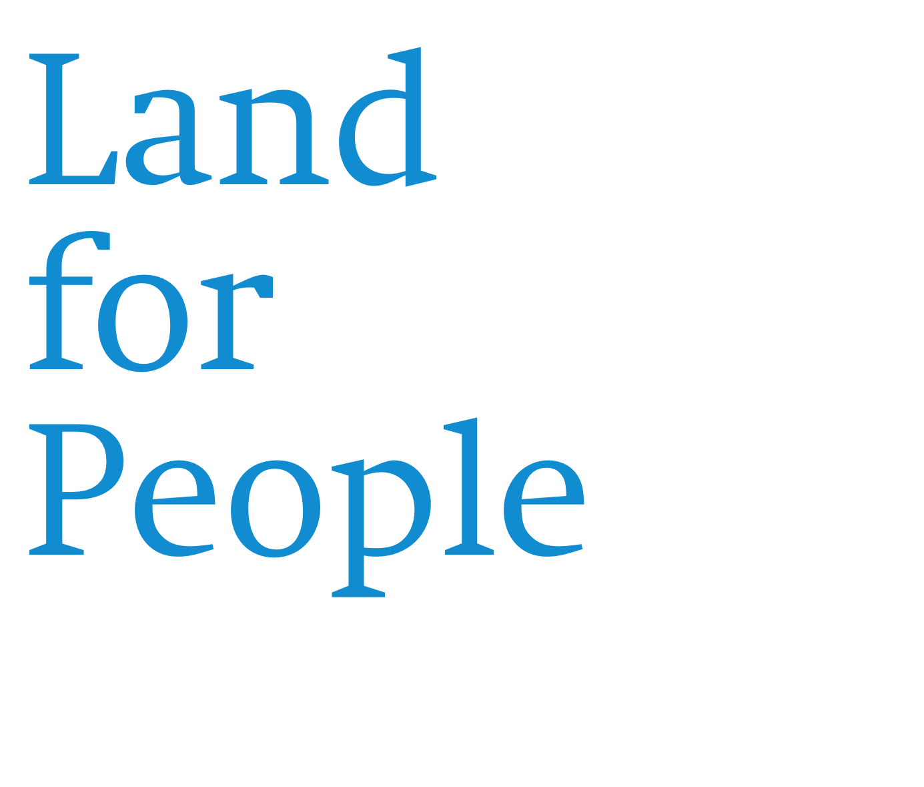


Slide 7
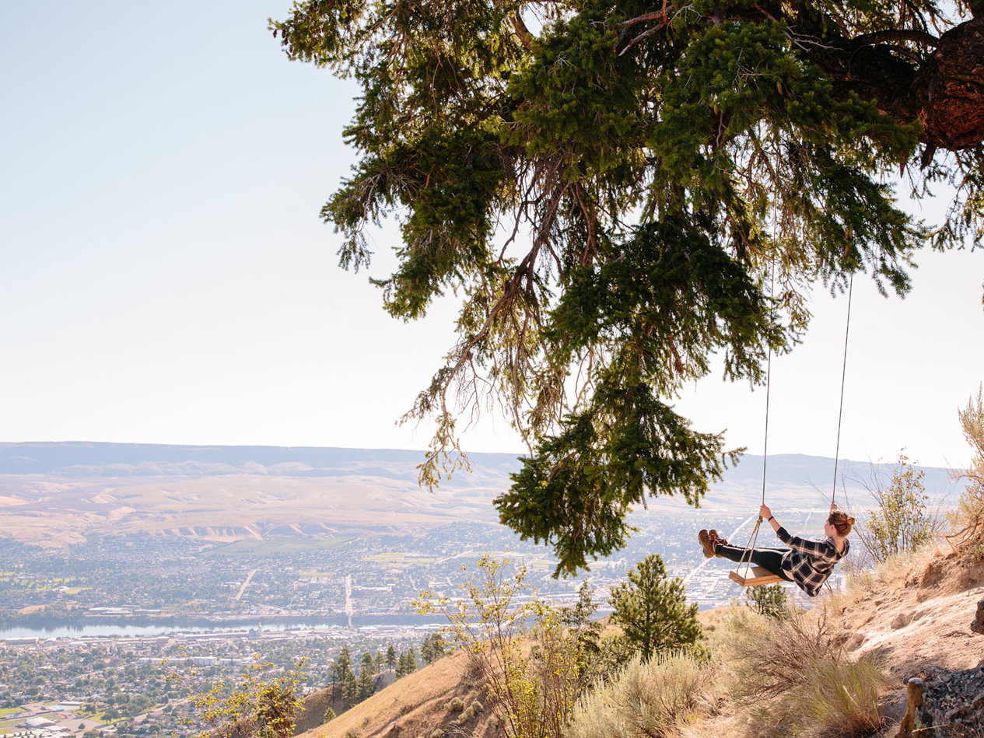


Notes:
Our mission does two things: it says WHAT we do (we create parks and protect land for people) and WHY we do it (to ensure healthy livable communities for generations to come)

Slide 8

A Proven Record of National Success
The Trust for Public Land is a national organization whose mission is to create parks and protect land for people to enjoy
We’ve worked for more than 40 years to conserve land for people.
Since 1972, we’ve completed more than 5,000 park and conservation projects across 47 states, Puerto Rico, and the U.S. Virgin Islands, conserving more than 3 million acres of land, from the inner city to the wilderness.
We are the national leader in creating public funds for land conservation, working with states, counties, and cities to generate nearly $60 billion for local conservation efforts since 1996.
We’ve created, sustained, or supported 340 local land trusts nationwide.

Slide 9
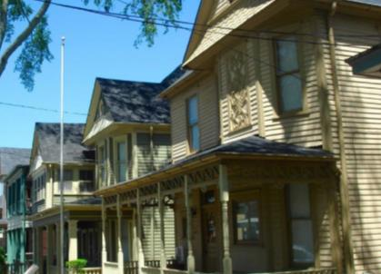
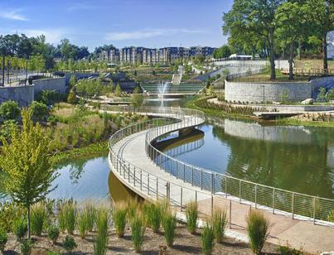
A Proven Record of Success in Georgia
TPL Has Played a Critical Role in Preserving Georgia’s History and in Spurring Innovative Infrastructure Improvements throughout Atlanta
TPL has protected more than 25,000 acres of open space and historic sites across Georgia.
Applied our expertise in protecting 18,000 acres along the Chattahoochee River, assembling parcels as part of the Martin Luther King, Jr. National Historic Site, and playing key roles in the implementation of Historic Fourth Ward Park and the Atlanta BeltLine.
TPL was chosen by the City to design, construct, and raise funds for Cook Park based on our organization’s resources and 35 years of local experience
Martin Luther King, Jr. National Historic Site
Historic Fourth Ward Park

Slide 10
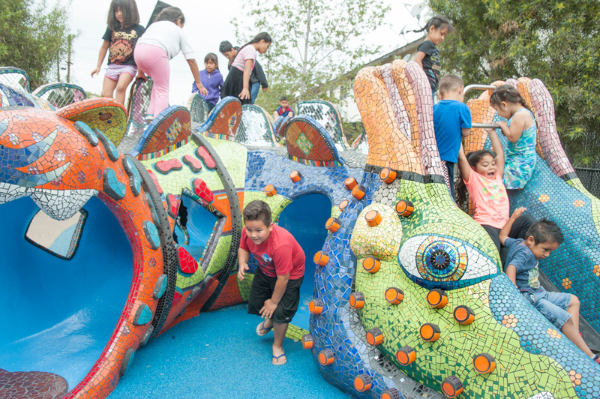
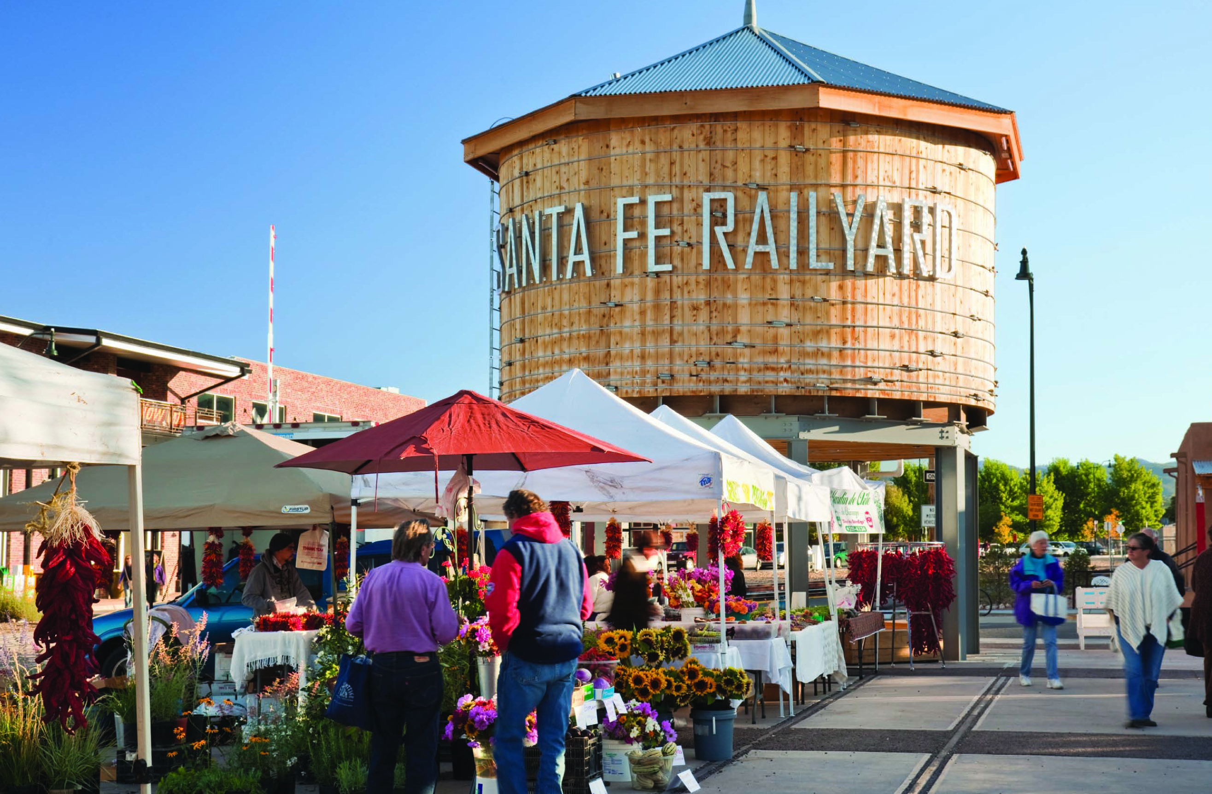
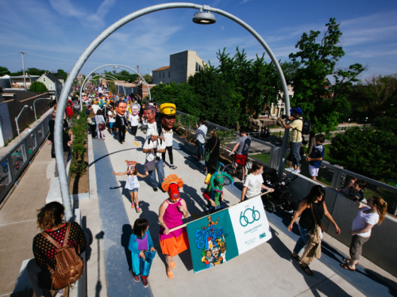
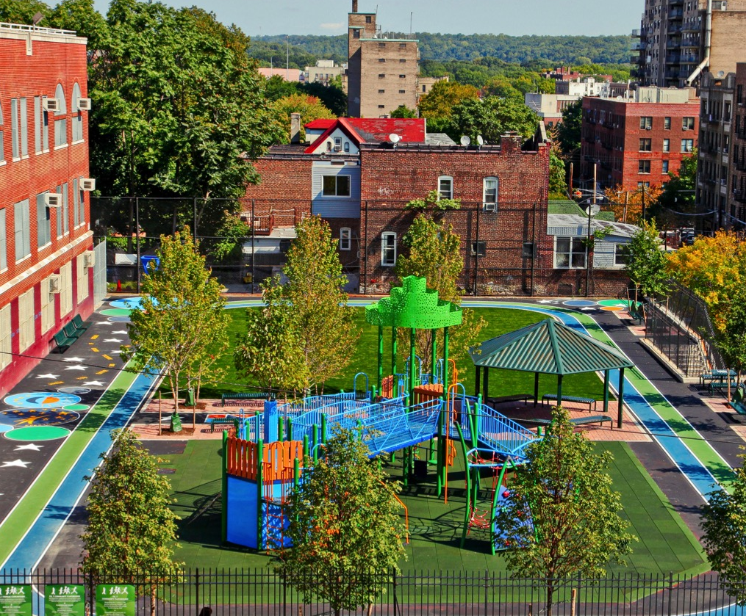
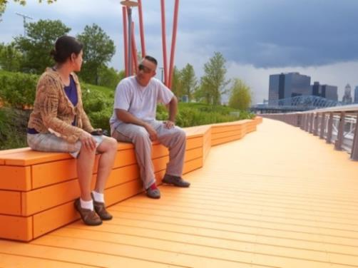
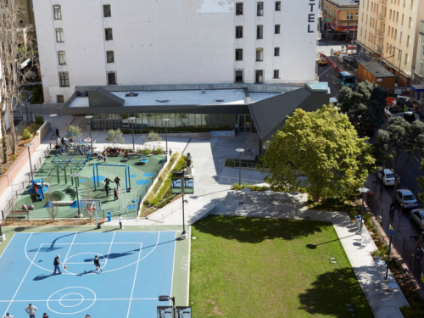
Benito Juarez Park – Maywood , CA
Santa Fe Railyard Park – Santa Fe, NM
The 606 – Chicago, IL
P.S. 7 – Bronx, NY
Newark Riverfront Park – Newark, NJ
Boeddeker Park - San Francisco, CA

Slide 11
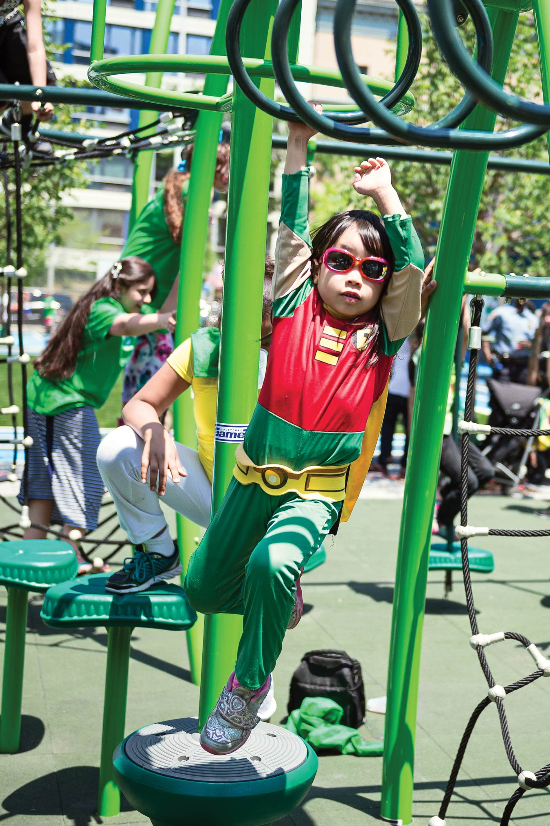
The best parks have superpowers
P.S. 111
P.S. 111 – Hell’s Kitchen, Manhattan, NY
Hell’s Kitchen, NY
Notes:
PHOTO: P.S. 111, Hell’s Kitchen, NY
When is a park more than a place to play? When it doubles as a hands-on learning lab. A public health facility. Protection against a changing climate.
That’s the idea behind The Trust for Public Land’s schoolyards-to-playgrounds effort, which taps students to transform their recess areas into vibrant neighborhood parks that soak up stormwater, easing strain on city sewer systems.
By replacing asphalt with permeable surfaces, renovated schoolyards—like P.S. 111 in Hell’s Kitchen, NY—can keep up to 1 million gallons of stormwater per year out of sewers and waterways. It’s a shining example of what we call “Climate-Smart Cities”—our approach to empowering cities to use parks and green space to combat challenges like flooding and heat waves.
In the mid-’90s, New York City had less green space per person than almost anywhere else in America. Looking to address the shortage, The Trust for Public Land spotted an underutilized resource: schoolyards. Back then, many public schools’ recess areas were barren asphalt lots—uninviting to students and closed to the rest of the community altogether. Taken as a whole, they represented an unprecedented opportunity to green the neighborhoods that needed it most.
Then-mayor Michael Bloomberg embraced the idea, partnering with us to achieve the city’s 30-year sustainability plan.
The cornerstone of our program is a three-month participatory design curriculum. Collaborating with parents, teachers, and neighbors, we help students plan their dream playgrounds.
Once renovated, the sites stay open to the public on evenings and weekends, providing much-needed community green space when school is closed.
Over the last two decades, we’ve created more than 180 new schoolyard playgrounds across the city, adding more than 150 acres of recreational space and putting a park within a 10-minute walk of nearly 3.5 million New Yorkers.
And we’ve expanded the effort, partnering with cities like Newark and Philadelphia to achieve their sustainability and livability goals.

Slide 12
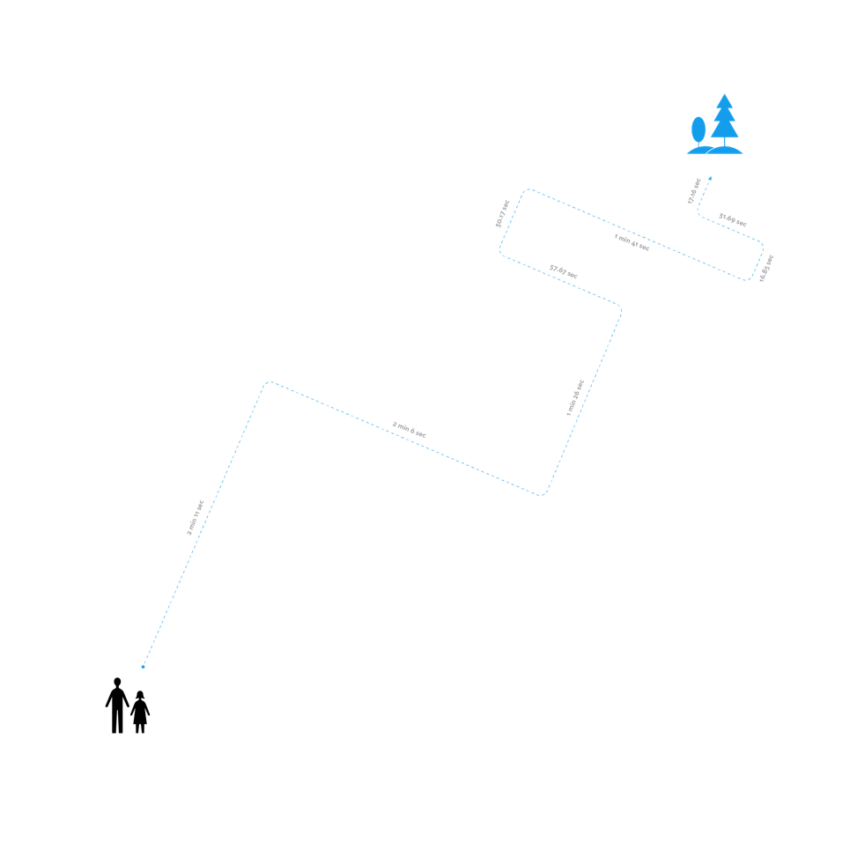




How close is your park?
The research is clear: close-to-home parks boost well-being for the entire neighborhood.
Notes:
10 minutes. That’s long enough to tackle a couple of quick household chores: fold some laundry or wash a few dishes.
You could start a chapter of that book on your nightstand, or — more likely — wile away your time in front of a screen.
But could you walk to a park?
The research is clear: close-to-home parks boost well-being for the entire neighborhood. From the child diagnosed with ADHD to the senior recovering from hip surgery, people who live near parks get more and better exercise and report better mental health than people who don’t.
Nearby green space makes it easier to socialize, recreate, and relax with a quick jog before work, a pickup soccer game after school, or a sunset stroll.
Civic leaders know that accessible green space is key to enhancing quality of life and attracting and retaining businesses and residents.
That’s why people across the country— mayors, council members, public health o cials, business owners, moms, and dads— are adopting The Trust for Public Land’s standard of a 10-minute walk to a park for all.

Slide 13
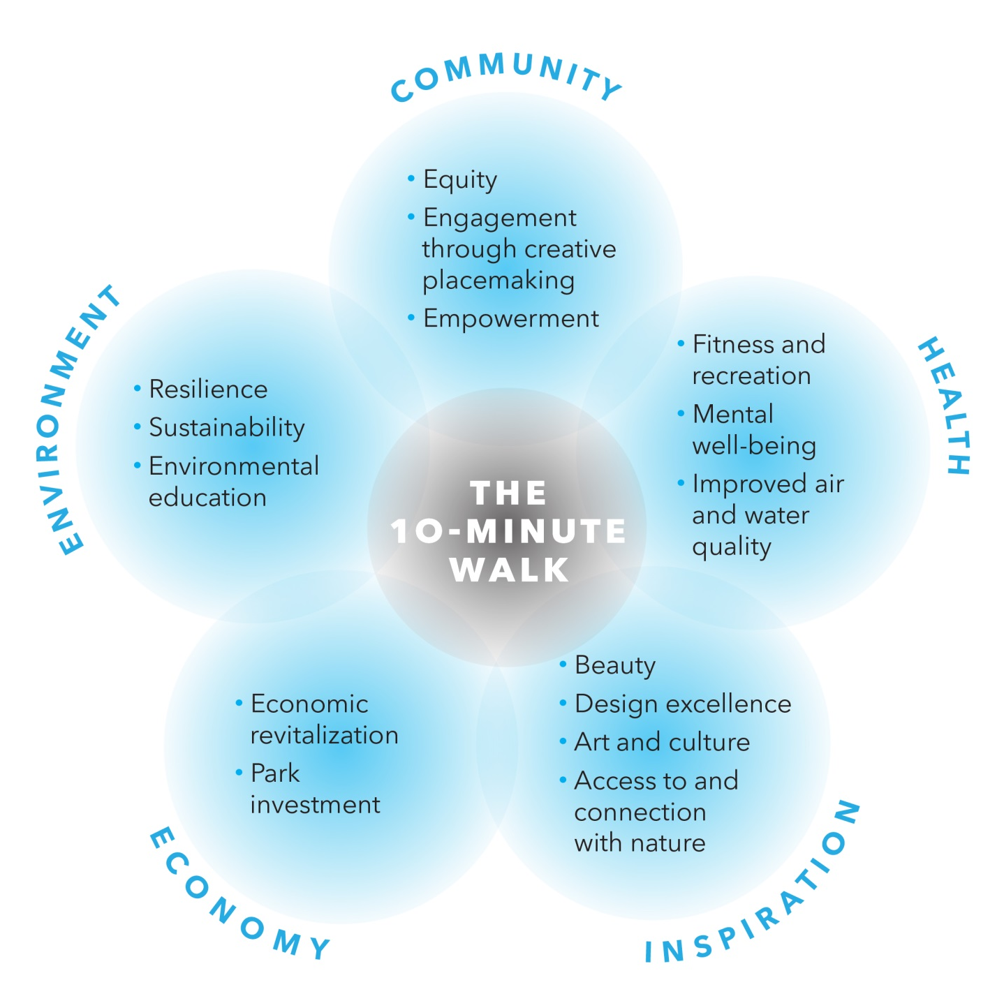
Notes:
Our land for people work, whether a new park or a protected place, can address many of these social challenges because all of our work delivers multiple benefits. We’ve organized our thinking about land for people benefits into five categories: community, health, inspiration, economic, and environmental benefits. This approach is helpful to us in several ways:
We can design our projects - both park design and development and land protection – to deliver those benefits most important to the community in which we are working.
We know that donors and partners all have different interests and that often they are focused on a particular subject – for example, water quality, or arts and culture, or jobs. By organizing the benefits of our work in this way, we are better equipped to focus our conversations with supporters on the outcomes they most want to achieve.
Finally, this approach allows us to better measure our impact. These benefit categories will be used to define metrics that we will track at the project level, the program level, and even at the organization-wide level to improve our ability to measure the difference we are making.

Slide 14
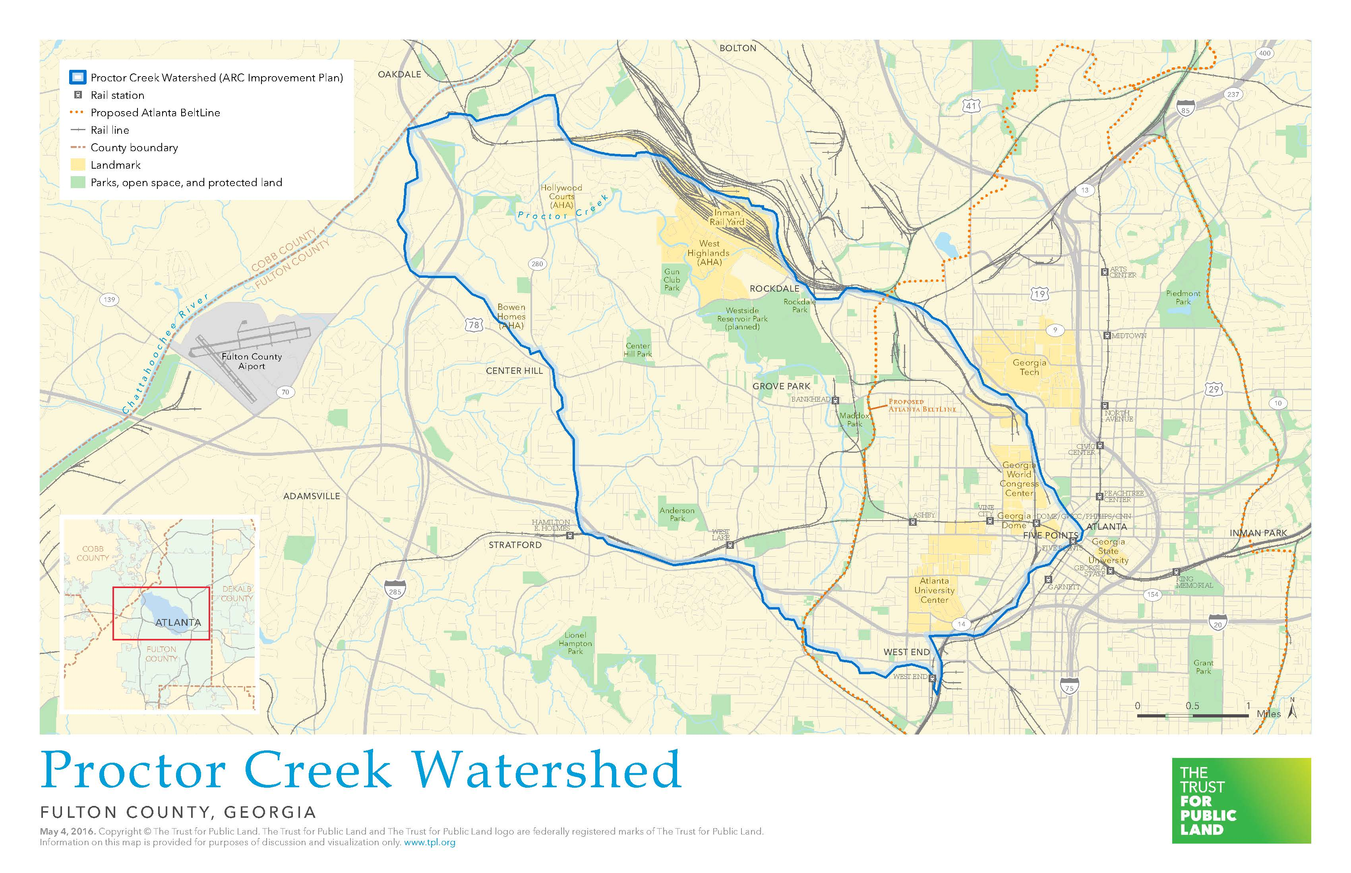
Cook Park is Important to the Proctor Creek Watershed
Boone Park West
Cook Park

Slide 15
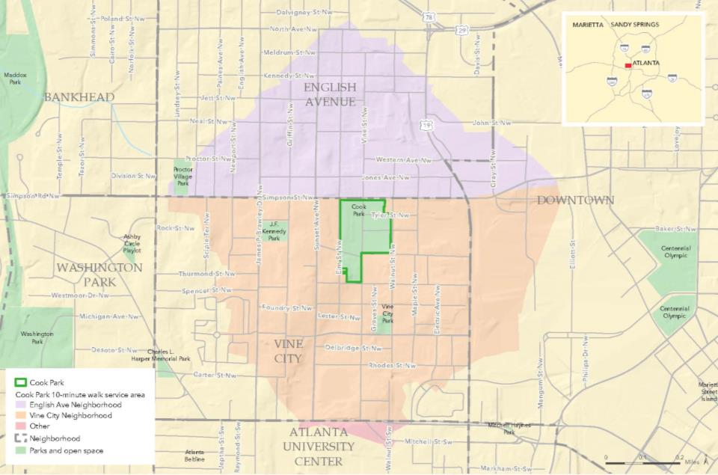
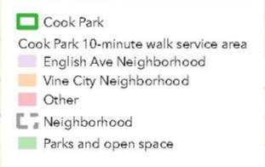
Cook Park’s Impact within a 10-Minute Walk is Significant
Notes:
Our vision of every resident in America being within a 10 minute walk of a high quality park.

Slide 16
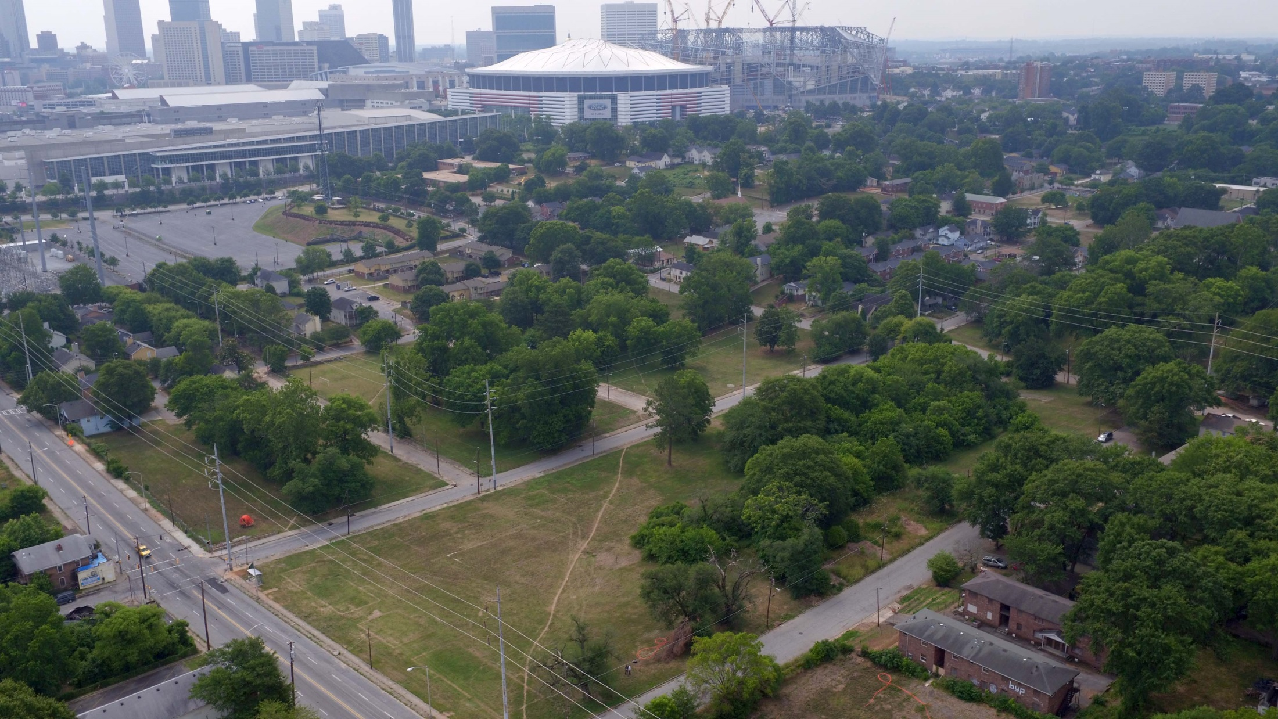
Aerial of Cook Park Site (Looking Southeast)
WALNUT ST
SPENCER ST
THURMOND ST
VINE ST
ROCK ST
TYLER ST
ELM ST
BOONE BLVD

Slide 17
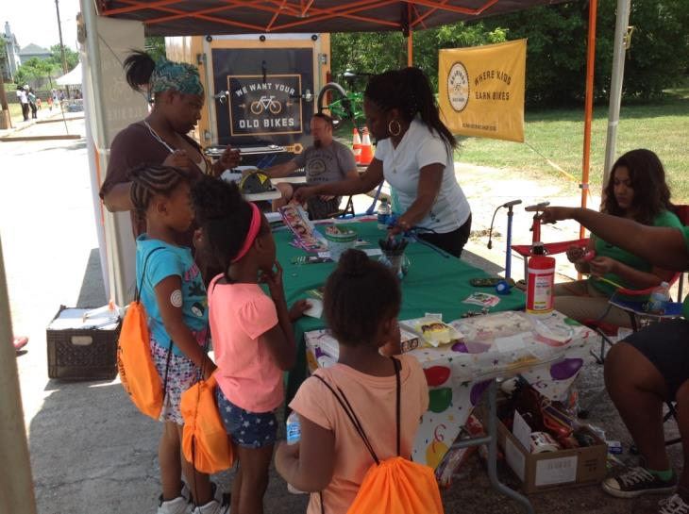
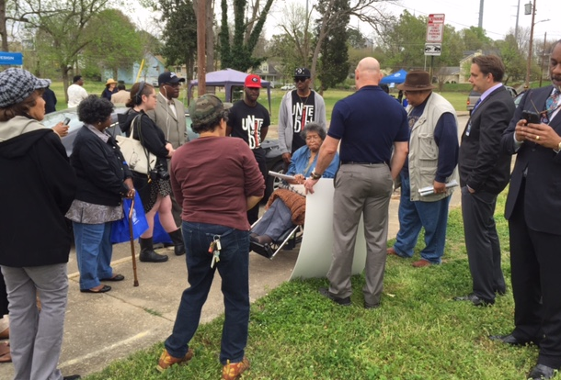
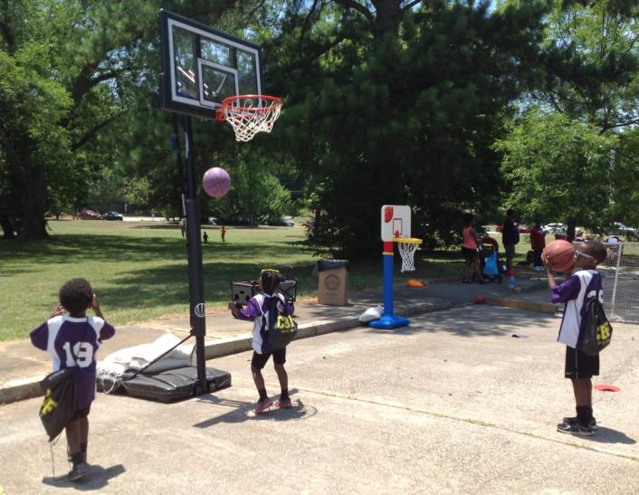
Rodney Cook, Sr. Park in Historic Vine City will be an innovative and dynamic 16-acre neighborhood park
When completed, Cook Park will:
Provide sustainable venues for a multitude of recreational activities and spaces for community gathering
Relieve local flooding & reduce the burden on the City’s existing water management facilities
Offer opportunities for job training and environmental education
Honor the legacy of your neighborhoods’ unique history
Project Partners
The Trust for Public Land
City of Atlanta Department of Watershed Management
City of Atlanta Department of Parks and Recreation
The National Monuments Foundation

Slide 18

Cook Park is Being Shaped with Four Criteria in Mind
EXISTING CONDITIONS
NEEDS OF THE COMMUNITY
COOK
PARK
ELEMENTS OF ORIGINAL MIMS PARK
STORMWATER STORAGE CAPACITY

Slide 19
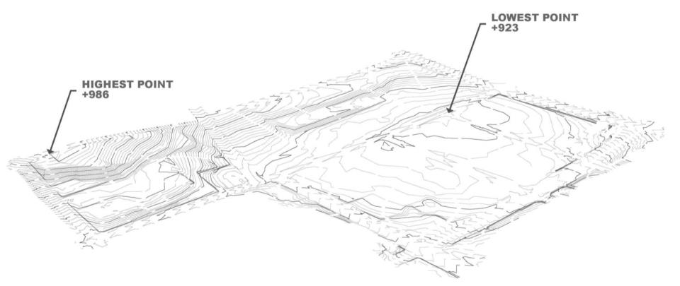
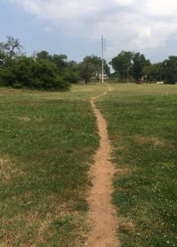
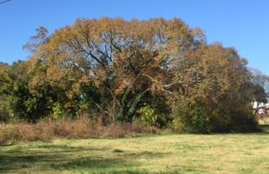
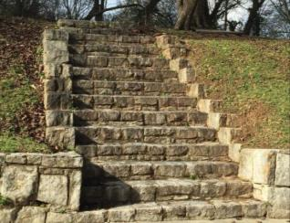
Existing Conditions
Elm St
Joseph E. Boone Blvd
Tyler St
Rock St
Walnut St
Spencer St
Thurmond St
Vine St
Existing Trees
Existing Architectural Remnants
Current Footpaths

Slide 20
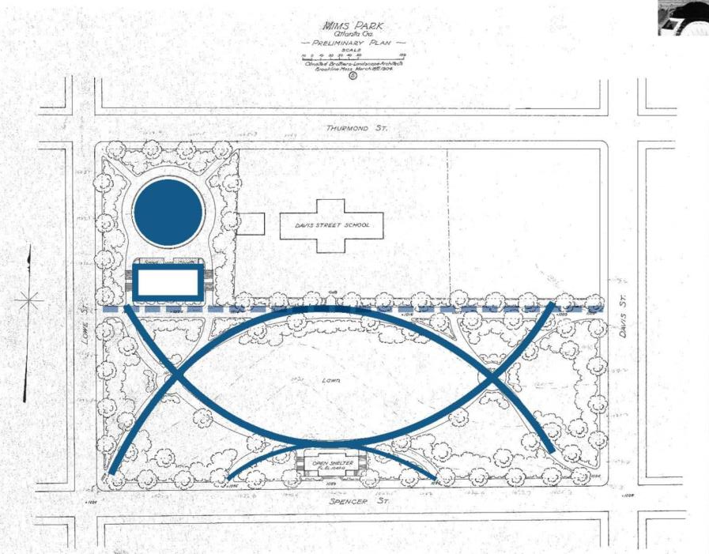
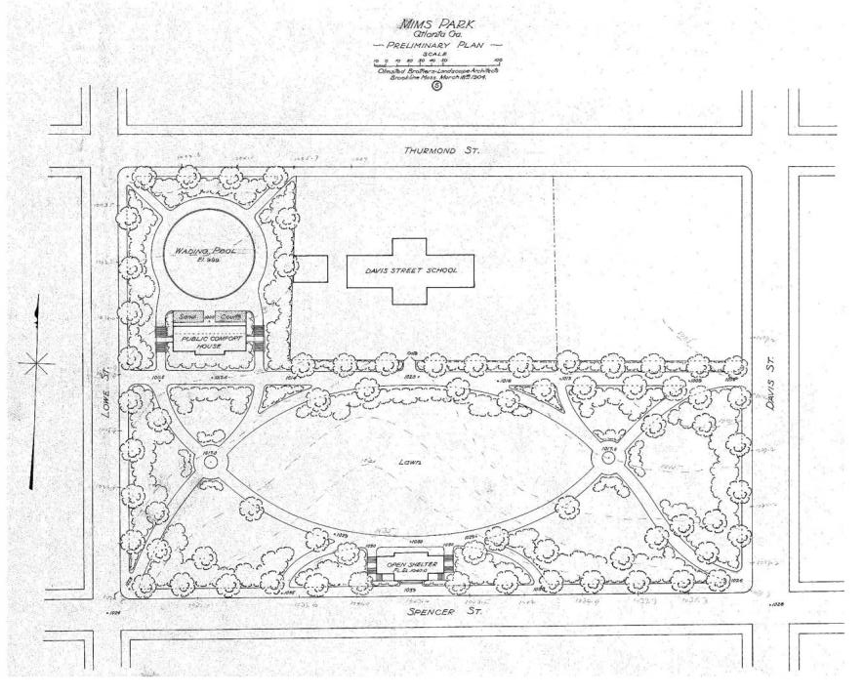
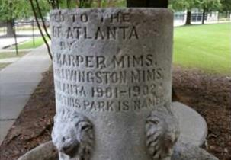
Original Mims Park

Slide 21
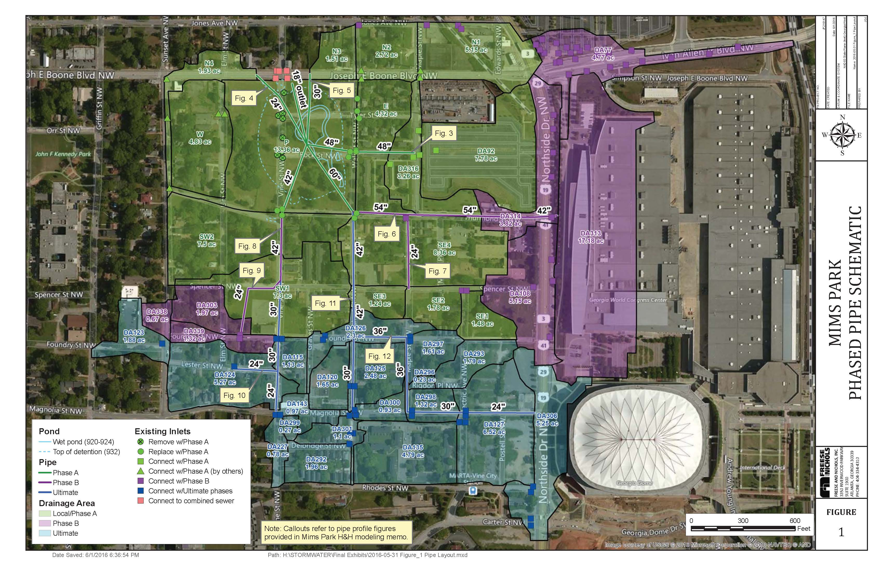
Stormwater Storage Capacity
Park Will Manage Stormwater from 150 Acre Area Surrounding Site
Notes:
Phased Combined Sewer Separation
Ultimate Drainage 150 acres
Eliminates combined sewer overflows for up to the 100-year storm event
Phase A – Green - 73 acres drainage
Phase B – Purple - 36 acres drainage
Phase C – Blue - 41 acres drainage

Slide 22
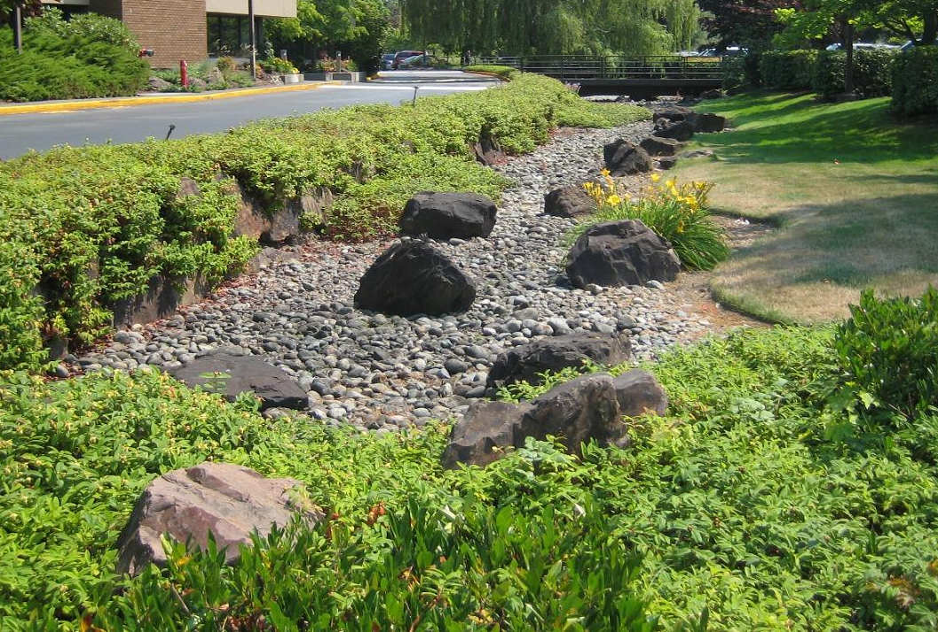
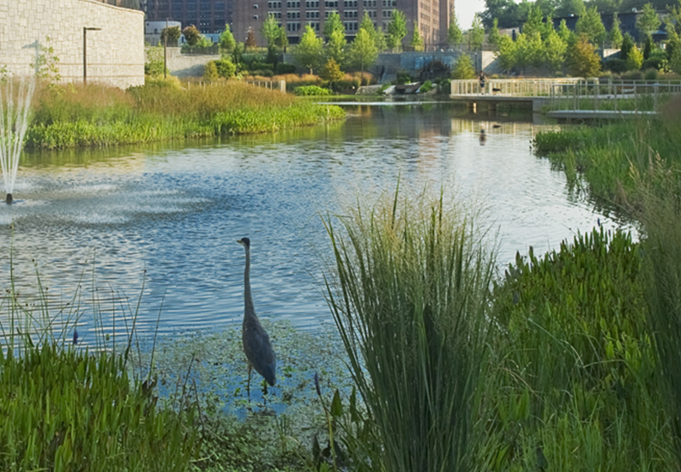
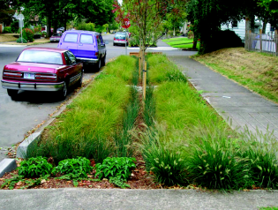
Cook Park Will Be Comprised of Green Infrastructure Components That Provide Multiple Benefits
Designed to redirect surface runoff away from the combined sewer system to reduce flooding in the surrounding areas
Complement the green infrastructure and sewer capacity relief efforts along Boone Blvd
Wet pond with aerating water features will provide capacity relief as an integrated amenity within the park
Green infrastructure will include:
Bioretention
Stormwater planters
Rainwater harvesting cisterns
Soil restoration

Slide 23
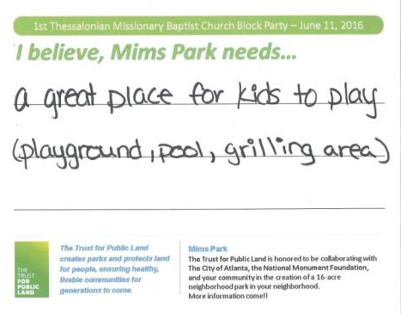
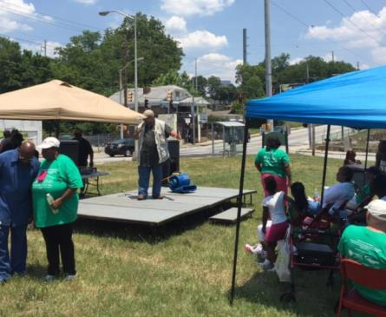
The Needs of your Community were identified & prioritized through numerous civic engagement activities
June 11, 2016 – 1st Thessalonians Baptist Church Block Party
Event organized by 1st Thessalonians Baptist Church
Recorded information from attendees through vision cards prefaced with:
“I believe, Mims Park needs…”

Slide 24
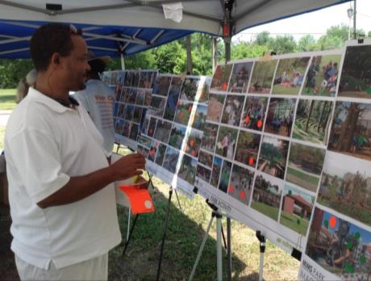
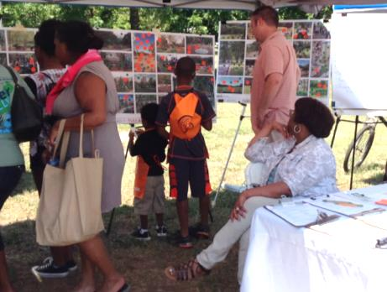
The Needs of your Community were identified & prioritized through numerous civic engagement activities
June 25, 2016 – Park ‘Play Day’
Recorded information from attendees through ‘Dot Exercise’
  6 boards of 107 total park images were displayed
  Each attendee was given 8 green dot stickers and 8 orange stickers
  Asked to place green dots on images of park elements one would like to see in the Park & orange dots on elements one would not like to see in the Park
Board subjects included:
Play Areas
Water Edges
Park Character
Park Activities
Urban Agriculture
Public Art

Slide 25
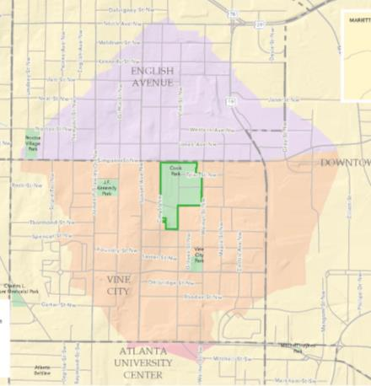

The Needs of your Community were clarified in a survey
Over 1,000 surveys were distributed throughout July & August 2016
Feedback included:
Tired of doing surveys
Areas for active recreation
Walking paths
Shade
Activities for seniors and youth
Market area
Safety and security
Jobs

Slide 26
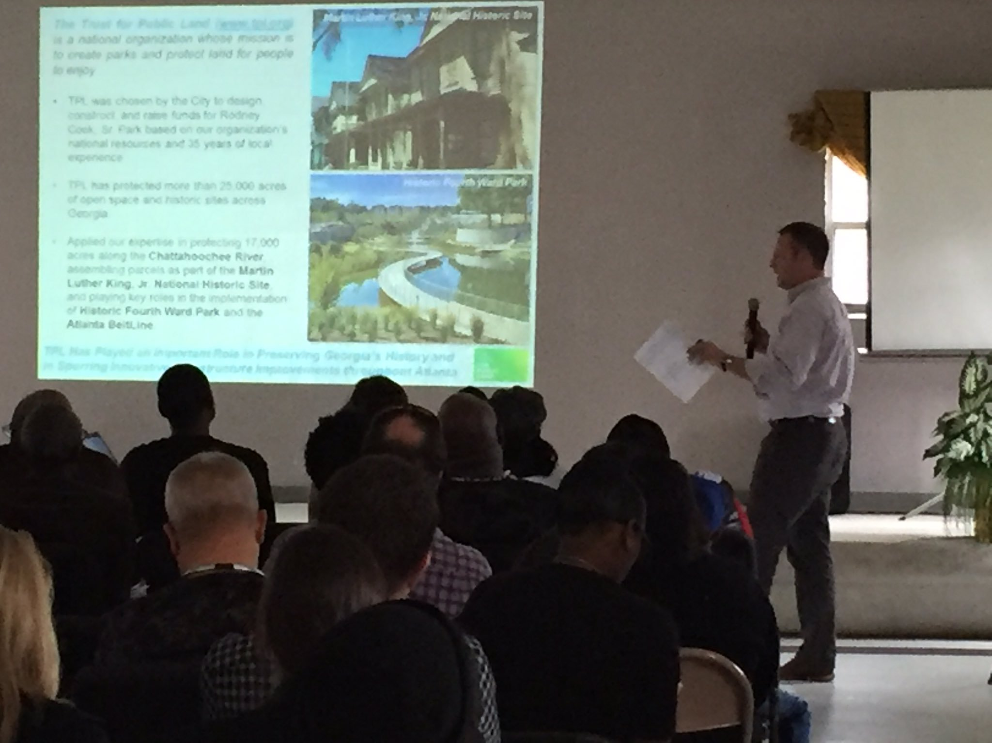
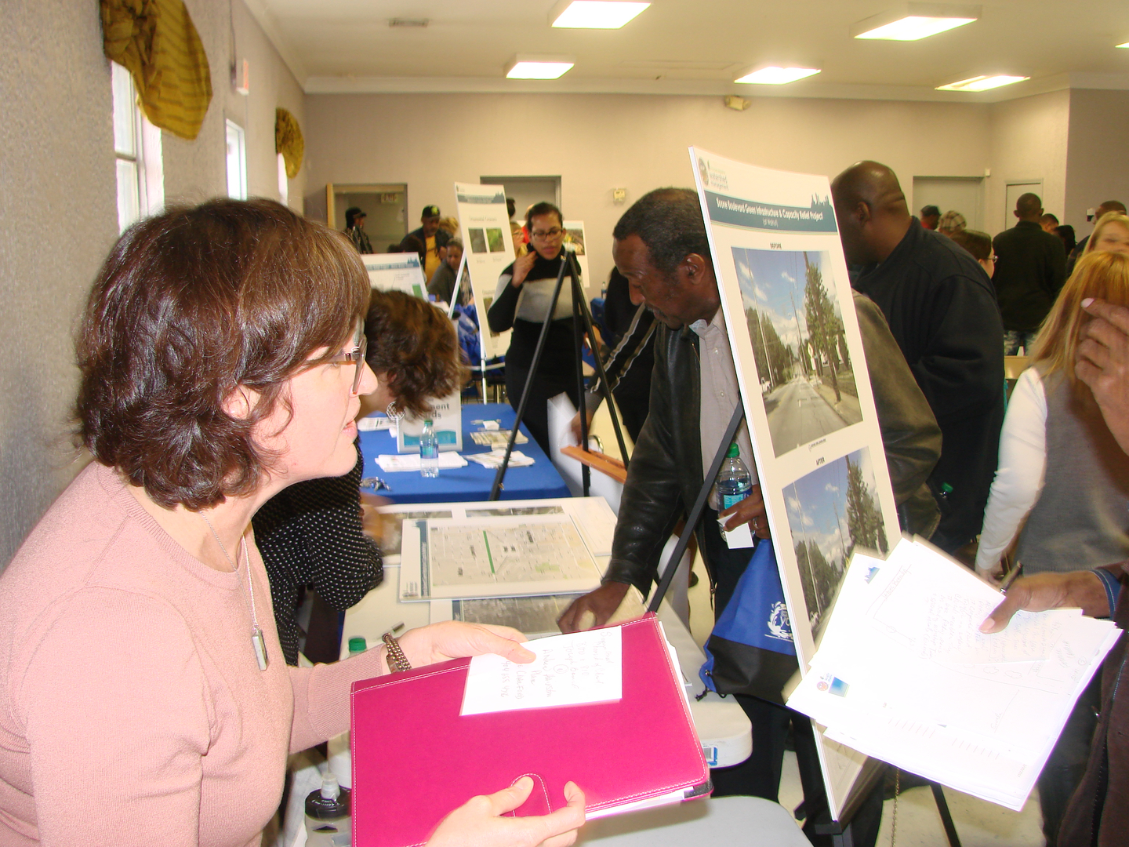
The Needs of your Community were identified & prioritized through numerous civic engagement activities
February 11, 2017 – Higher Ground Empowerment Center
Event facilitated by The Trust for Public Land and Dept of Watershed Management
Presentations by CM Young, City, TPL, & NMF of Boone Blvd and Cook Park
Additional information shared and feedback received at breakout tables

Slide 27
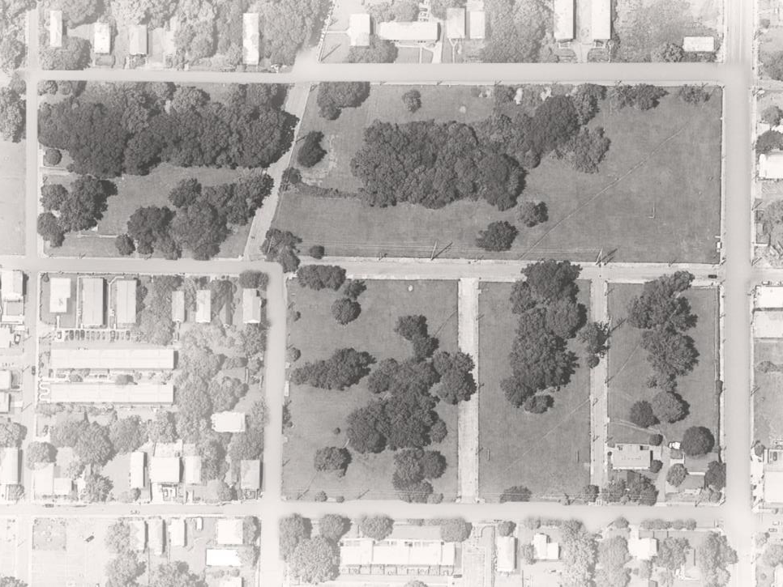
ELM ST
SPENCER ST
VINE ST
JOSEPH E. BOONE BLVD
THURMOND ST
ROCK ST
TYLER ST
SCALE
N
N
0’ 100’ 200’
WALNUT ST

Slide 28
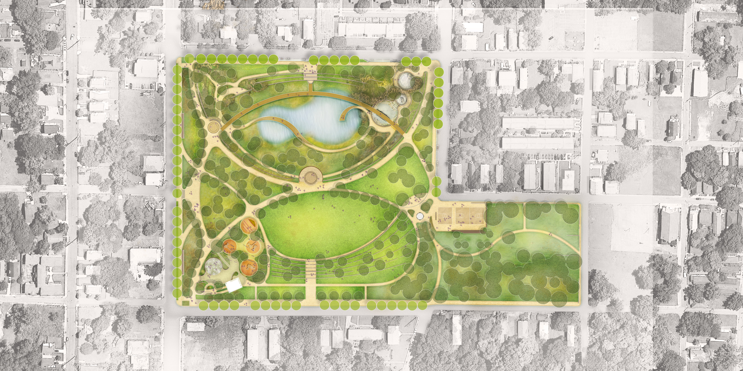


ELM ST
RESTROOMS
MARKET PLAZA
SPENCER ST
TERRACED LAWN
KIDS PLAY & EDUCATION AREA
UPPER LAWN
SPORTS COURTS
THE GREAT LAWN
WELCOME PLAZA
VINE ST
FITNESS ZONE
JOSEPH E. BOONE BLVD
PICNIC
LAWN
PERFORMANCE PLAZA
THURMOND ST
OPEN
POND
TERRACED
POOLS
SCALE
PARK GATEWAY
N
N
0’ 100’ 200’
WALNUT ST
Rodney Cook, Sr. Park in Historic Vine City
CONCEPT PLAN

Slide 29
ELM ST
H.
F.
AMPHITHEATER
G.
PEACE
COLUMN
RESTROOMS
E.
P.
M.
SPENCER ST
PEACE
PANTHEON
K.
TERRACED LAWN
KIDS PLAY & EDUCATION AREA
O.
N.
L.
J.
D.
UPPER LAWN
SPORTS COURTS
I.
THE GREAT LAWN
WELCOME PLAZA
Statues
VINE ST
FITNESS ZONE
Alonzo Herndon
Booker T. Washington
W.E.B. DuBois
Joseph E. Boone
Maynard Jackson
Julian Bond
Grace Towns Hamilton
Rodney Cook, Sr.
Dorothy Bolden
John Lewis
Joseph E. Lowery
Hosea Williams
Andrew Young
Ralph David Abernathy
Coretta Scott King
Martin Luther King, Jr.
JOSEPH E. BOONE BLVD
PICNIC
LAWN
PERFORMANCE PLAZA
C.
B.
THURMOND ST
OPEN
POND
TERRACED
POOLS
PARK GATEWAY
SCALE
N
A.
N
0’ 100’ 200’
WALNUT ST
Rodney Cook, Sr. Park in Historic Vine City
CONCEPT PLAN

Slide 30
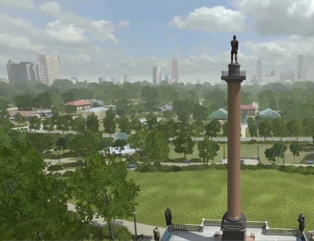
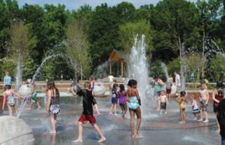
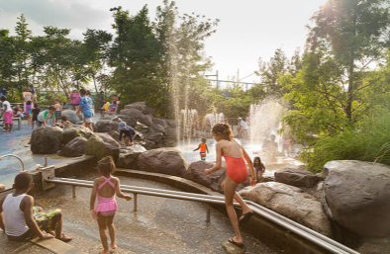
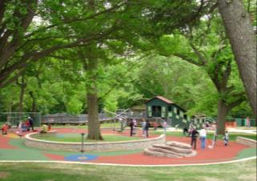
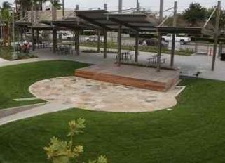
ACCESSIBLE SPLASH PAD
ELM ST
RESTROOM
SHADED PLAYGROUND AREAS DESIGNED FOR ALL ABILITIES
TOT LOT
SPLASH
PAD
PLAYGROUND
THE GREAT LAWN
OUTDOOR LEARNING VENUE
OUTDOOR LEARNING SPACE
WELCOME PLAZA
N
N

Slide 31
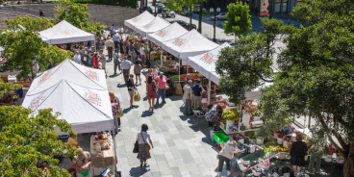


ELM ST
MARKET WALK
TERRACED LAWN
THE GREAT LAWN
THE GREAT LAWN
MARKET WALK
PERFORMANCE PLAZA
N
N
TERRACED LAWN

Slide 32



MULTI-USE SPORTS COURTS
UPPER LAWN
PICNIC PAVILION
MULTI-USE
SPORTS COURTS
FITNESS ZONE AREA
VINE ST
FITNESS
ZONE
AREA
N
N
THURMOND ST
OUTDOOR EDUCATION

Slide 33


BOARDWALK OVER POND
BOULDER ENTRANCE
PICNIC LAWN
PERFORMANCE PLAZA
OPEN
POND
JOSEPH E. BOONE BLVD
THURMOND ST
TERRACED
POOLS
BRIDGE
PLAZA
WALNUT ST

Slide 34


Notes:
Insert New Rendering on this slide

Slide 35

Notes:
Insert New Rendering on this slide

Slide 36

EXISTING PARK SITE – LOOKING SOUTHEAST

Slide 37


PROPOSED COOK PARK – LOOKING SOUTHEAST

Slide 38

EXISTING PARK SITE – LOOKING SOUTHWEST

Slide 39

PROPOSED COOK PARK – LOOKING SOUTHWEST

Slide 40

EXISTING PARK SITE – LOOKING NORTHEAST

Slide 41

PROPOSED COOK PARK – LOOKING NORTHEAST

Slide 42


Slide 43


Slide 44


Slide 45


Slide 46


Slide 47


Slide 48


Slide 49


Slide 50


Slide 51


Slide 52


Slide 53


Slide 54


Slide 55


Slide 56


Slide 57


Slide 58


Slide 59


Slide 60
Building Community
& Green Infrastructure
in the Westside’s New Parks
Transform Westside Summit - July 7, 2017
Darryl Haddock Westside Atlanta Watershed Alliance
Jay Wozniak The Trust for Public Land
Andrew White Park Pride

