Slide 1
Westside Future Fund
Transform Westside Summit
Friday, August 18th, 2017

Slide 2
Equifax’s Mission and Vision
We support healthy communities starting with our own internal community of engaged employees. Central to our approach is a desire to engage in a collaborative process with residents, non-profits, fellow corporations, foundations and government stakeholders.
We implicitly understand that businesses cannot be healthy and successful if the society around them is ill. As a world class provider of information solutions in the financial sector, we seek to balance our business priorities with complimentary focus areas in underserved communities with a special emphasis on creating economically healthy individuals and communities.

Slide 3
Strategic Approach in the Westside
Collaborative: align our philanthropic and human resources in partnership with The Arthur M. Blank Family Foundation, ACP, universities, public institutions, non-profits, community stakeholders and residents
Geographically-focused: invest with an eye for impactful economic opportunities in all of the Westside, but build a base of activity and investment in Vine City before expanding our footprint over time
Evidence-based: invest in strategic opportunities informed by data analysis and driven by a desire to increase evaluative sophistication over time
Long-term: invest with the understanding that systemic change takes time

Slide 4
Strategic Snapshot
Goal 1:
Knowledge sharing and skill building
Goal 2:
Encourage and engage residents in financial wellbeing practices
Goal 3:
Increase access to financial institutions and asset building products
a) Train coaches, case managers & other front-line workers to deliver financial education and coaching using
standardized qualifications and culturally responsive practices.
a) Develop and implement a financial wellness program for residents across all income levels and ages, and types (e.g., current owners, renters and future renters and homeowners).
a) Establish standards for safe checking accounts, auto loans, and other financial products
b) Develop and deliver a coordinated menu of financial education, coaching and appropriate financial products in the community served.
b) Create awareness and community participation in financial wellness programs
b) Provide financial products that meet local needs in partnership with Westside Financial Capability Center
c) Promote wealth-building by addressing pipeline to home ownership, stable housing, workforce development, college and career readiness, asset-building and money management.
c) Provide ongoing support to coaches, case managers and other front-line workers to deliver financial education and coaching and ongoing support to the community to make informed and timely decisions
Aligned with GEEARS / Ed Counsel and Health Collaborative recommendations
= Priority 1 (6-12 months)
= Strong ties to Education Collab
= Priority 2 (12 - 24 months)
= Strong ties to Land Use / Retention
= Priority 3 (18 – 36 months)
= Strong ties to Health Collab

Slide 5
Early Investments and Partnerships
Formation and Support of the Westside Future Fund
  Advised ACP on the formation and creation of the WFF and provide funding and in-kind support (loaned executive) for ongoing operations
Formation and Support of the WEIC
  Helped in the formation and structure of the Westside Economic Inclusion Collaborative and provide ongoing funding for the program manager
The On the Rise Financial Capability Center
  In partnership with AMBFF, Invest ATL & The National Federation of Community Development Credit Unions, we created and support the new center
Additional Economic Partnerships
  Center for Civic Innovation – Fellows Program
  Trees Atlanta – community workforce development program
Employee Engagement
  Ongoing application of cross-functional teams that leverage our talent and skills in support of non-profits and small businesses

Slide 6
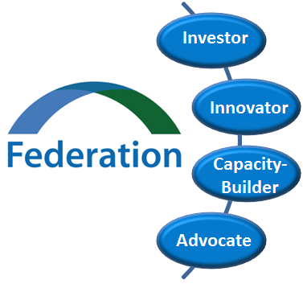



National Federation of Community Development Credit Unions
Mission-driven CDFI Intermediary and trade association targeting capital, technical assistance, advocacy, training and programmatic support to credit unions committed to low-income people and communities.
    Network of 200+ member Community Development Credit Unions credit unions (CDCUs) in 46 states
    $60 Billion Assets under Management
    More than 6 million members served
  Together, we’re bringing financial inclusion to Atlanta

Slide 7
Credit Union Philosophy & Structure
Established as an alternative to traditional banks to provide financial services to the working class, or “people of small means” as defined in the Credit Union Act.
Democratically owned and controlled institutions. Credit union boards of directors are elected by members, who have an equal vote regardless of how much he or she has on deposit.
Unbanked: 15.6 million
“To help low- and moderate-income people and communities achieve financial independence through credit unions.”
Underbanked: 51 million
Low Income or Income Volatility: 91 million
Credit Challenged:121 million
Total US Population: 324 million
Notes:
Are democratically owned and controlled institutions. Credit union boards of directors are elected by members
Each member has an equal vote regardless of how much he or she has on deposit.
Not-for-profit financial cooperatives serving groups of members who have a “common bond”
This common bond is defined as “field of membership” FOM
Community credit union: a financial cooperative that may serve anyone who lives or works within a particular geographic
SEG (select employee group)-based or Sponsor-based credit union: a financial cooperative that serves groups of employees or associations

Slide 8
Why Financial Inclusion Matters
Financially underserved consumers spent $141 billion in fees and interest to use $1.61 trillion in financial services
Alternative Financial Services (AFS) Providers: check cashers; payday lenders; money remitters, etc. are projected to grow by 2.1% in 2017
An unbanked person with average income of $20k or less will spend
  $1,200 a year on check cashing and money orders
  Over $40,000 in unnecessary fees in their lifetime
Consumers with low or no credit scores may pay $200,000 more over a lifetime for financial products and services than those with good scores
  64 million US consumers have insufficient or no credit history
  121 million US consumers have subprime credit scores (ranging from 500-649)

Slide 9
Proven Solutions
Use partnerships and integration to
  Connect clients to socially responsible financial institutions
  Improve saving behavior
  Improve access to credit
Financial Capability can be the “connective tissue” between social services providers and CUs
  Identify financial product\service needs
  Prepare client for membership
  Supports their productive use of CU service

Slide 10

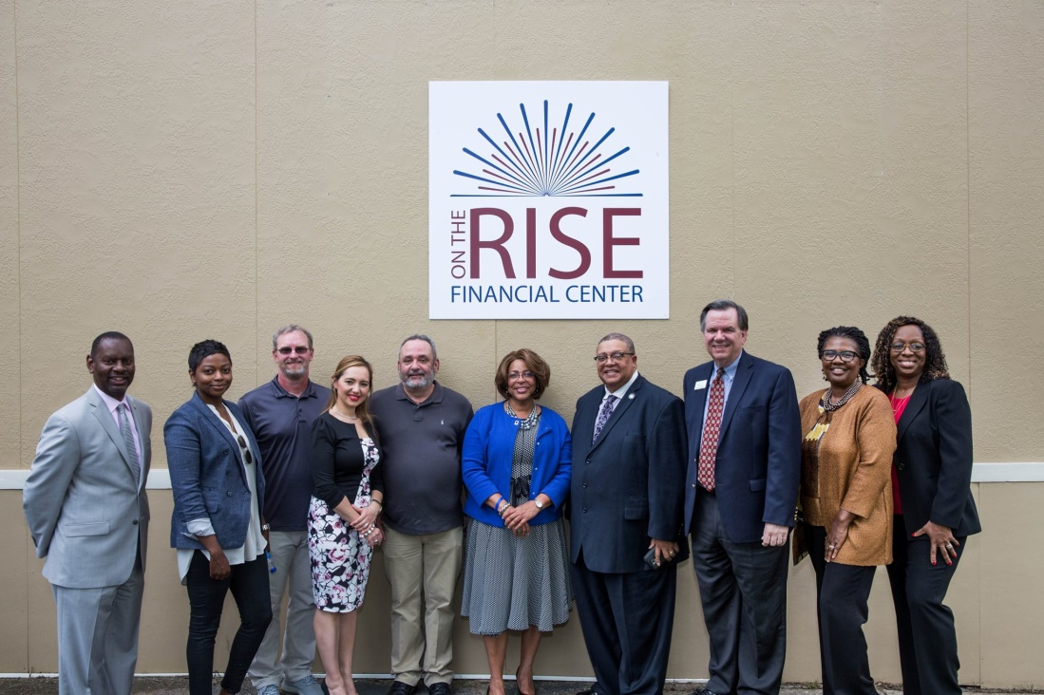


New Ways to Serve the Westside
In April 2017, the Federation launched the Atlanta-based On the Rise Financial Center to build financial well-being for individuals and families in the Vine City, English Avenue, and Castleberry communities.
The Center is an initiative of Federation in partnership with local credit unions, 1st Choice CU, BOND Community FCU, Credit Union of Atlanta, and Peach State FCU.

Slide 11

On the Rise Products/Services
We offer a wide range of financial education to support Westside residents to reach their financial goals:
  Workshops: Home Buyer Education and Money Management
  Classes: Group Financial Awareness and Stability Training (FAST)
  Counseling: Individual budget planning with credit-building tools
In collaboration with our CDCU partners, On the Rise Financial Center also has a suite of products and services including:
  Remote Account Access
  Checking Accounts (debit cards and direct deposit)
  Savings Accounts
  Small Dollar Loans
  Auto Loans
Notes:
Additional products we plan to offer to Center clients include:
Share Secured Loans
Credit Cards
Mortgage Loans
Small Business Loans
Student Loans
Home Equity Loans
IRAs

Slide 12
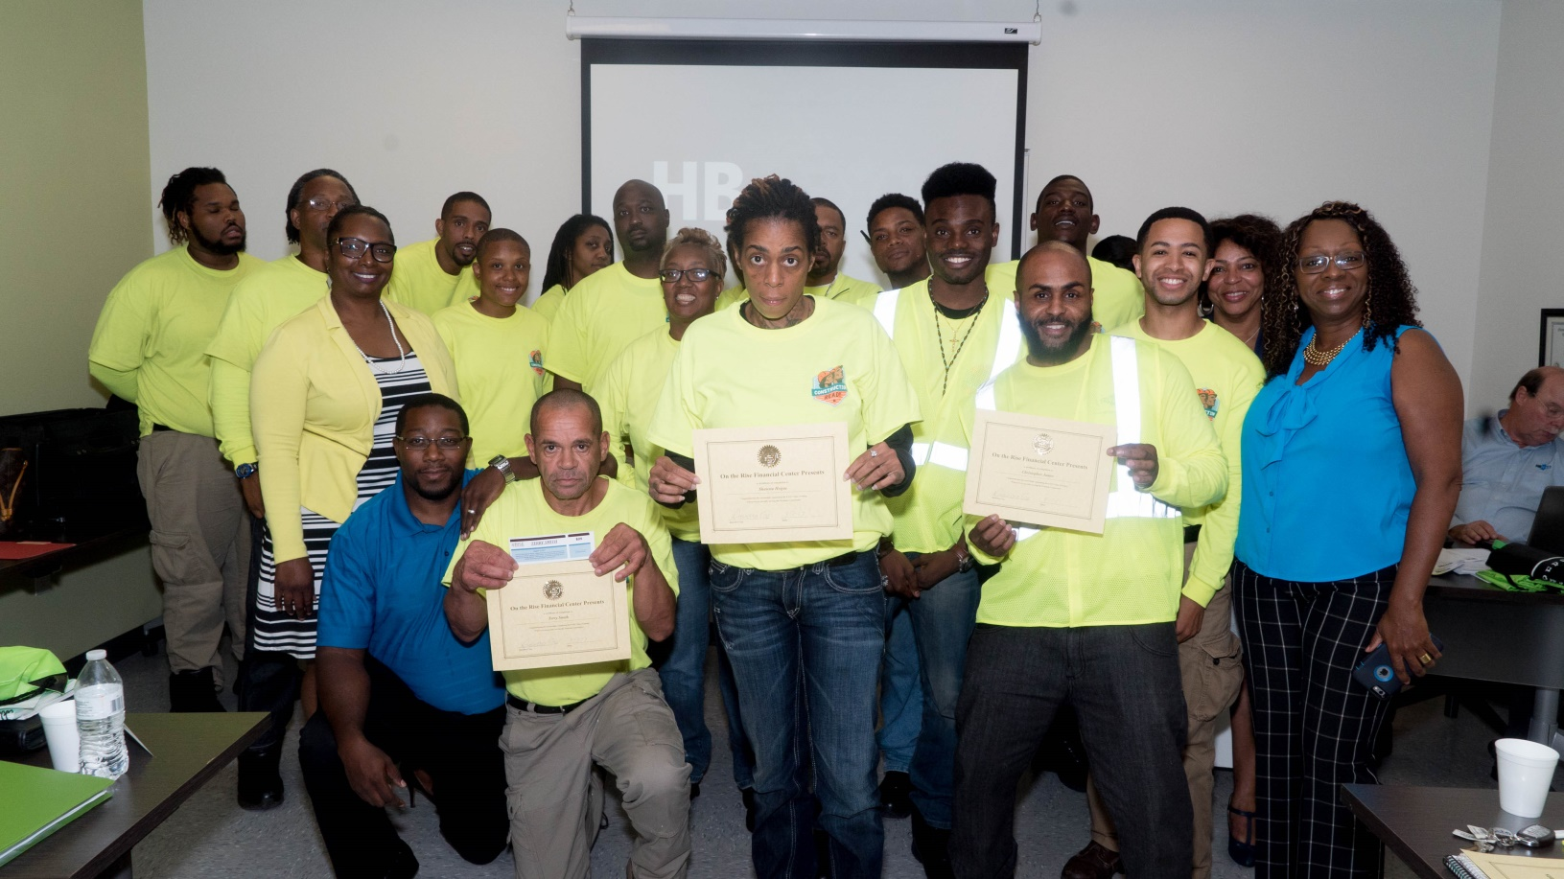
CEFGA’s Graduating Class
  CEFGA participants celebrating their completion of the group Financial Awareness and Stability Training (FAST) class earlier this month!
Notes:
Additional products we plan to offer to Center clients include:
Share Secured Loans
Credit Cards
Mortgage Loans
Small Business Loans
Student Loans
Home Equity Loans
IRAs

Slide 13

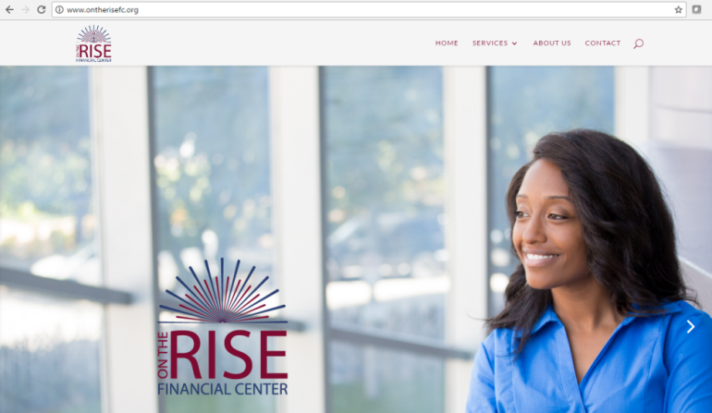
Connect with the Center
Mon - Fri, 10am – 4pm. Residents able to walk in, receive materials on financial education classes, sign up for credit union accounts and/or apply for credit union products and services.
Mon - Fri, 10am – 2:30pm. One-on-one counseling by appointment. Appointments can be made online, by phone, or in-person at the Center.
Our class and counseling schedule is online: http://www.ontherisefc.org/
Follow us on Facebook: https://www.facebook.com/On-the-Rise-Financial-Center-1543980372279337/
Notes:
Additional products we plan to offer to Center clients include:
Share Secured Loans
Credit Cards
Mortgage Loans
Small Business Loans
Student Loans
Home Equity Loans
IRAs

