Slide 1
Westside Summit
Watershed Management in Proctor Creek
September 1, 2017
CITY OF ATLANTA
Kasim Reed, Mayor
Kishia L. Powell, Commissioner

Slide 2
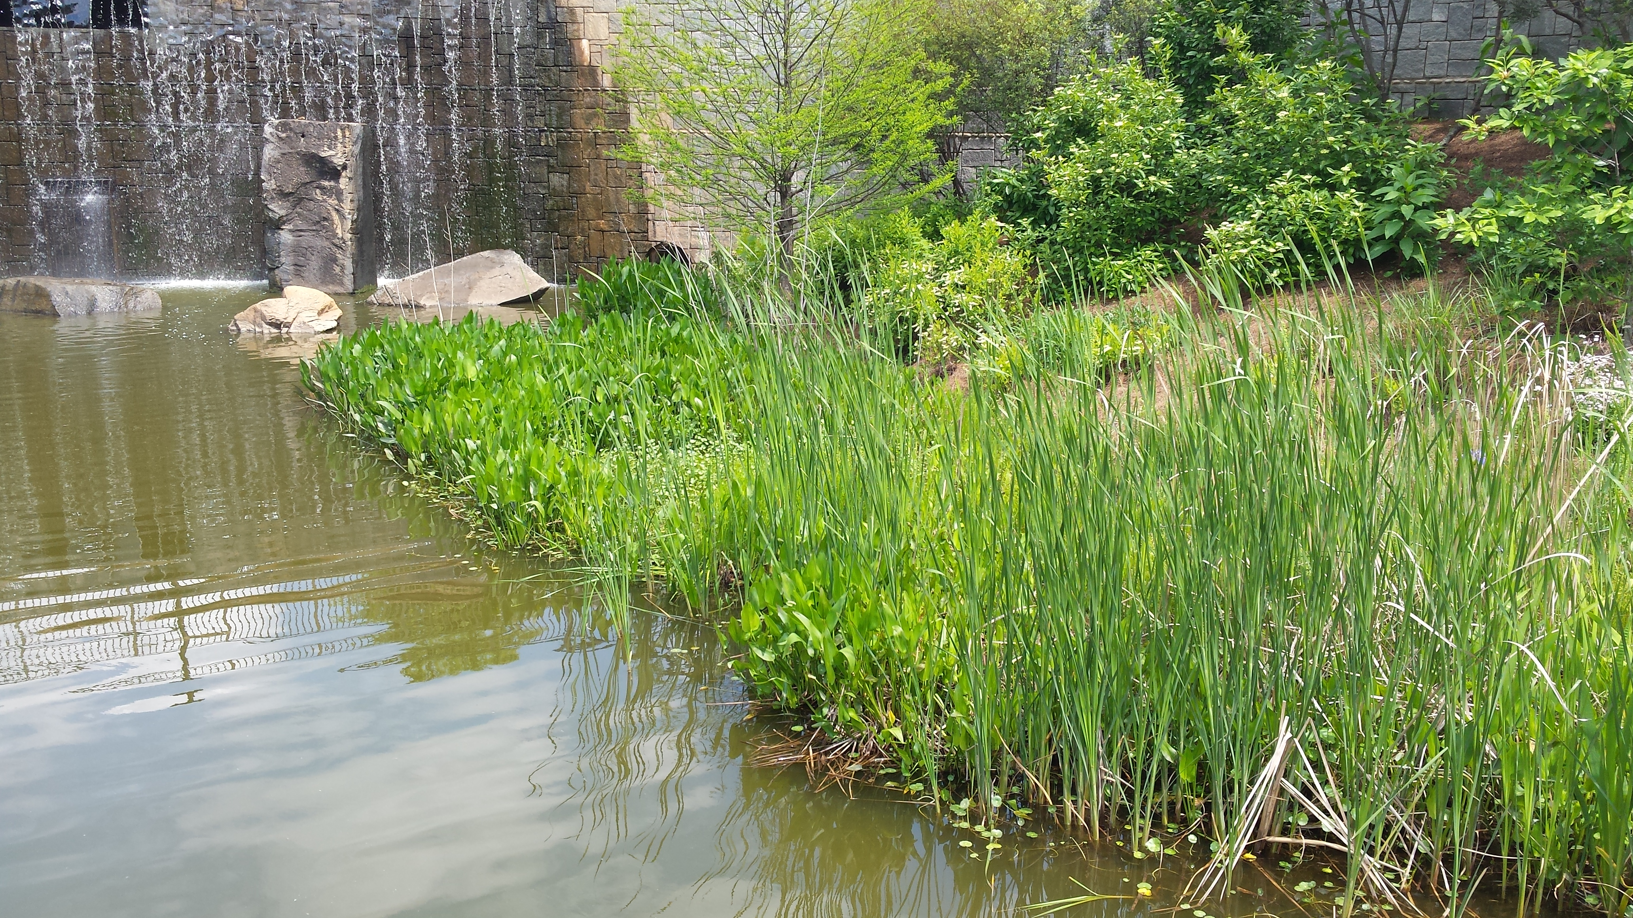
Delivers 98 MG of drinking water per day
Treats 150 MG of wastewater per day
1.2M Customers
Served
$609M
FY 2018 Operating Budget
$1.25B
5-YR Capital Improvement Program
WATER SYSTEM | WASTEWATER SYSTEM | WATERSHED PROTECTION
3,028 miles of pipeline 62,204 valves 24,385 fire hydrants 18 pump stations 3 water treatment plants | 1,900 miles of pipeline 47,327 manholes 22 pump stations 4 water reclamation centers 2 water quality control facilities | 603 miles of pipe 47,351 inlets 2,349 culverts 6,175 outlets 10 drainage basins

Slide 3
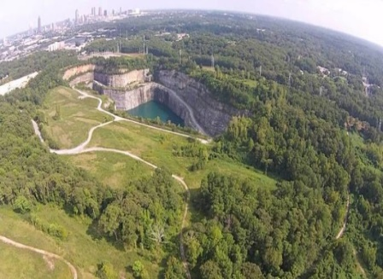
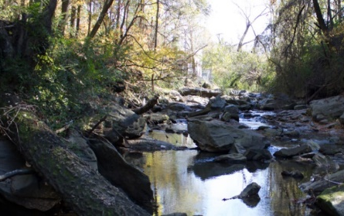
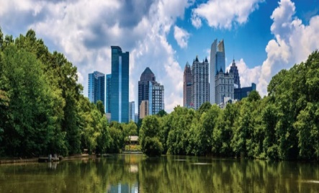
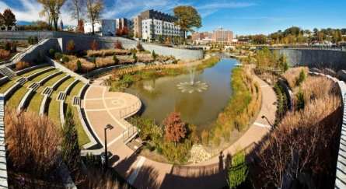
Major Programs and Initiatives
Water Supply Program
Atlanta’s $350 million investment to address aging infrastructure and create a more sustainable water future. Boring a five-mile tunnel to repurpose an old rock quarry as a new raw water reservoir to hold 2.4 billion gallons; increasing the City’s water reserves from 3 to 30 days or more and protecting $100M a day in economic output.
Urban Waters Federal Partnership
for Proctor Creek
Atlanta’s Proctor Creek Watershed one of 19 designated Urban Waters in the US
Connecting 35 neighborhoods
Over $100M investment needed to restore watershed and improve water quality
Opportunity to introduce innovative financing approach
Clean Water Atlanta
Atlanta’s Wastewater Consent Decree Program
$2B in improvements since 1998
Second CD extended until 2027
Rehabilitation of 363 miles of collection system; 97% reduction in spill volume
Green Infrastructure Strategic Action Plan
Action Plan developed in 2012
GI Task Force leverages multiple stakeholders
Highlighted Atlanta as leader in GI Implementation
Four action areas including sustainable funding and policy development

Slide 4
100 Resilient Cities
Resilient systems withstand, respond to, and adapt more readily to shocks and stresses to emerge stronger after tough times, and live better in good times.
City of Atlanta is a partner in the Rockefeller Foundation’s 100 Resilient Cities initiative
Identified shocks and stresses
  Aging infrastructure/Infrastructure failure
  Cyber attack
  Drought
  Economic inequality
  Rainfall flooding
  Terrorist attack

Slide 5
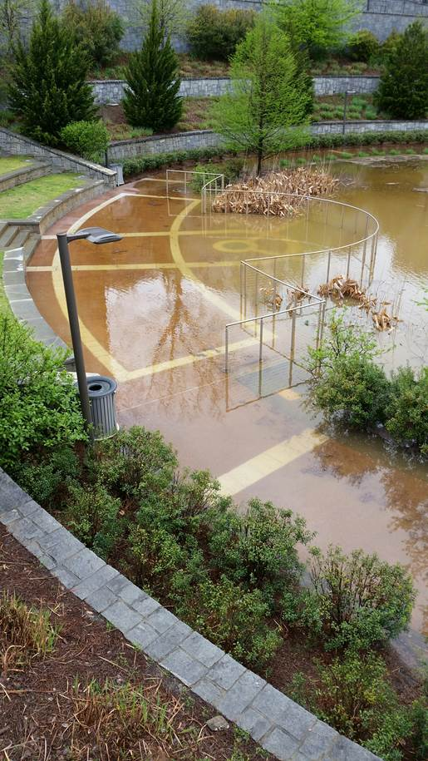
DWM Resiliency Response
Aging infrastructure/Infrastructure failure
  $1.25B CIP – Focused on Clean Water Atlanta, Distribution system and Water/Wastewater Facilities
Drought
  Water Supply Program
Rainfall flooding
  Climate Change Resiliency/Flooding Mitigation
  GI Strategic Action Plan
  Integrated Planning
Cyber attack
  SMART H2O and Information Management Infrastructure Upgrades
Terrorist attack
  Security Upgrades at Critical Facilities
Economic inequality
  Improvements to our Care and Conserve Program

Slide 6
Stormwater Challenges

Slide 7
Highly Urbanized Environment

Slide 8
Challenges in Urban Watersheds

Slide 9
History of Wet Weather Focus
1998 – CSO Consent Decree
1999 - SSO Consent Decree
2003 - Nancy Creek Tunnel Project Added
2012 – Green Infrastructure Strategic Action Plan Developed
2014 - Phase I MS4 Permit
2015 – 100yr Storm Flooding
2012 - Time Extension to 2027
2007 - Sewer Separation Completed
2008 - CSO CD Reqs. Met
2009 -100-500yr Storm - Flooding
2013 - Post Development Stormwater Ordinance

Slide 10
Green Infrastructure Task Force

Slide 11
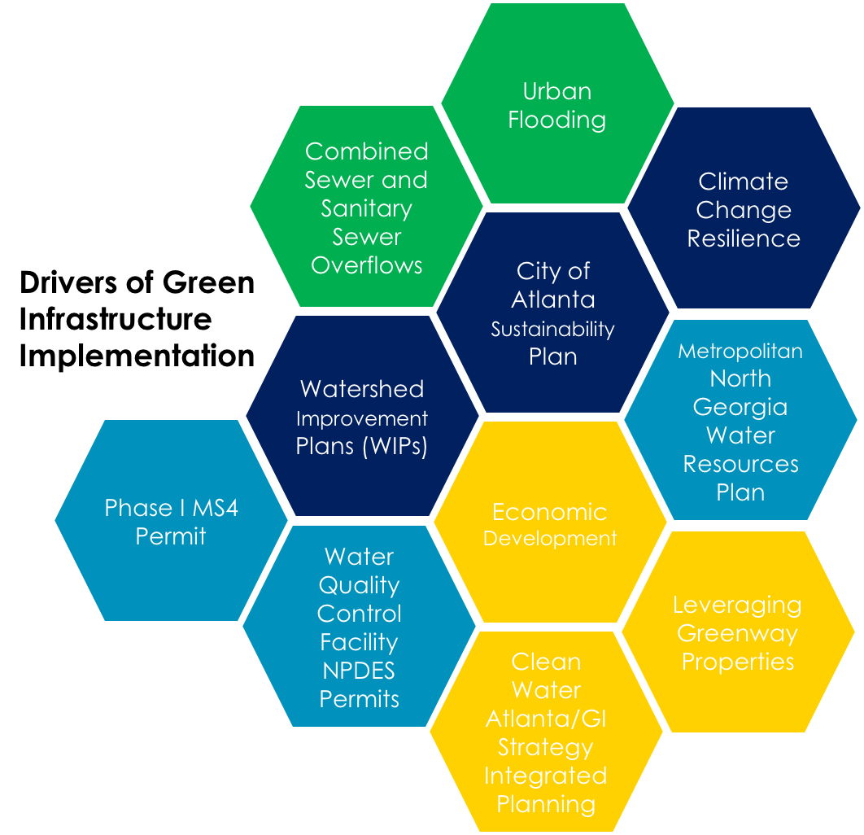
Current GI Drivers in Atlanta

Slide 12
Amended Stormwater Ordinance

Slide 13
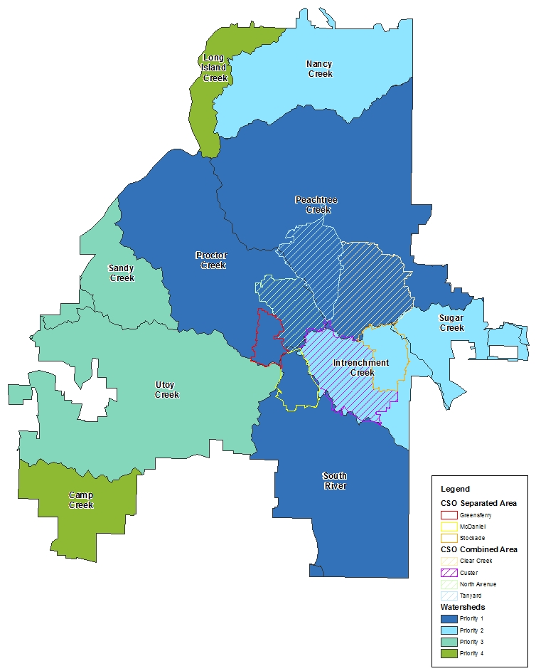
Integrated Watershed Management
Protection and restoration, on a watershed basis, to improve water quality, ensure resilience and manage resources while addressing the challenges of growth and climate change
10 watersheds prioritized in 2012
Watershed Improvement Plan (WIPs) updates underway
332 Green Infrastructure and Stream Restoration Projects Identified for first 3 Watersheds at a total cost of $167.4M
Maintain a program in alignment with the Metro District Water Resources Management Plan (June 2017)
Underpinned by our GI Strategy, WIPs, Clean Water Atlanta, Urban Waters Program and Water Supply Program

Slide 14
Proctor Creek WIP & PNA Vision

Slide 15
Proctor Creek Project Opportunities

Slide 16
MOST Funded Stormwater Projects
10% of MOST Revenue has been allocated to SW projects across the City
10 in Proctor Creek Watershed – 1 completed, 1 in design, 7 in 3rd phase

Slide 17
Clean Water Atlanta/Consent Decree

Slide 18
Upper Proctor Creek
Flooding Mitigation

Slide 19
Upper Proctor Creek Capacity Relief Ponds at Cook, Sr. Park

Slide 20
Boone Blvd Green Street

Slide 21
Boone Blvd Green Street

Slide 22
Urban Waters Federal Partnership

Slide 23
Community Participants

Slide 24
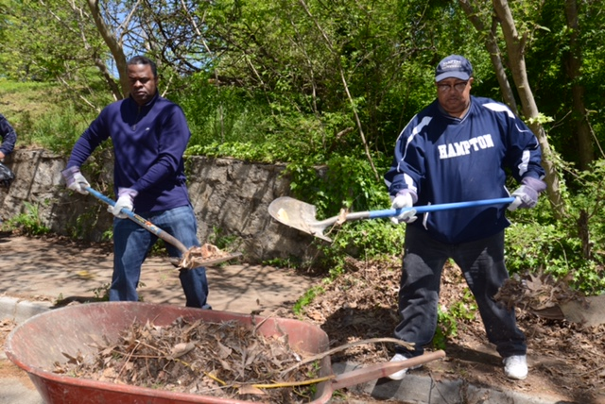
Mayor’s Commitment
“It is my goal for Atlanta to become one of the top tier sustainable cities in the nation.”
-Mayor Kasim Reed

