Slide 1


Slide 2
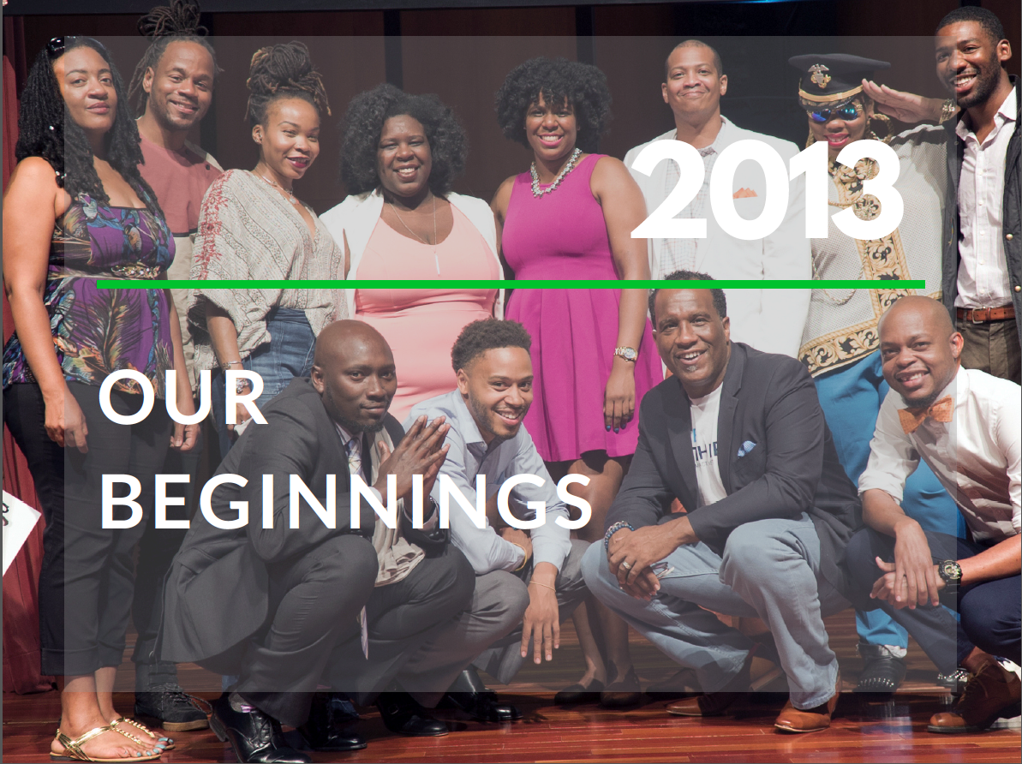

Slide 3
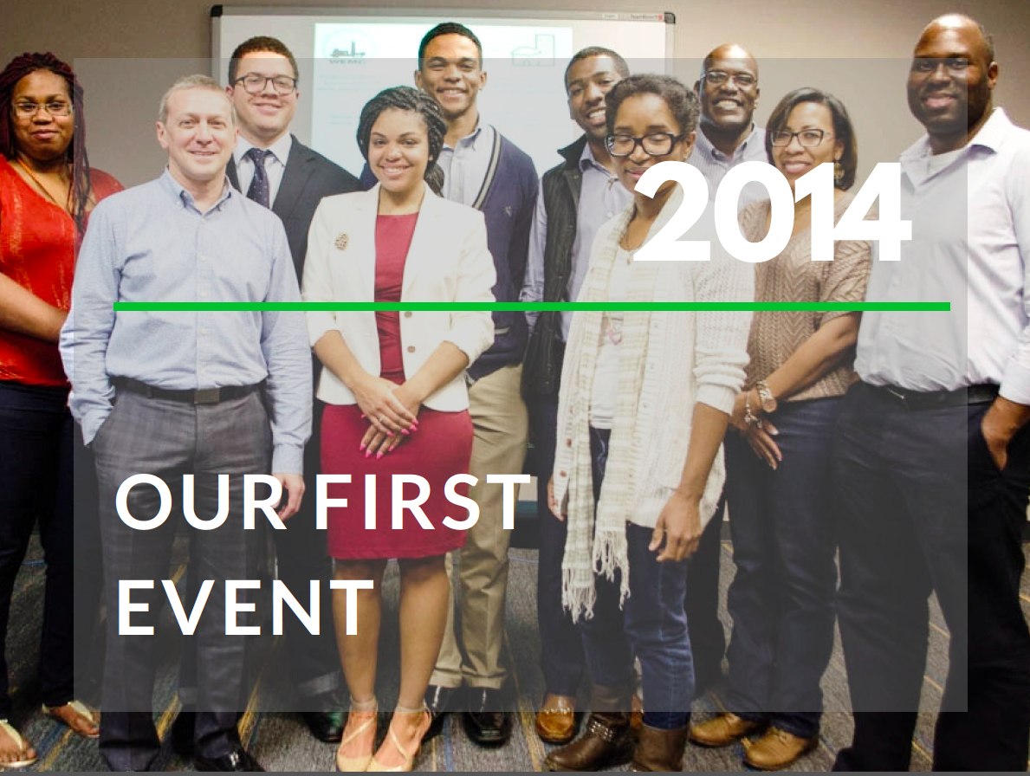

Slide 4
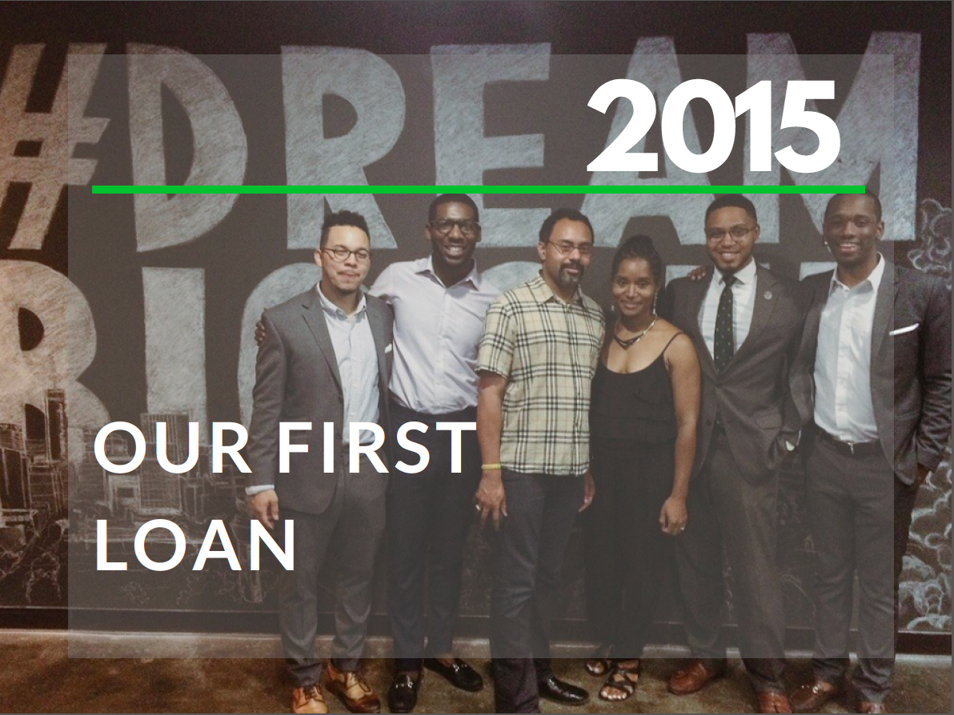

Slide 5
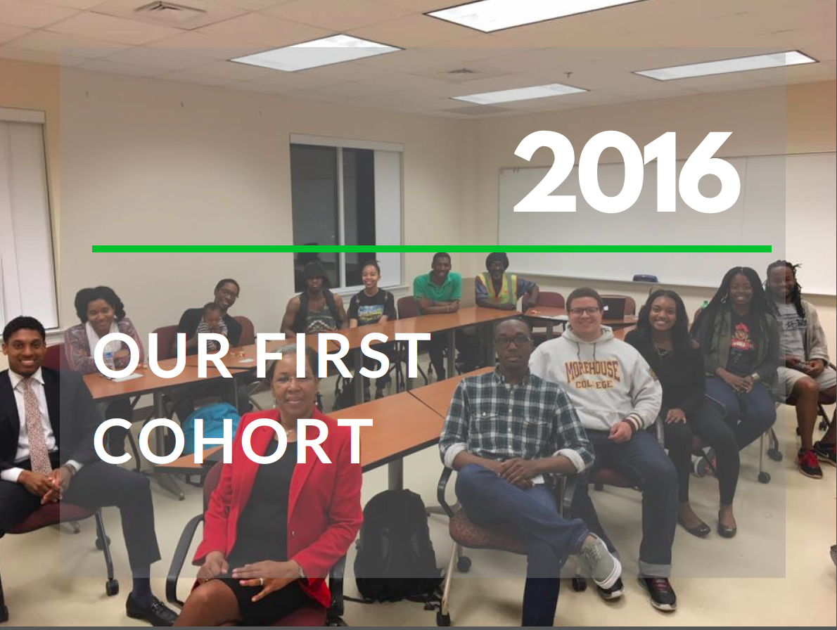

Slide 6


Slide 7
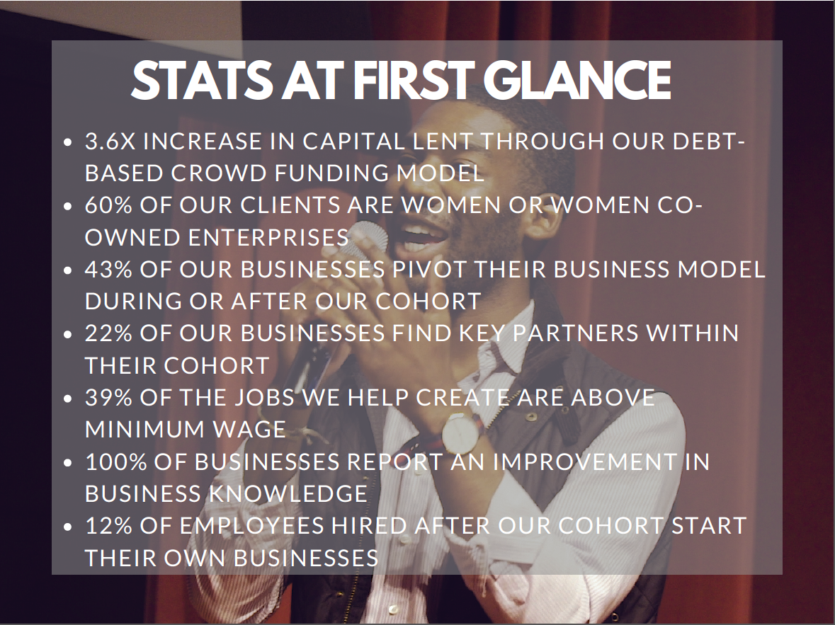

Slide 8
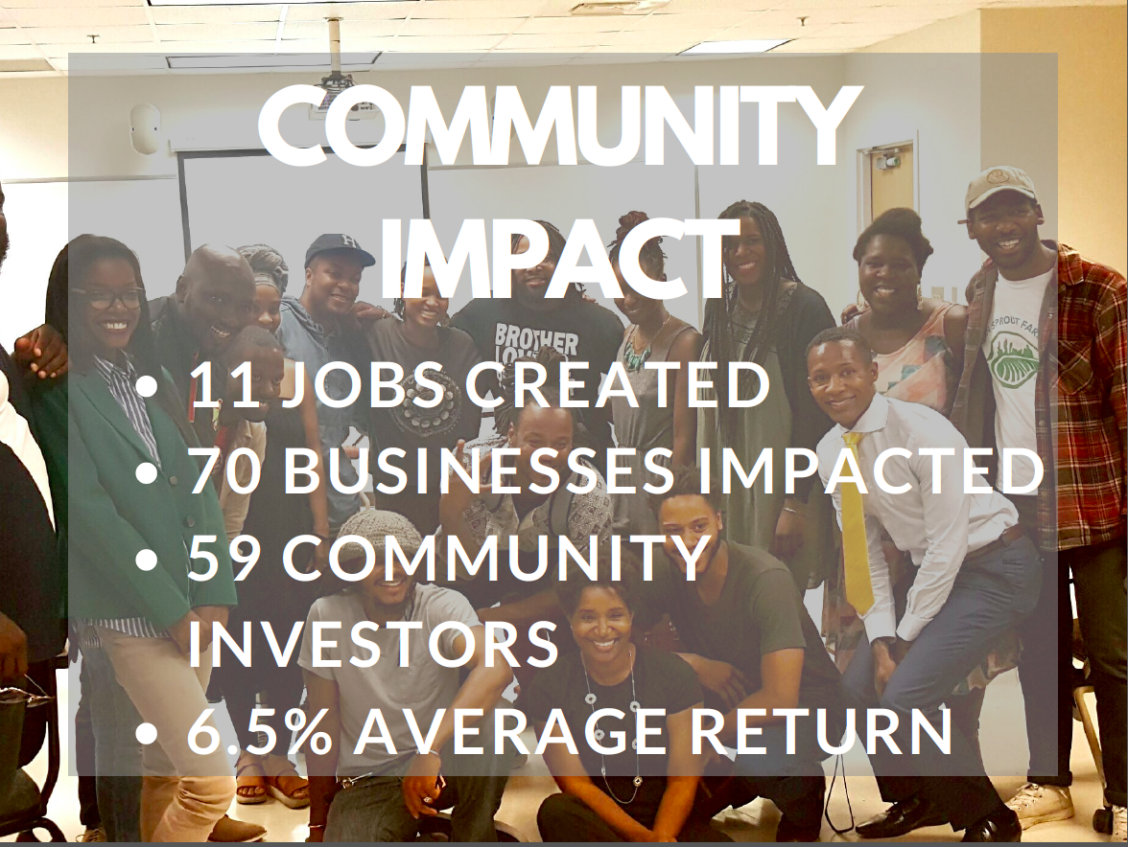

Slide 9


Slide 10

Mbye Njie
Founder/CEO
Legal Equalizer, Inc
E: mbye@legaleqapp.com
W: Legaleqapp.com
P: 478-719-0515

Slide 11


Slide 12


Slide 13


Slide 14


Slide 15

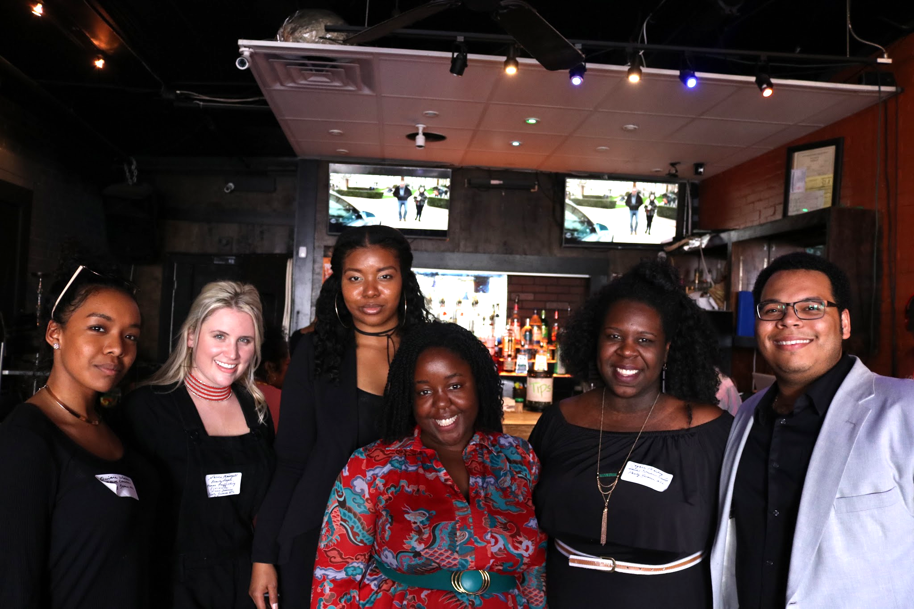

Slide 16


Slide 17


Slide 18


Slide 19
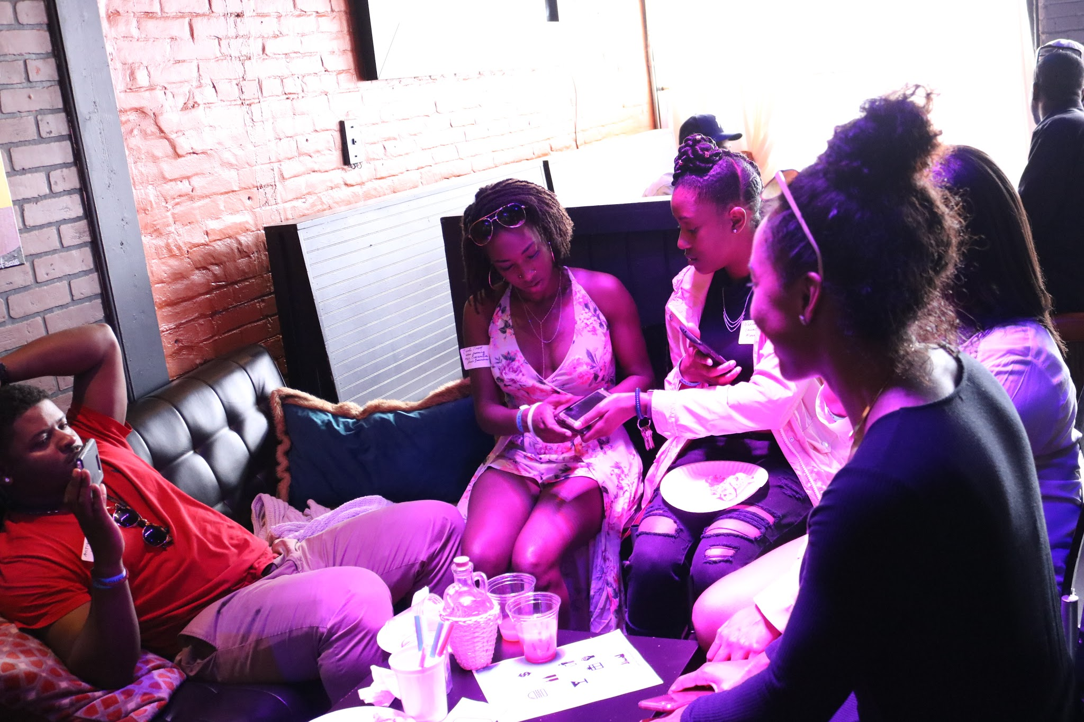

Slide 20


Slide 21
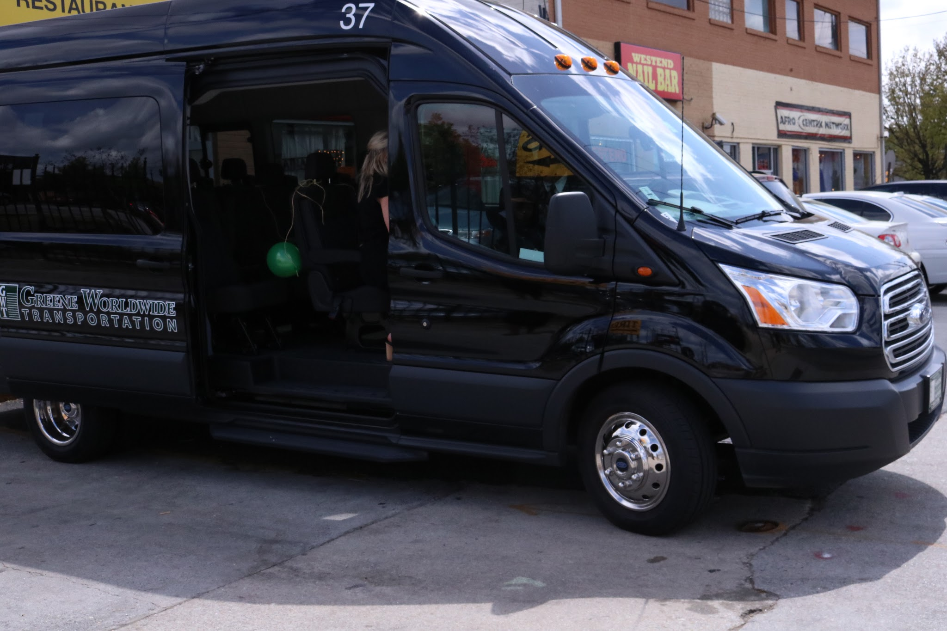

Slide 22
www.partybecauseatl.com
partybecauseatl@gmail.com
IG:partybecause

Slide 23


Slide 24


Slide 25


Slide 26


Slide 27


Slide 28


