Slide 1
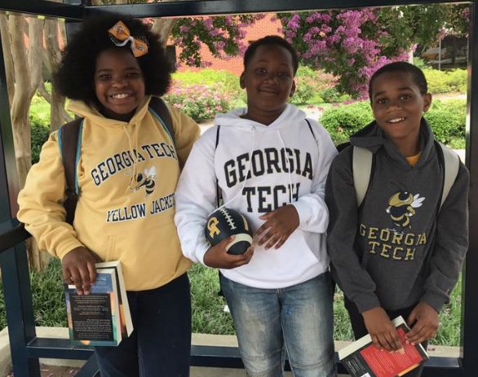

Voices of Hollis Students
PK-8 EL Education/STEM Academy
Notes:
Open Presentation with two-three students
Students will speak on “What’s special about Hollis?” “One thing I want you to know about my school.” “What is your service to my school?”

Slide 2
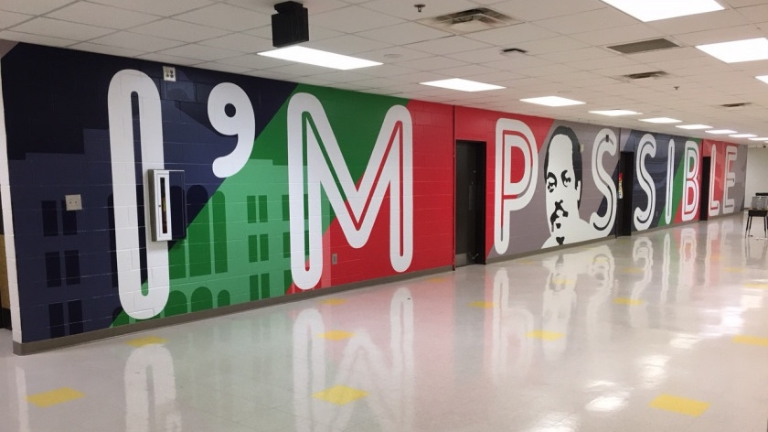

Slide 3
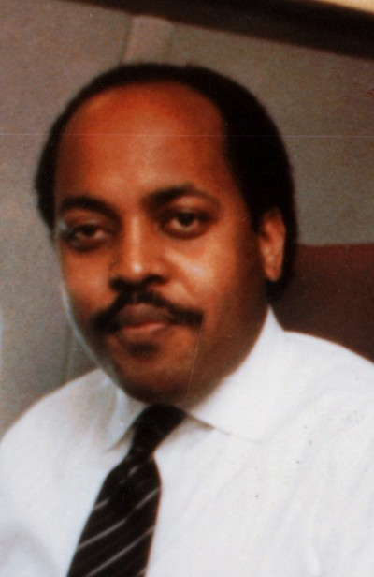
Who is Michael R. Hollis?
Graduate of Booker T. Washington (Class of 1971)
Dartmouth College and University of Virginia School of Law
Associate Chief Counsel for the Jimmy Carter Administration
A founding trustee of Clark Atlanta University
Entrepreneur of the 1st African American owned and operated commercial airline- Air Atlanta
Communication Collaboration
Creativity Empathy
Perseverance Self- Discipline
Notes:
Graduate of Booker T. Washington (Class of 1971)
Dartmouth College and University of Virginia School of Law
Associate Chief Counsel for the Jimmy Carter Administration
A founding trustee of Clark Atlanta University
Entrepreneur of the 1st African American owned and operated commercial airline- Air Atlanta
1 Who is Michael R. Hollis ?

Slide 4
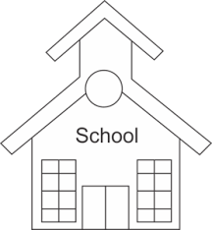
Hollis Innovation Academy Story
Year | CCRPI Score
2012 | 39
2013 | 42
2014 | 45.2
2015 | 44.7
2016 | 39.7
Bethune
Elementary School
Closed May 2016
M.R. Hollis
Innovation Academy
Opened August 2016
42
39
2012
2013
2014
2015
2016
Bethune Elementary School 2012-2016 CCRPI Data

Slide 5
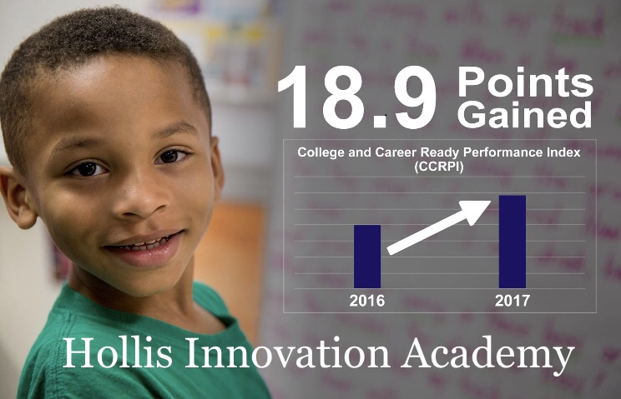
58.6
39.7
Notes:
Turn & Talk
What do you think is critical component to support student growth?

Slide 6
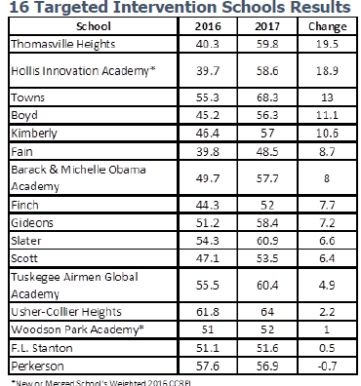
The 10 schools that achieved the highest improvements are
Crim High School (23.9 points), Centennial Academy (21.6), Thomasville Heights Elementary (19.5), Hollis Innovation Academy (18.9), Beecher Hills Elementary (17.9), Charles Drew Junior/Senior Academy (17.4),
Hutchinson Elementary (15.4), Washington High (14.9),
Douglass High (14.2) and
Towns Elementary (13).

Slide 7
Students with involved parents or other caregivers earn higher grades and test scores, have better social skills, and show improved behavior.
Research shows that effective teachers are one of the most important factors contributing to student achievement.
“The answer lies within the school culture—principals need to create a positive school culture that promotes learning and engagement for students and adults.
Yes, all the other roles and responsibilities of a school principal are important. But a positive school culture is imperative.”

Slide 8




Challenge you to do more than what you think possible & Success is when your entire CREW achieves
Research driven and pedagogically sound practices
Notes:
Discuss Flexibilities and Autonomies that allow Hollis to be able to choose it’s own school reform model and curriculum, manage the budget creatively and create unique positions.
Talk specifically about our EL Education Program

Slide 9
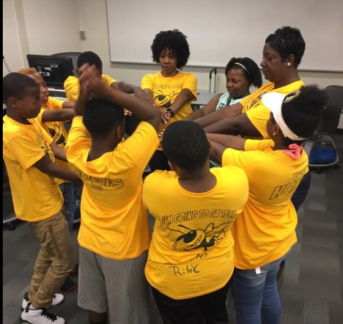
A Focus on Culture & CREW
Culture & CREW
We work hard to create an environment where children and staff feel safe to learn and have a sense of belonging.
"We are CREW not Passengers!"
Notes:
What else makes Hollis unique – a unwaivering focus and attention to CREW and Culture.

Slide 10
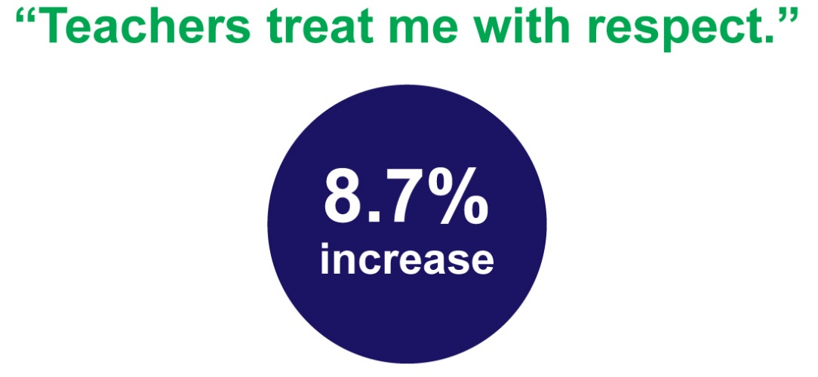
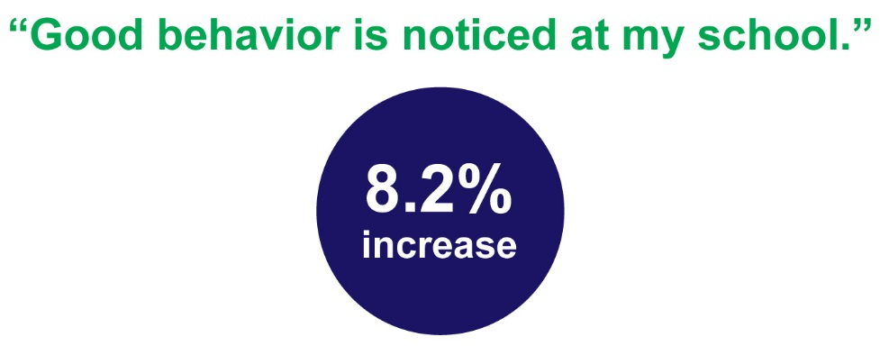
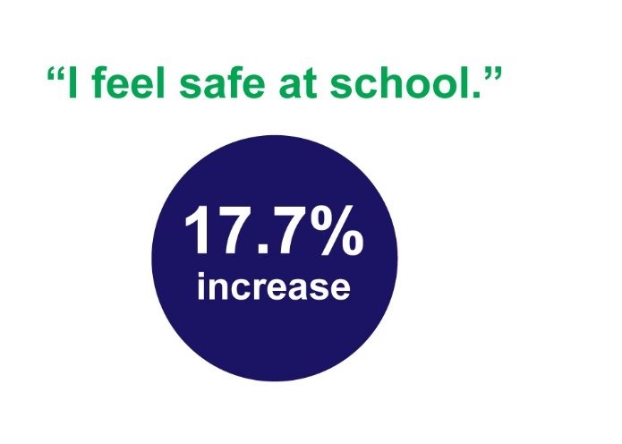
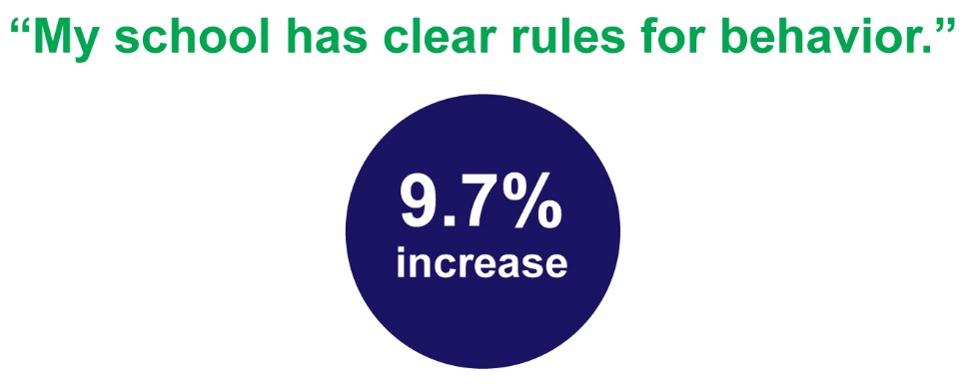

Slide 11
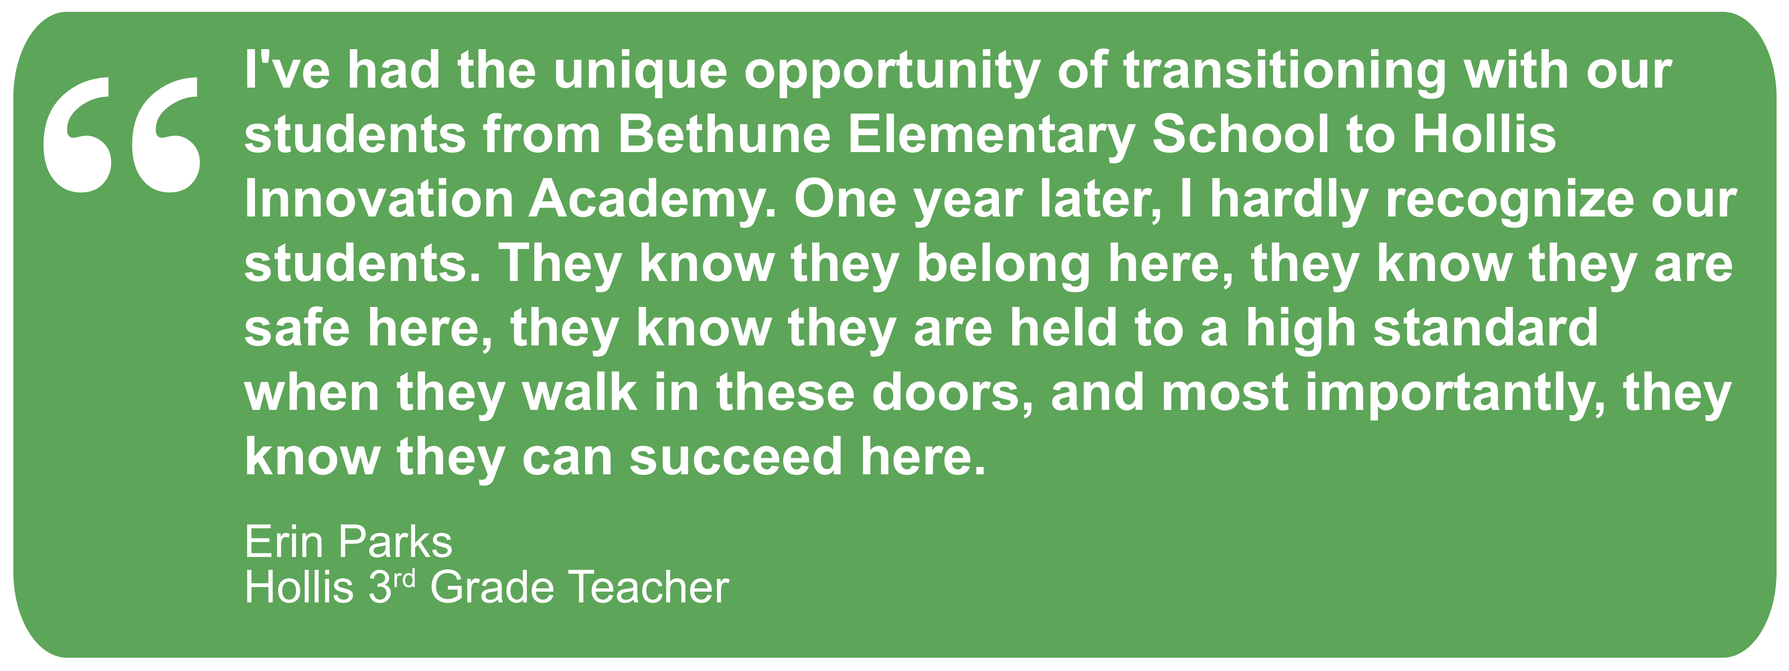
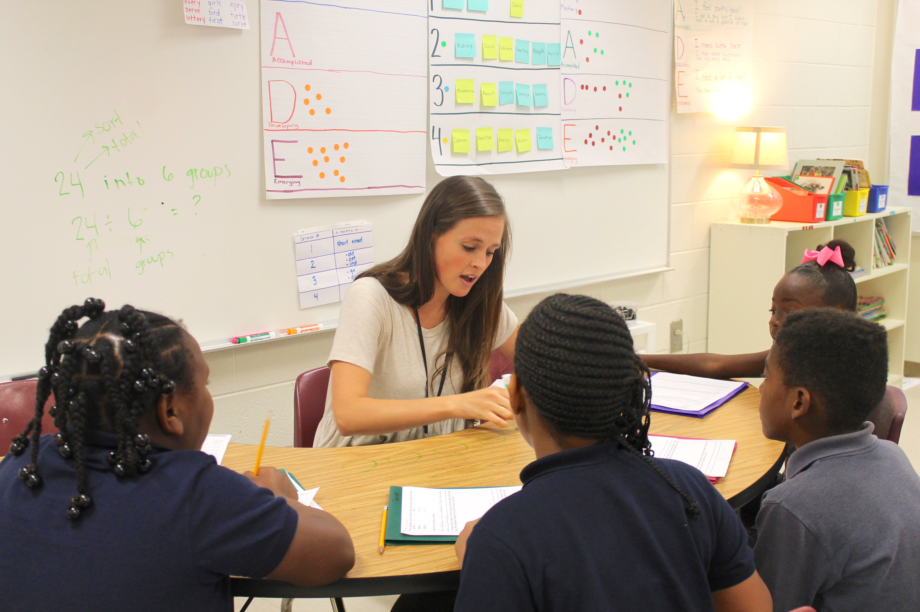
Notes:
How do we create belonging?

Slide 12





Hollis Innovation Academy
CREW HOUSES

Slide 13
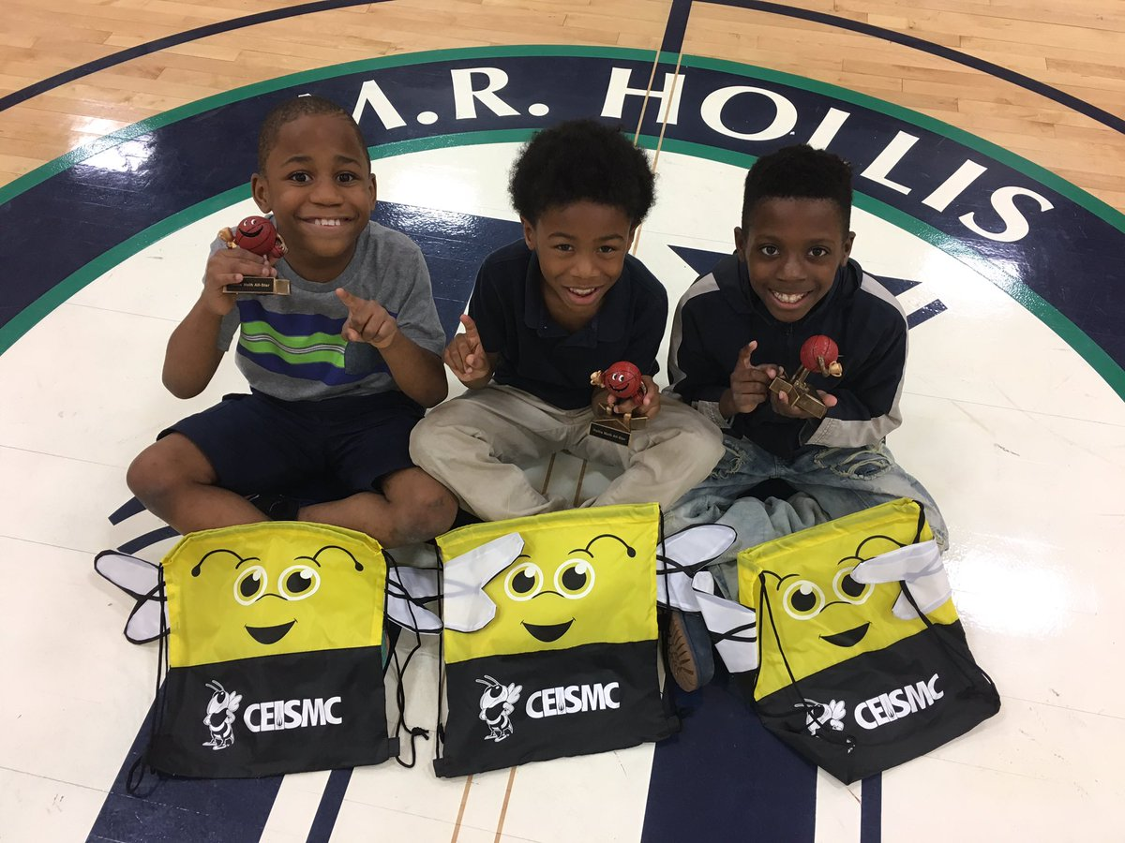
6 Habits of Hollis
_____________
Communication
______________
______________
Self-Discipline
______________
Notes:
Students will quiz the audience. Who knows the missing Habit of Hollis. Provide a T-shirt and share the importance of Collaboration on a daily basis.

Slide 14
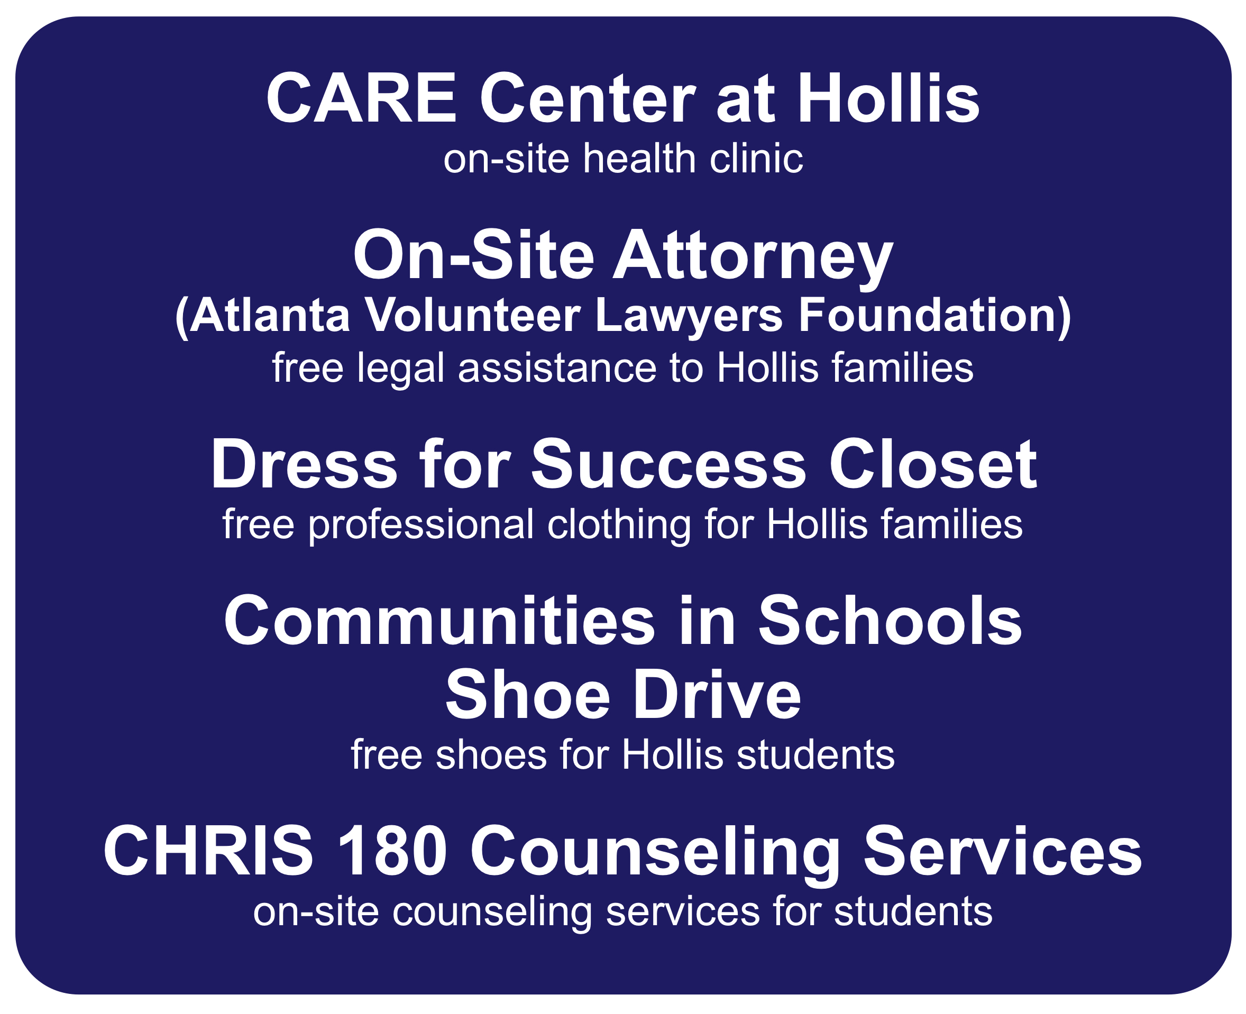
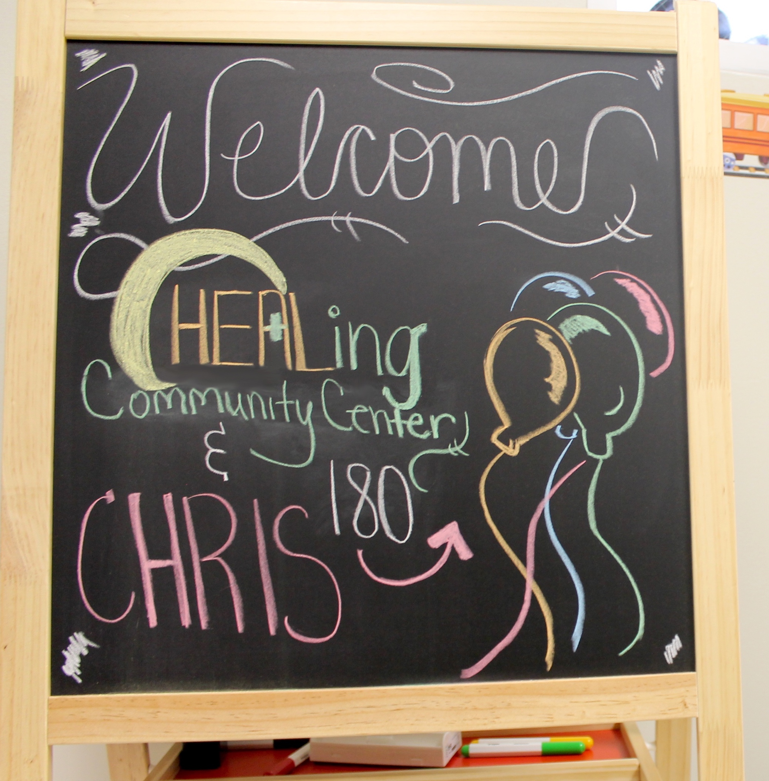
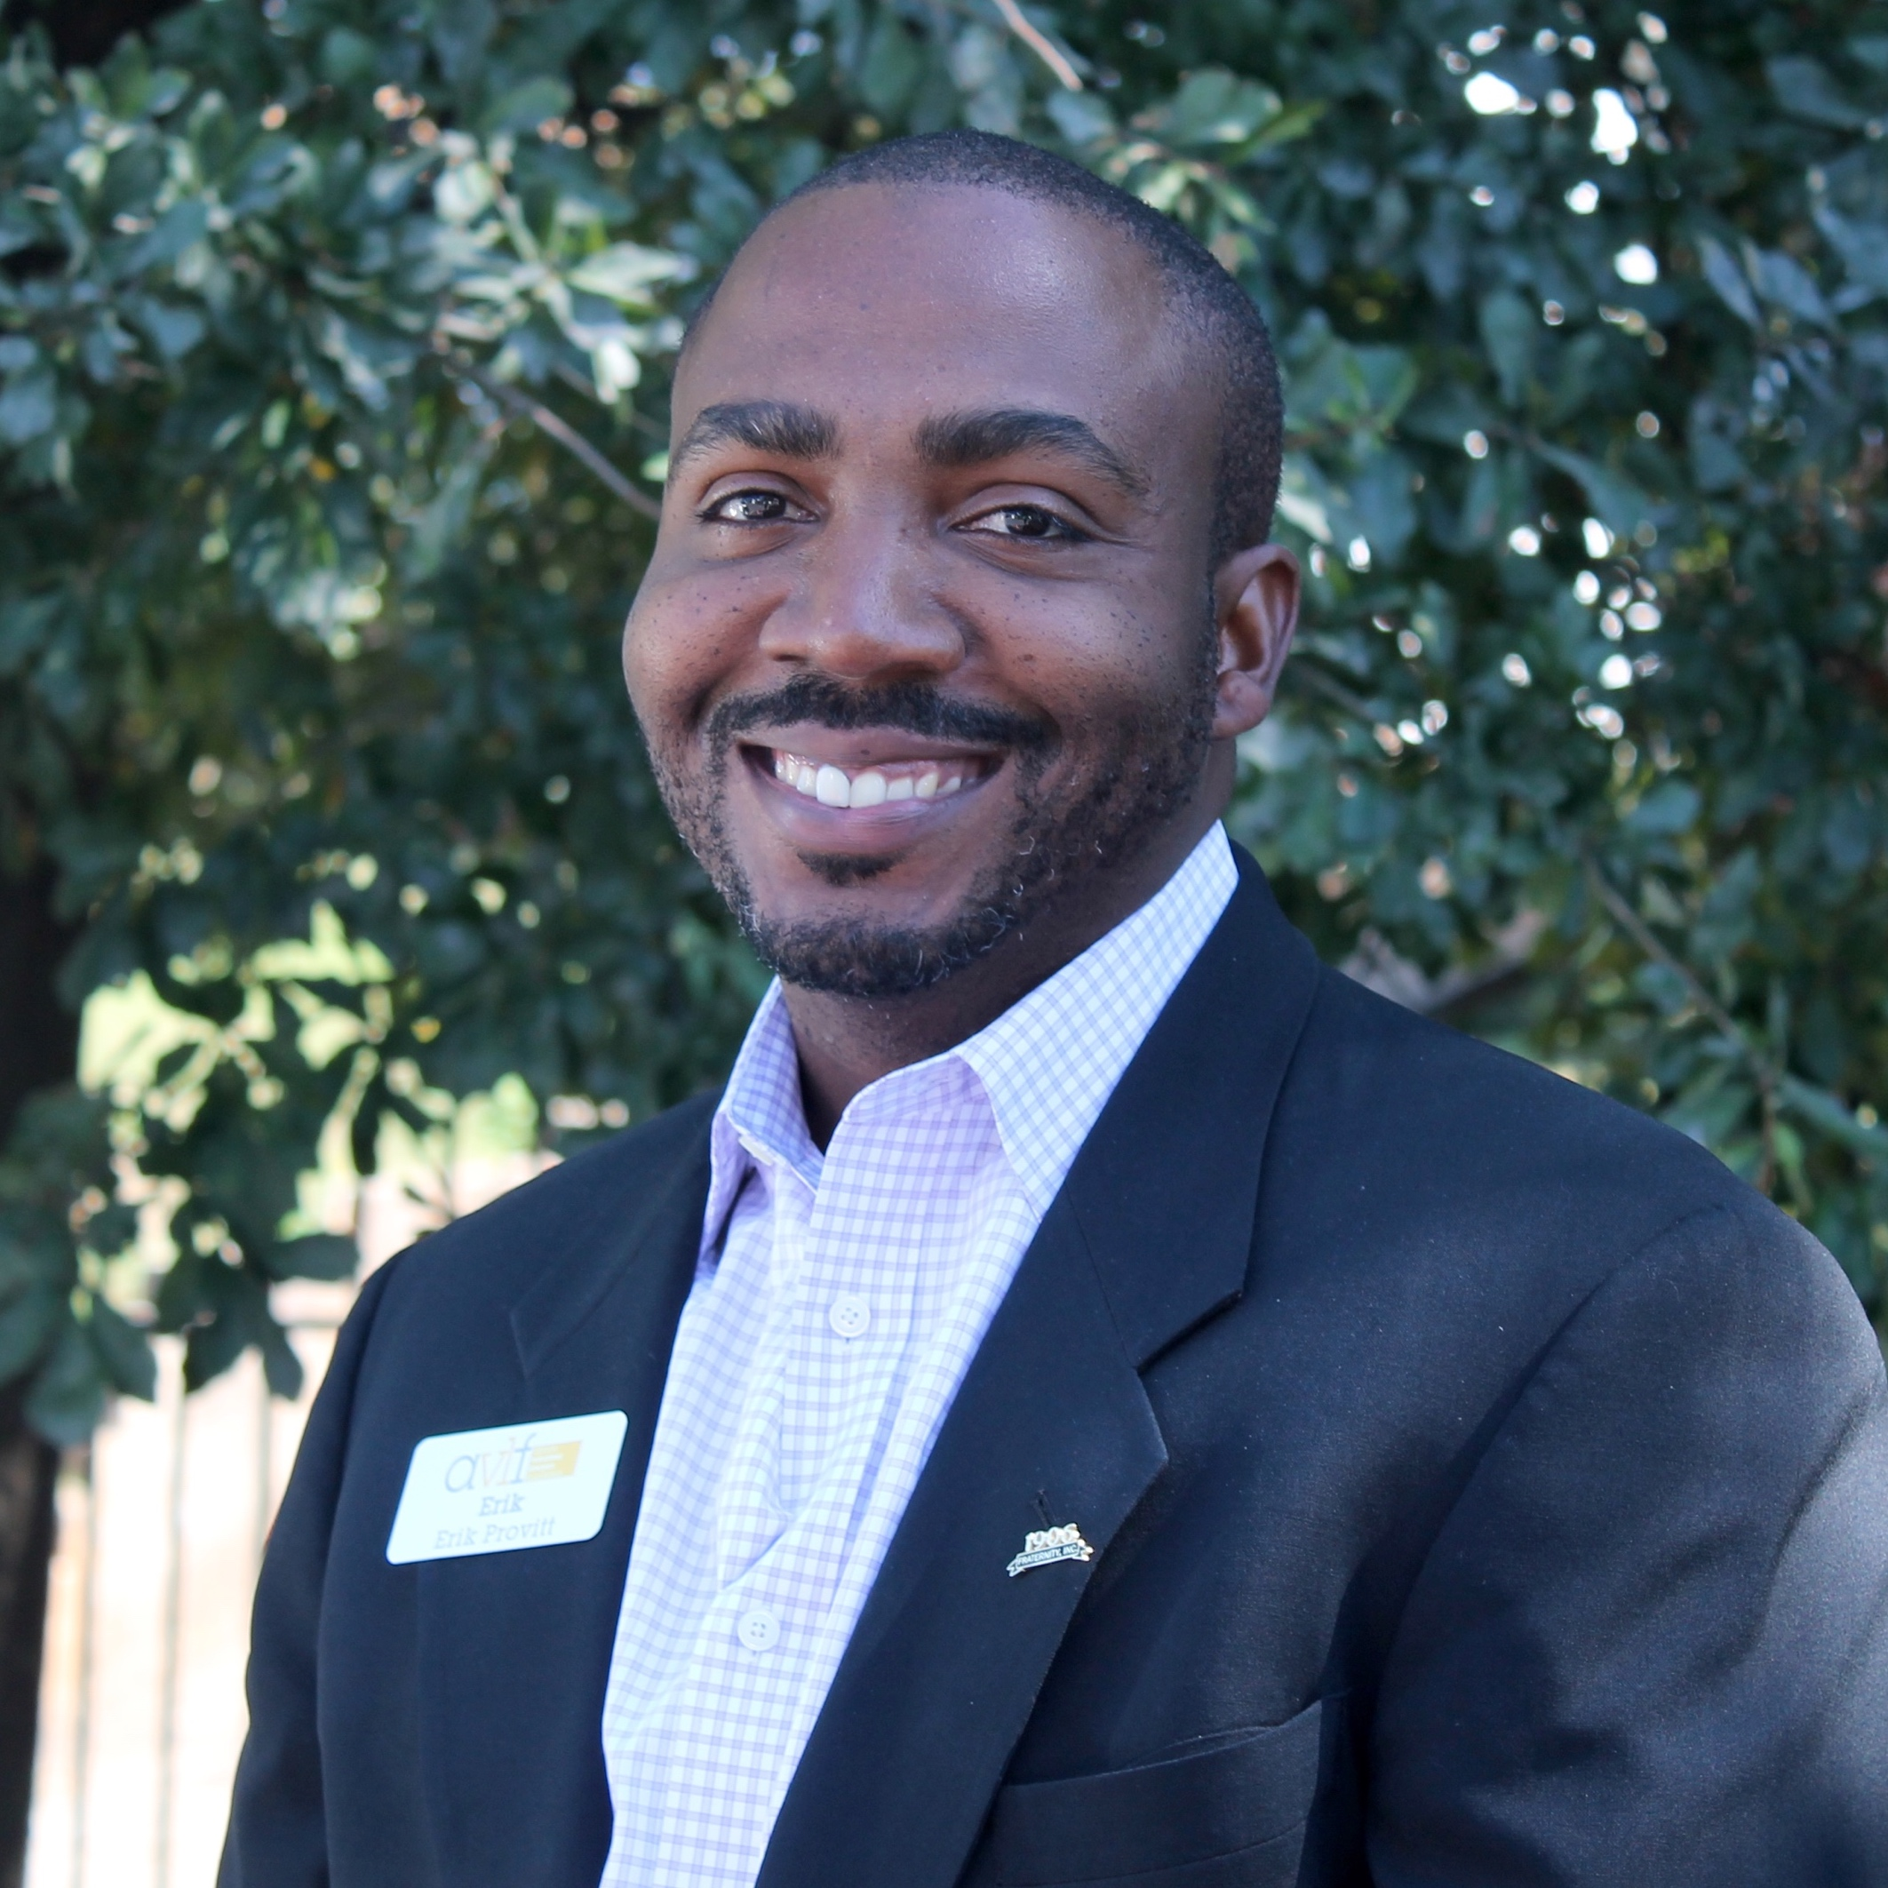
Notes:
We also believe that culture is beyond just the classroom and extends into the community. We believe Hollis is an will be a community driven school. Introduce GO Team

Slide 15
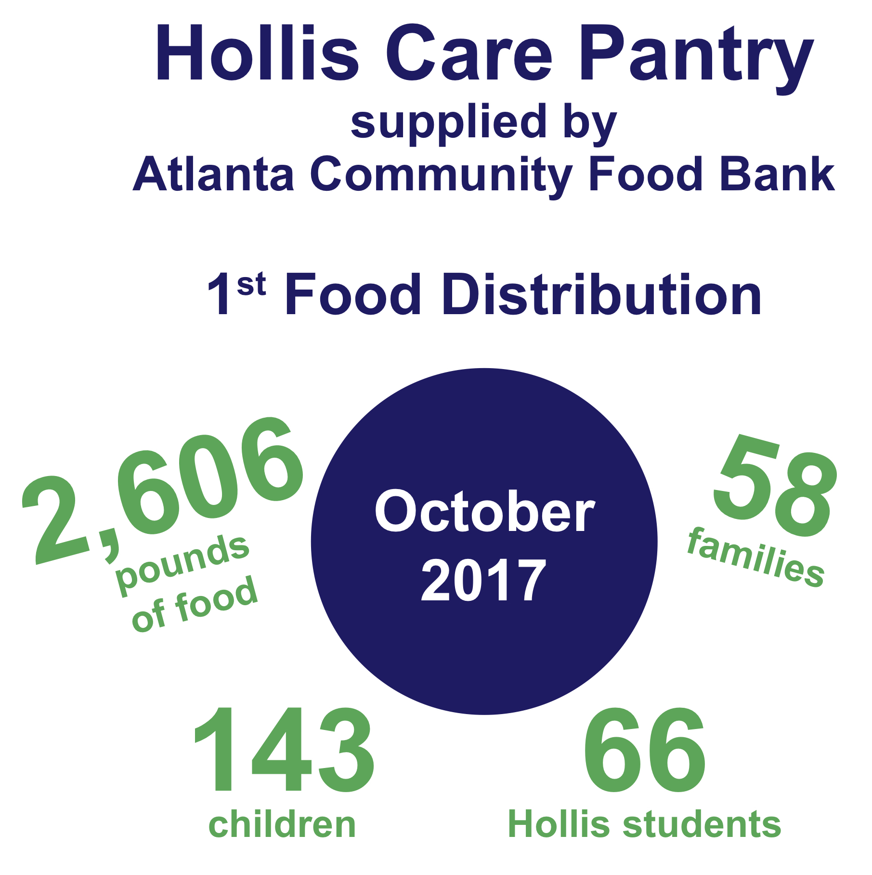
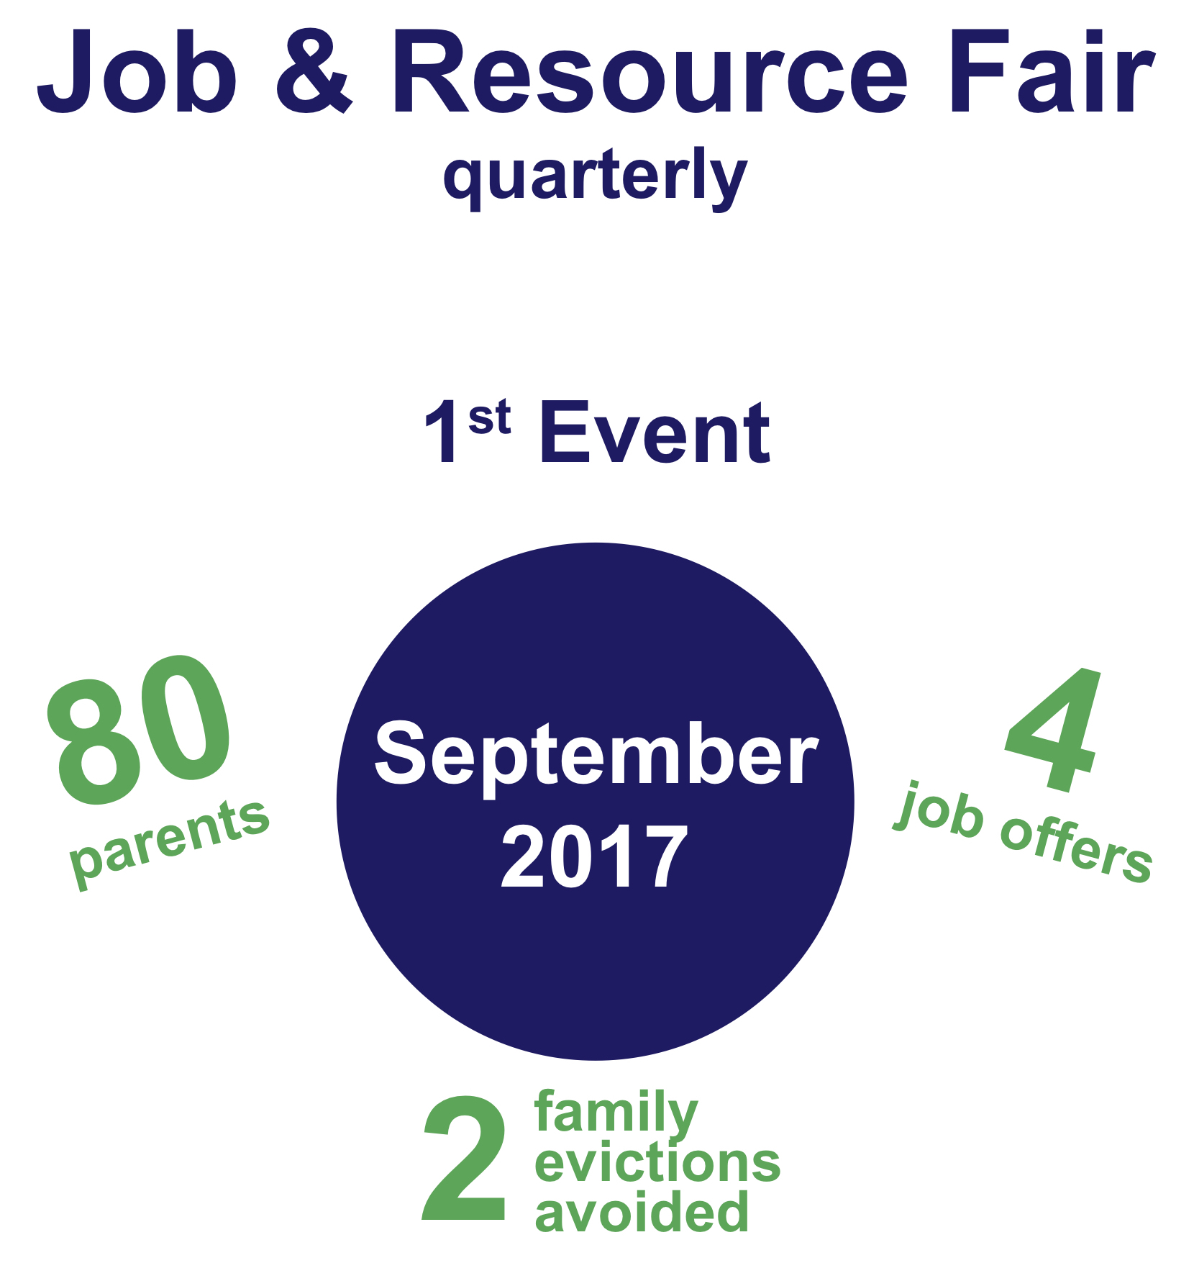
Parents & Community

Slide 16
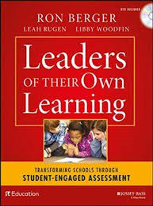


Robust Curriculum, Instructional Best Practices & Professional Development

Slide 17

Lower School PK - 4
Modules | KDG | 1st | 2nd | 3rd | 4th
1 | Toys & Play | Tools & Work | Schools & Communities | Overcoming Challenges Near and Far | Poetry, Poets & Becoming Writers
2 | Weather Wonders | Sun, Moon & Stars | Fossils Tell of Earth’s Changes | Adaptations & the Wide World of Frogs | Animal Defense Mechanisms
3 | Trees are Alive | Birds Amazing Bodies | The Secret World of Pollination | Exploring Literacy Classics | American Revolution

Slide 18
Upper School 5 - 8
Modules | 5th | 6th | 7th ⁽²⁰¹⁸⁻²⁰¹⁹⁾ | 8th ⁽²⁰¹⁹⁻²⁰²⁰⁾
1 | Human Rights | Myths: Not Just Long Ago | Journeys & Survival | Finding Home: Refugees
2 | Biodiversity in the Rainforest | Rules to Live By | Working Conditions: Then & Now | Taking a Stand
3 | Athletes: Leaders of Social Change | Sustaining the Oceans | Slavery- The People Could Fly | The Civil Rights Movement and the Little Rock Nine
4 |  |  | Screen Time and the Developing Brain | Sustainability of the US Food Supply Chain

Slide 19

Summer Bridge Program for rising 6th grade students
Myths: Not Just Long Ago & Coding Project

Slide 20
STEM Program @ Hollis - Innovation for Change
Computer Science & Engineering Fields Focused
 | Kindergarten - 2nd | 3rd – 4th | 5th – 6th | 7th & 8th
Program | Fundamentals in Coding-Code.org Scratch Jr. Message From Me Basic Computer Skills/Programming Level 1 & Level 2 Maker Tools Introductory Principles in Engineering and Design Design and Design Makerspace Projects Finch Robotics GA Tech Hollis Innovators Support | Hummingbird Robot CS-First - Scratch Fundamentals in Coding - Code.org 3-D Design App Development & Design Level 1-3 Maker Tools GA Tech Hollis Innovators Support | Hummingbird Arduino Makey Makey Code.org/Computer Science Discoveries GA Tech Engineering App Development & Design Robotics 3-D Design w/TinkerCAD and ONShape Level 1-4 Maker Tools GA Tech Hollis Innovators Support | Arduino Code.org/ Computer Science Discoveries GA Tech Engineering App Development & Design Robotics 3-D Design w/TinkerCAD and ONShape Level 1-4 Maker Tools GA Tech Hollis Innovators Support

Slide 21
STEM Program @ Hollis - Innovation for Change
Computer Science & Engineering Fields Focused
 | Kindergarten – 2nd | 3rd – 8th
Extra Curricular & Clubs | Dash & Dots KinderCODERS Hollis Mini-Hackers Jr. First Lego League Makers-Monday Hollis Garden Club/ Cooking Matters | Game Changers Coding Club iBots Robotics Team First Lego League Hollis Hackers Georgia Tech Inventure Squad Hollis Garden Club/Cooking Matters APS Technology Fair Team Technovation - App Development Team

Slide 22

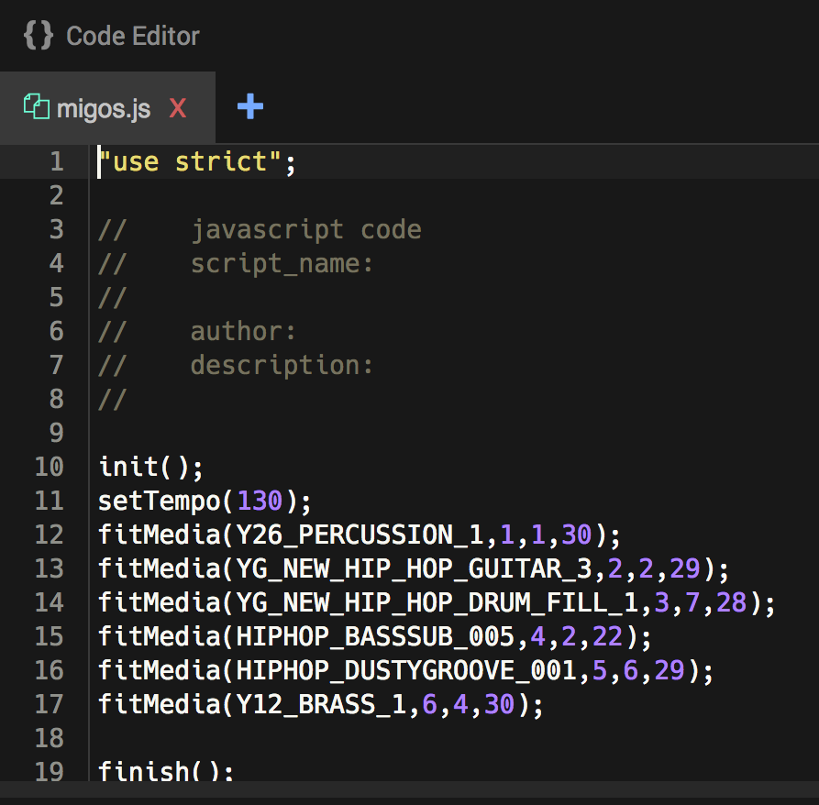
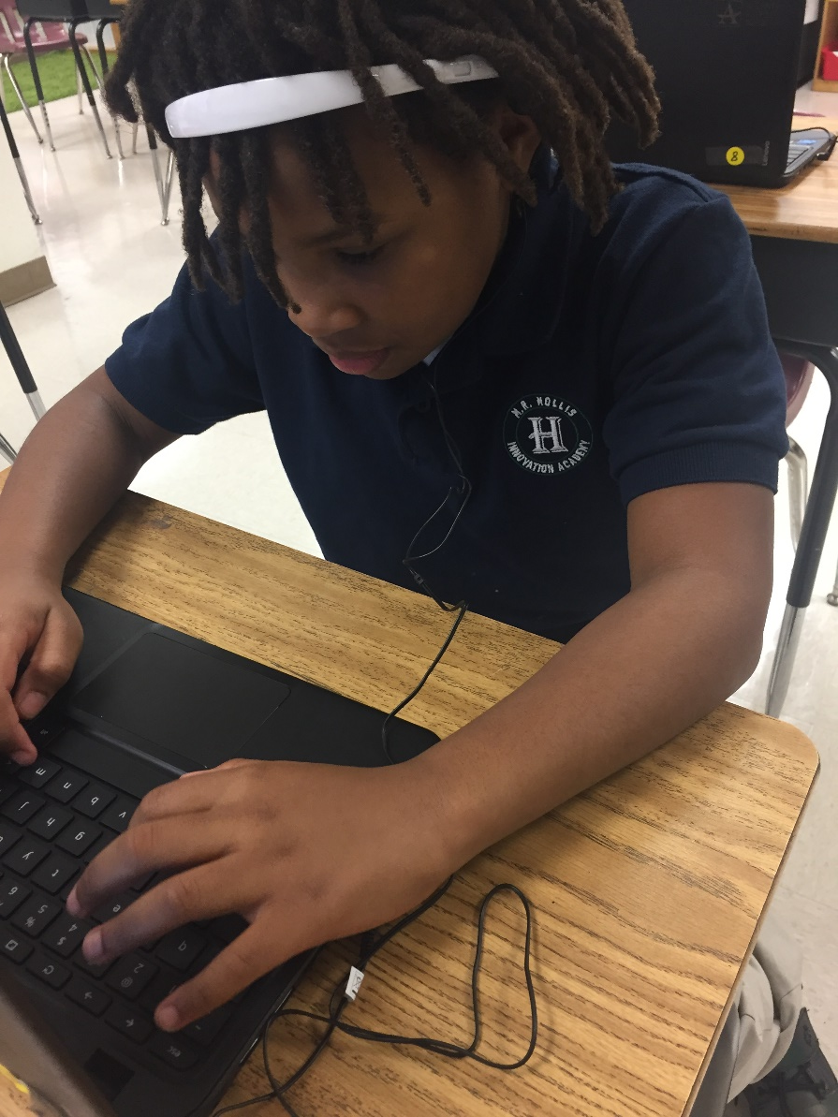
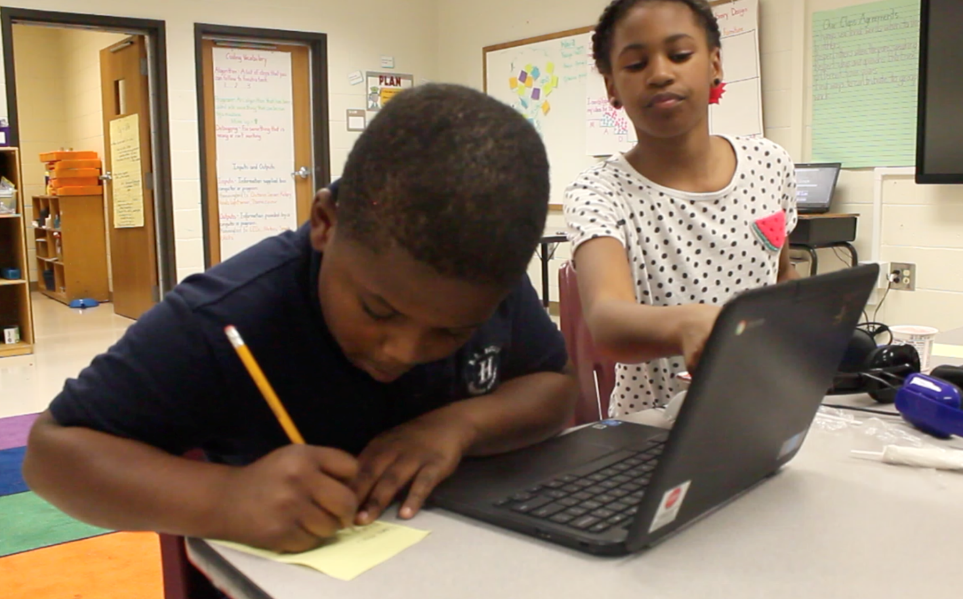
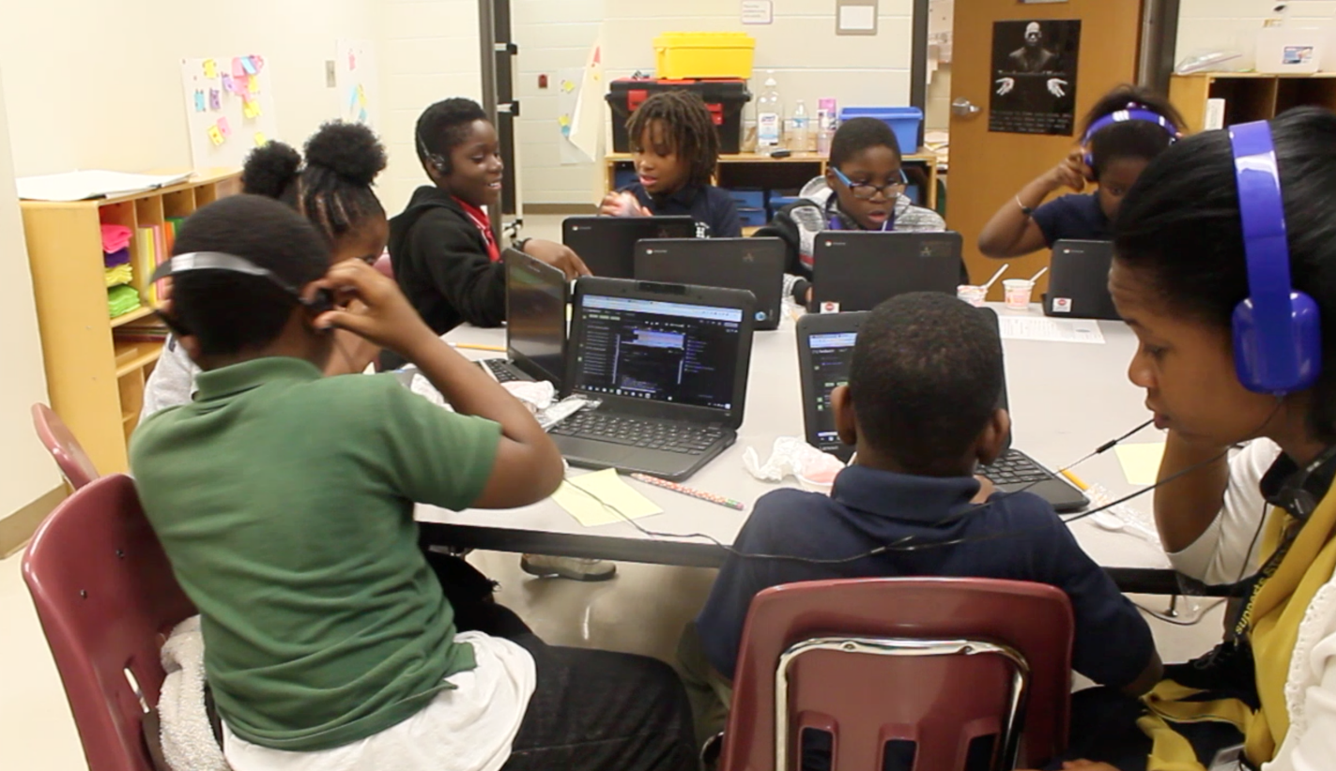
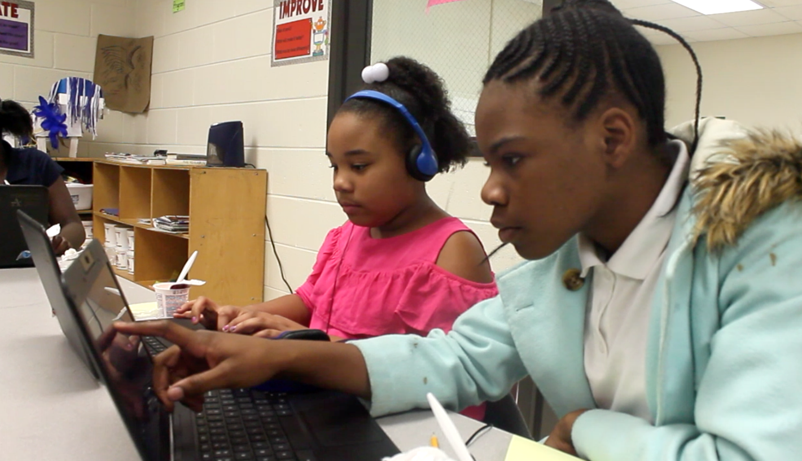

Game Changers Coding Club
Students use EarSketch, a coding application, to create music

Slide 23
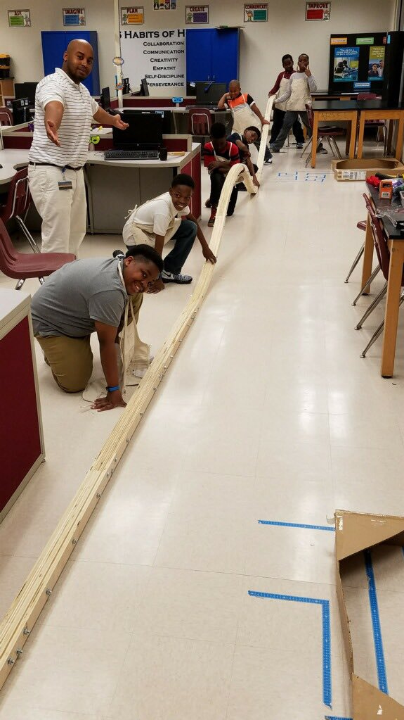
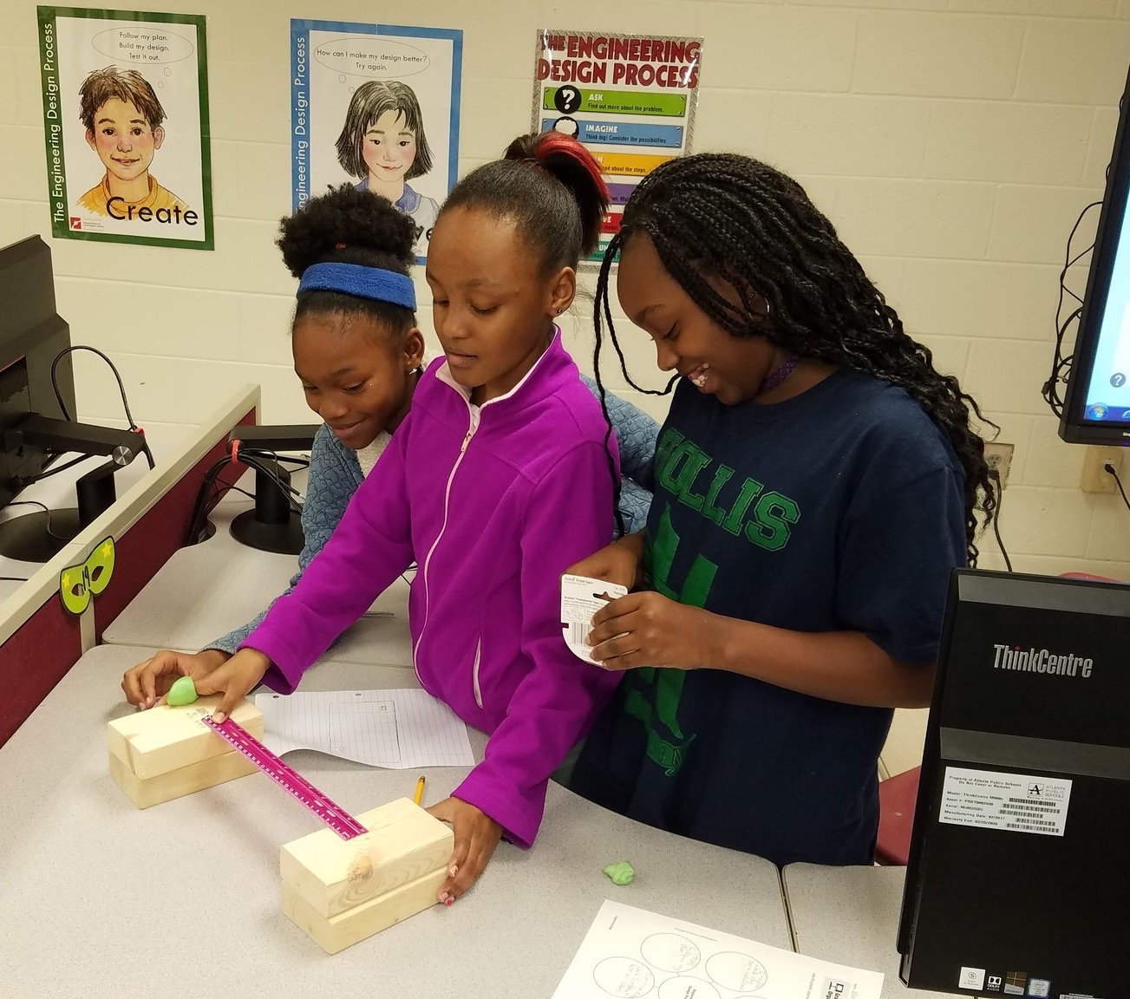
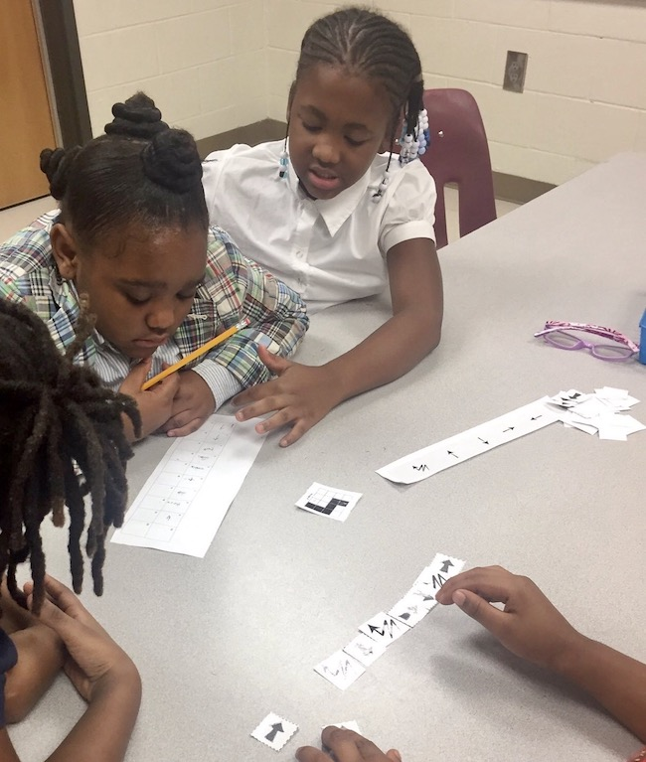
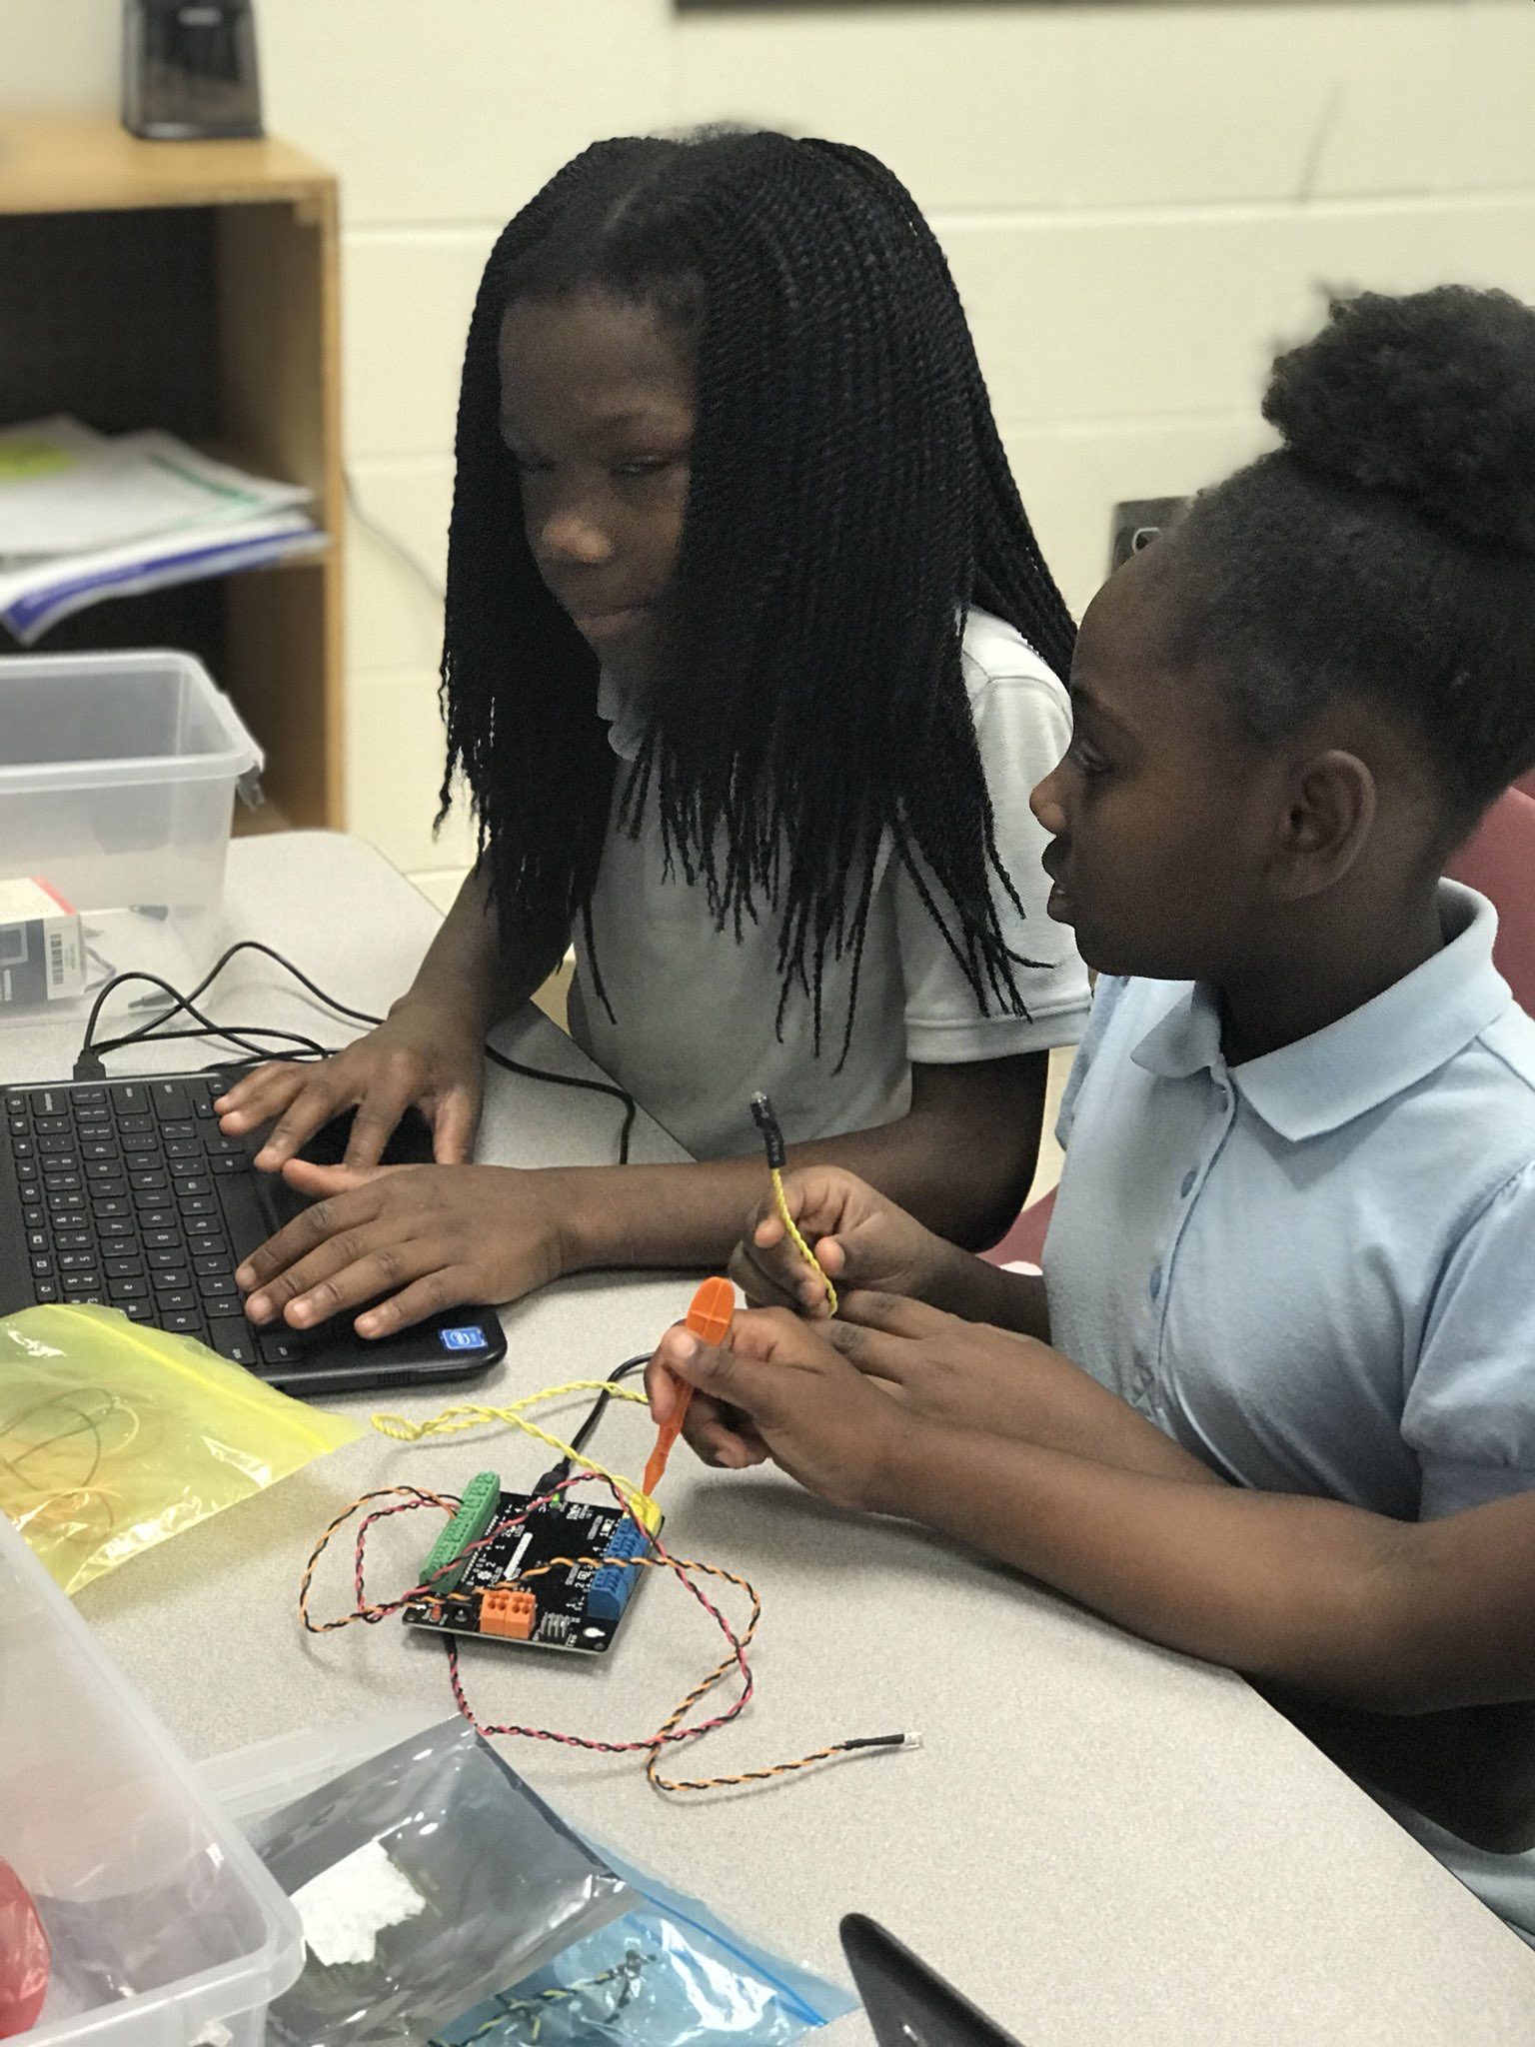
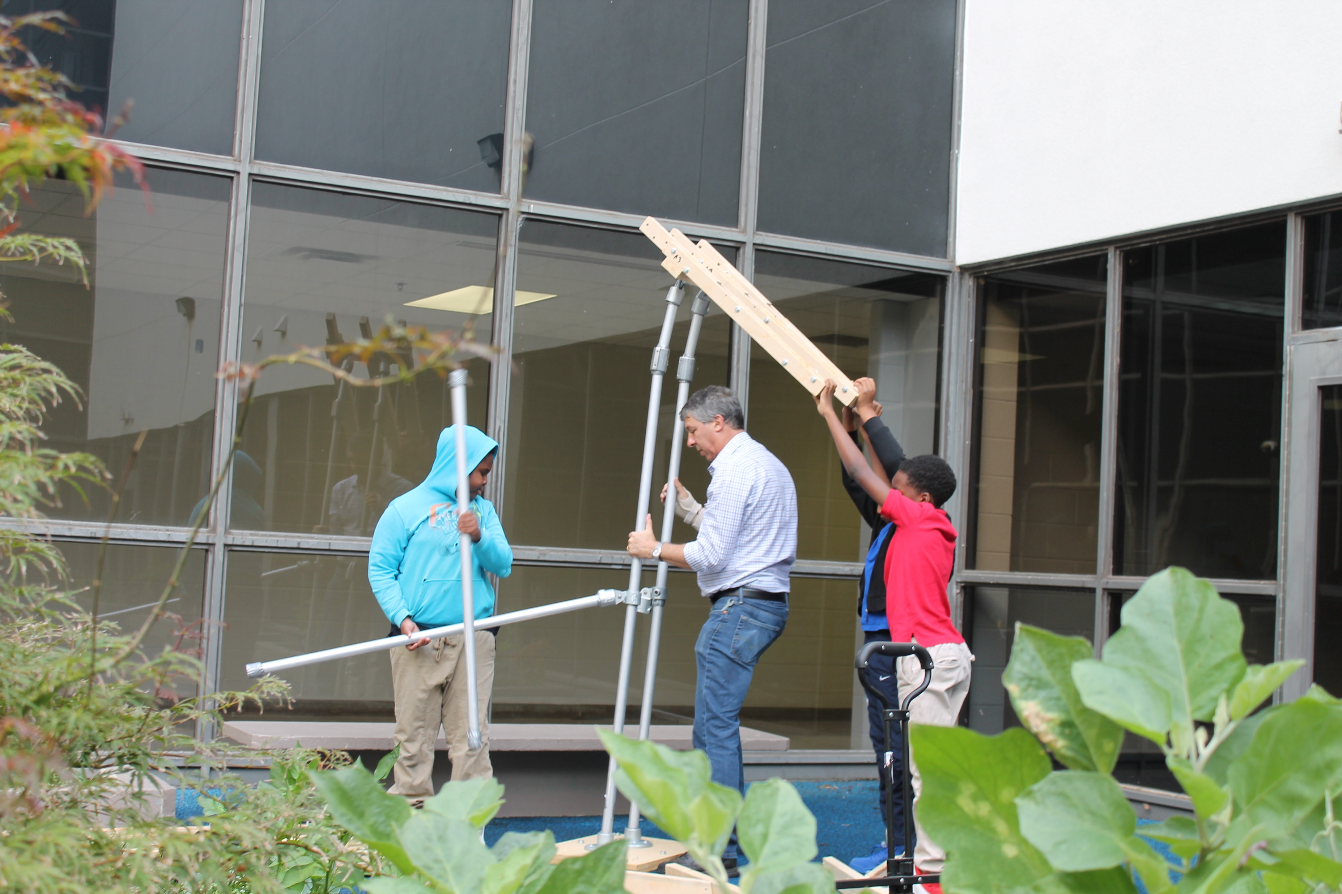
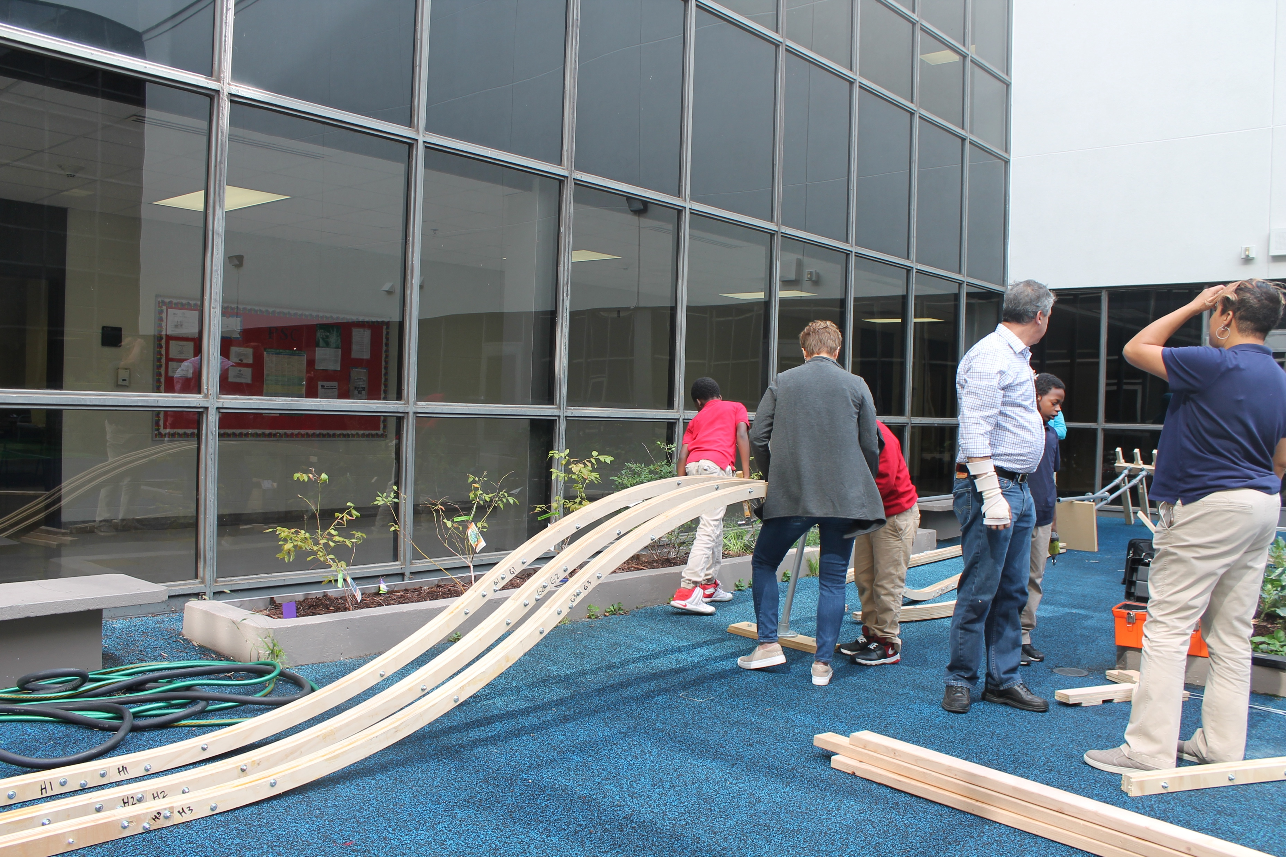
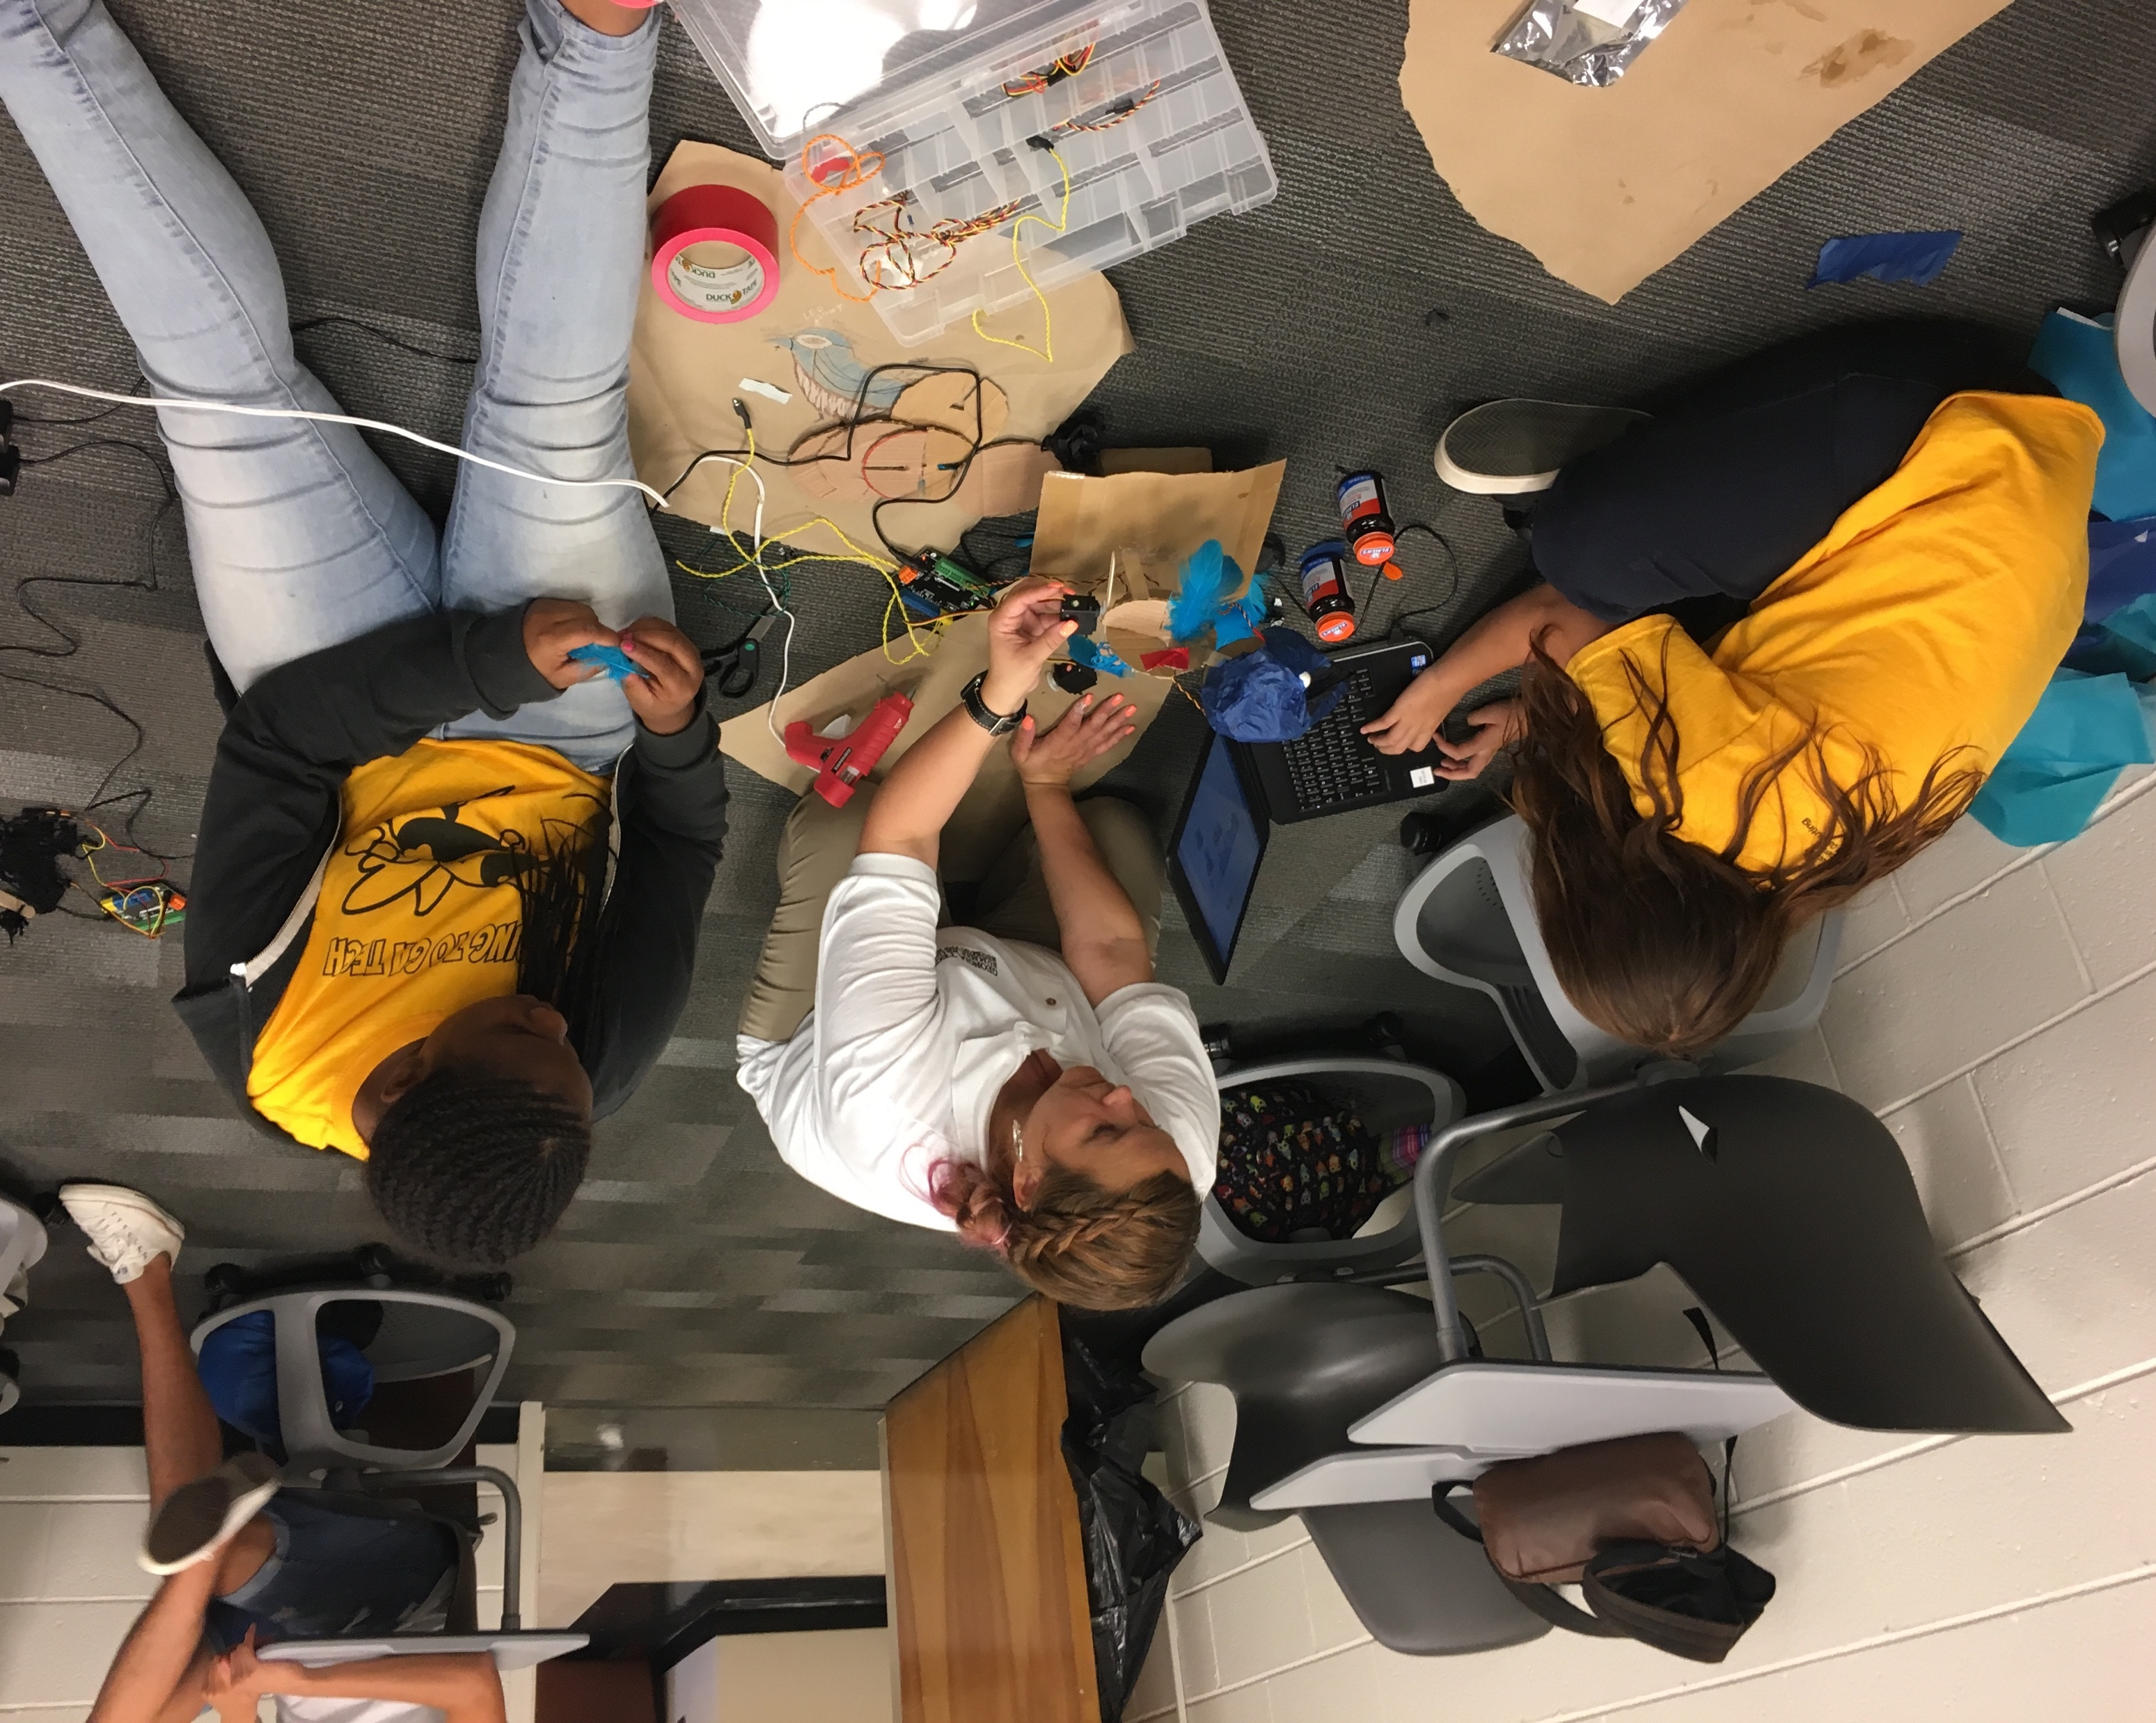
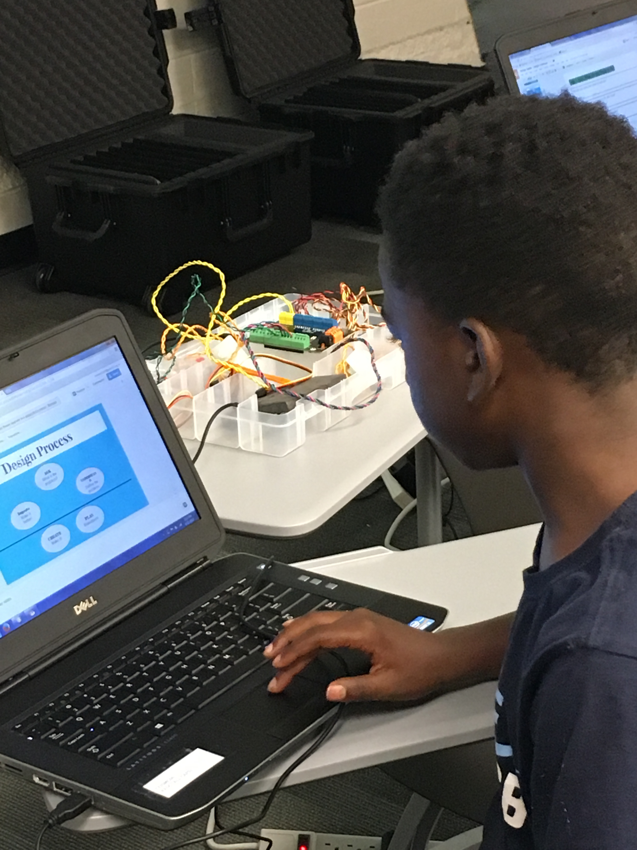
4 Innovators-in-Residence
  Animatronic Puppeteer
  Civil Engineer & Woodworker
  Aerospace Engineer
  Computer Scientist

Slide 24
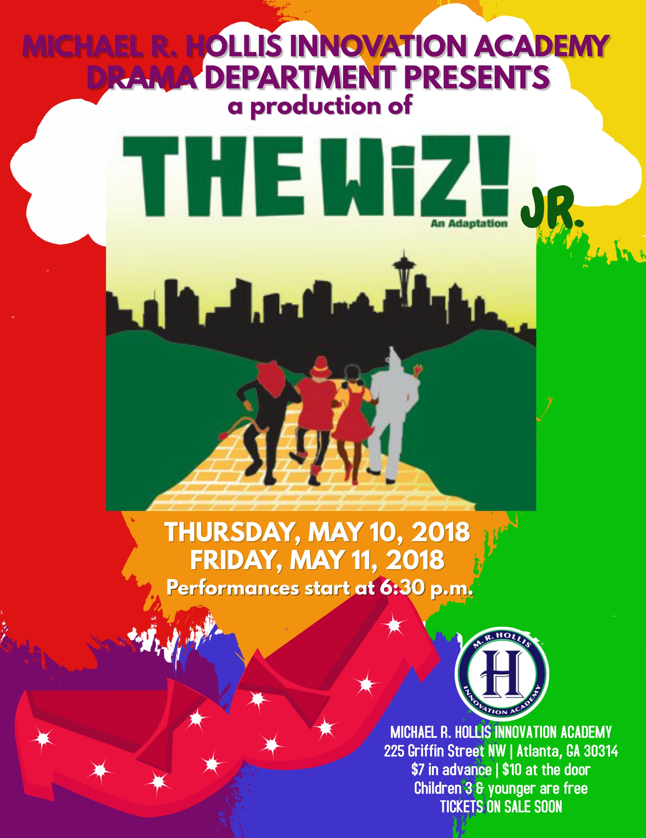

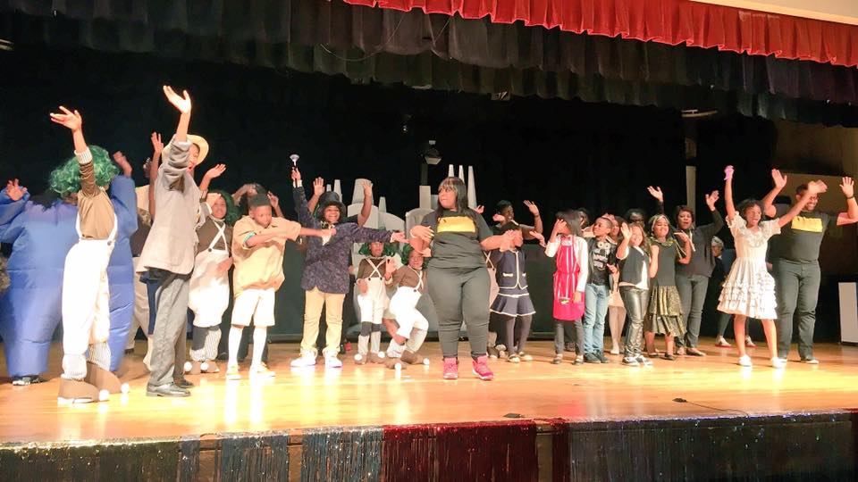
The Arts

Slide 25
Extended Learning Opportunities
Summer P.E.A.K.S.
@ Georgia Tech
Rising 3rd – 5th Graders
Horizons Summer Program
@ Georgia Tech
Summer Bridge
@ Georgia Tech
Rising 1st Graders
Rising 6th Graders
Breakthrough Atlanta
High Flyer Tutorial Program
Rising 7th & 8th Graders
2nd – 6th Graders
(2:45 – 5:00 PM)

Slide 26
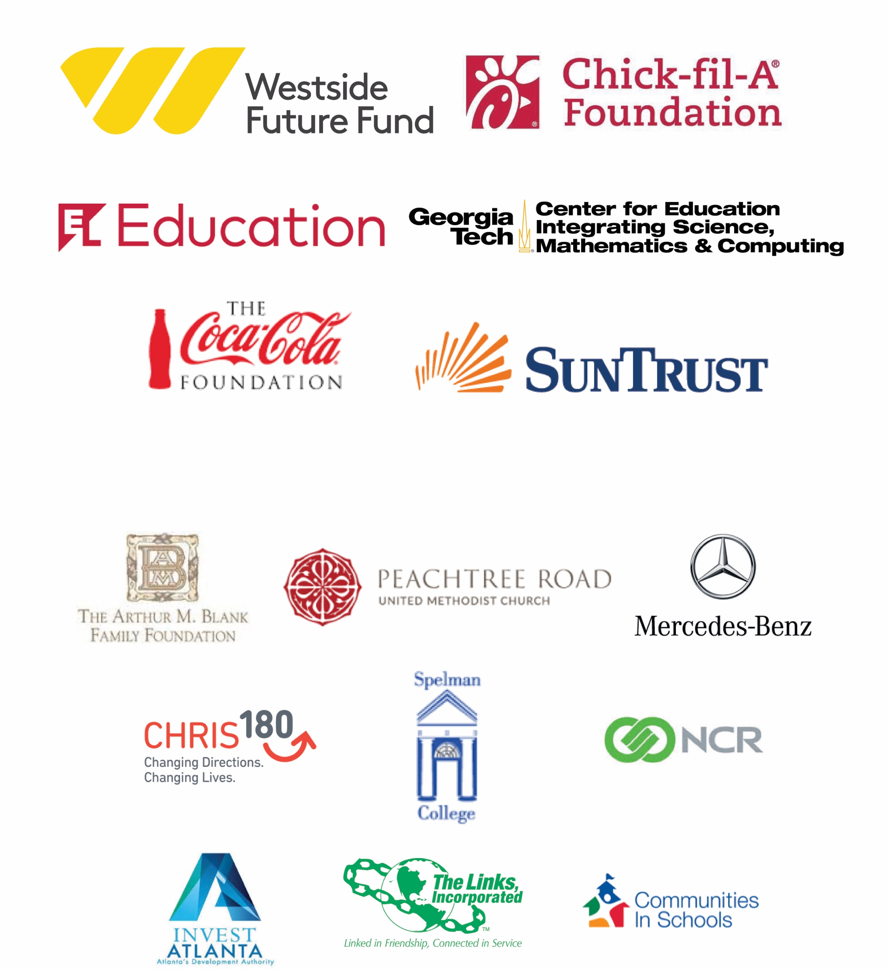
Hollis could not get here without the robust support of our partners.

Slide 27
