Slide 1
WELCOME TO THE
Transform Westside
Summit

Slide 2

Opening Speaker
Quincy Springs
Owner/Operator, Vine City Chick-fil-A

Slide 3
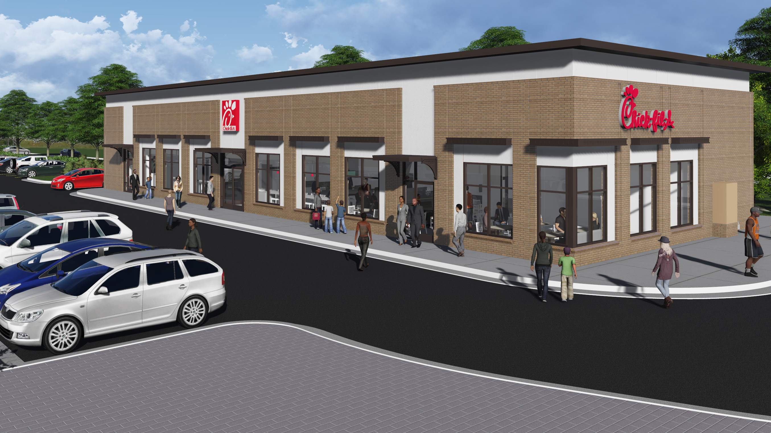

Amat Victoria Curam:
Victory Loves Preparation
QUINCY L. A. SPRINGS, IV
OWNER/OPERATOR

Slide 4


VISION: Remarkable Light
LEAD/MOTIVATE/CULTIVATE WITH E-L-S
Flawless Execution Genuine Love Great Stewardship
Business Scripture: “You are the light of the world. A town built on a hill cannot be hidden. Neither do people light a lamp and put it under a bowl. Instead they put it on its stand, and it gives light to everyone in the house. In same way, let your light shine before others, that they may see your good deeds and glorify your Father in heaven.” Matthew 5: 14-16
Vine City Chick-fil-A’s cultural concept is to be a REMARKABLE LIGHT.
Personal Vision: Regents Axiom - “A leader is like a Shepard. He sends the most nimble sheep ahead, whereupon the others follow, not realizing that they are being directed from behind.”
Notes:
Messaging is a mix
Commitment – From the top down inspiration and defining culture.
How employees are dispositioned to respond to messaging.
Perceptions – Is my company right. Is my company going the right direction? Do they justify and communicate why we’re going that direction, does it make sense?
Attitudes – Do I agree with my company? Agreement with the company’s position and direction
CAPABILITY – What employees do? Comes from the bottom up
Motivations – Is this change good? Why is it good? What’s the incentive to change?
Behaviors -

Slide 5


Slide 6
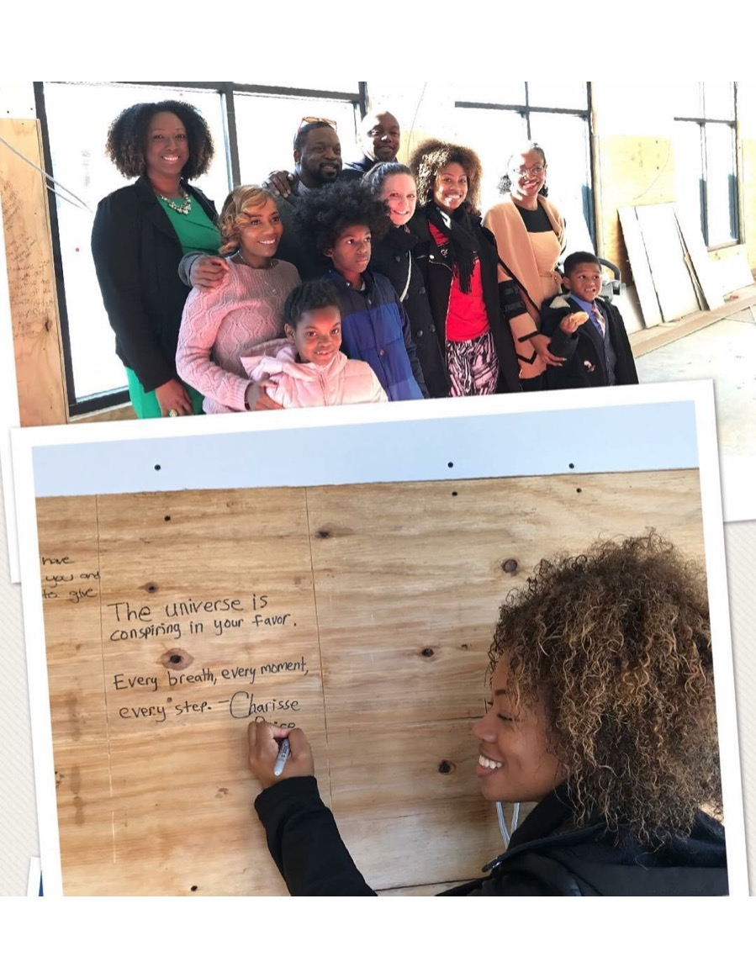

Slide 7
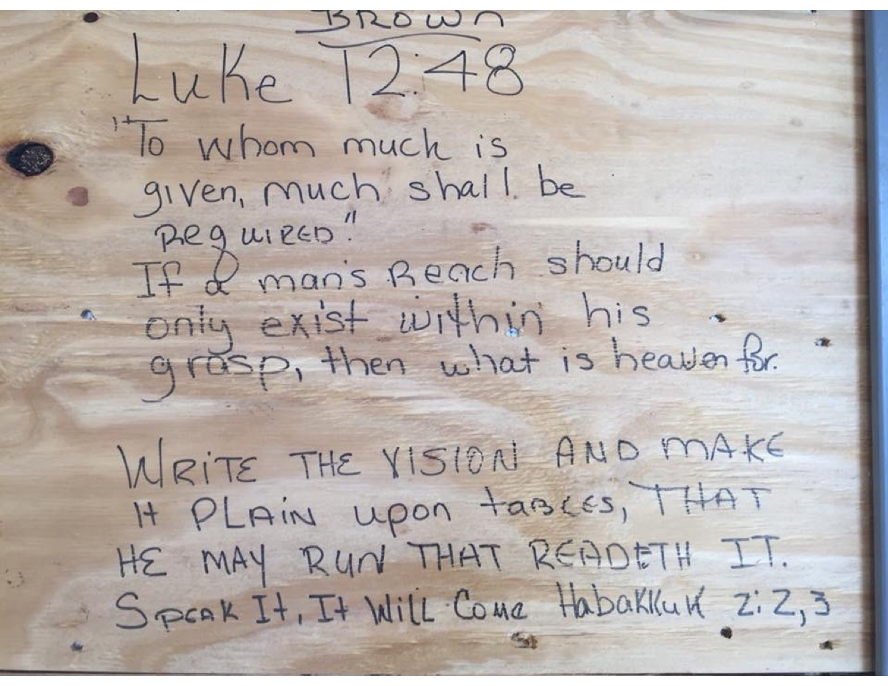

Slide 8


Slide 9
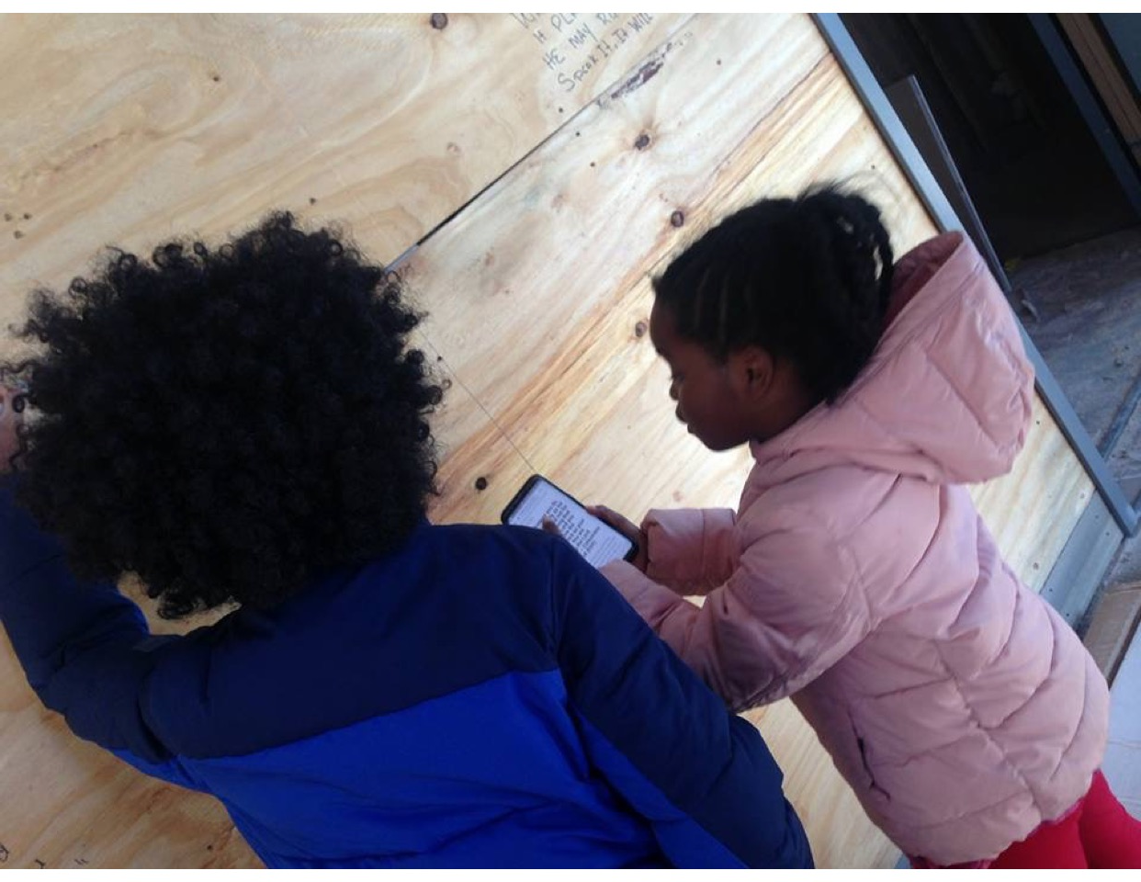

Slide 10
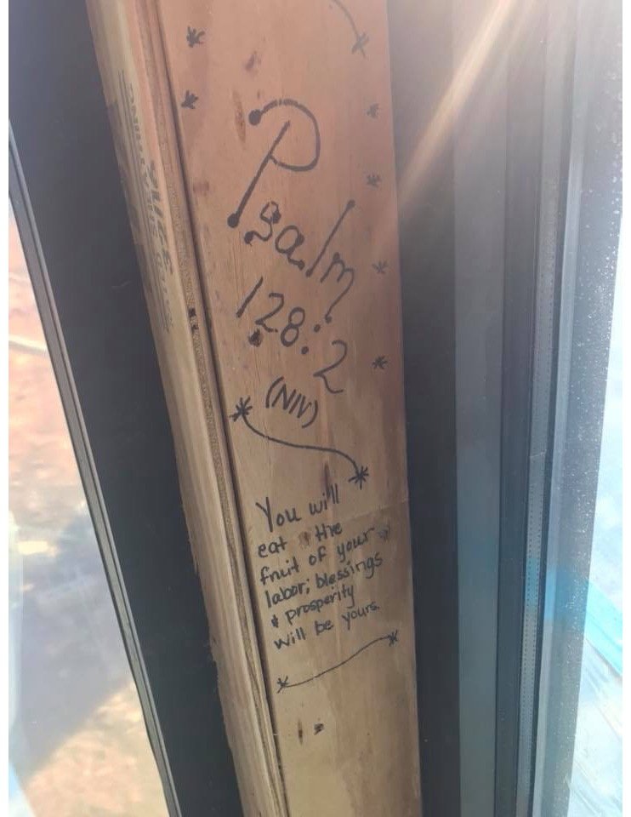

Slide 11
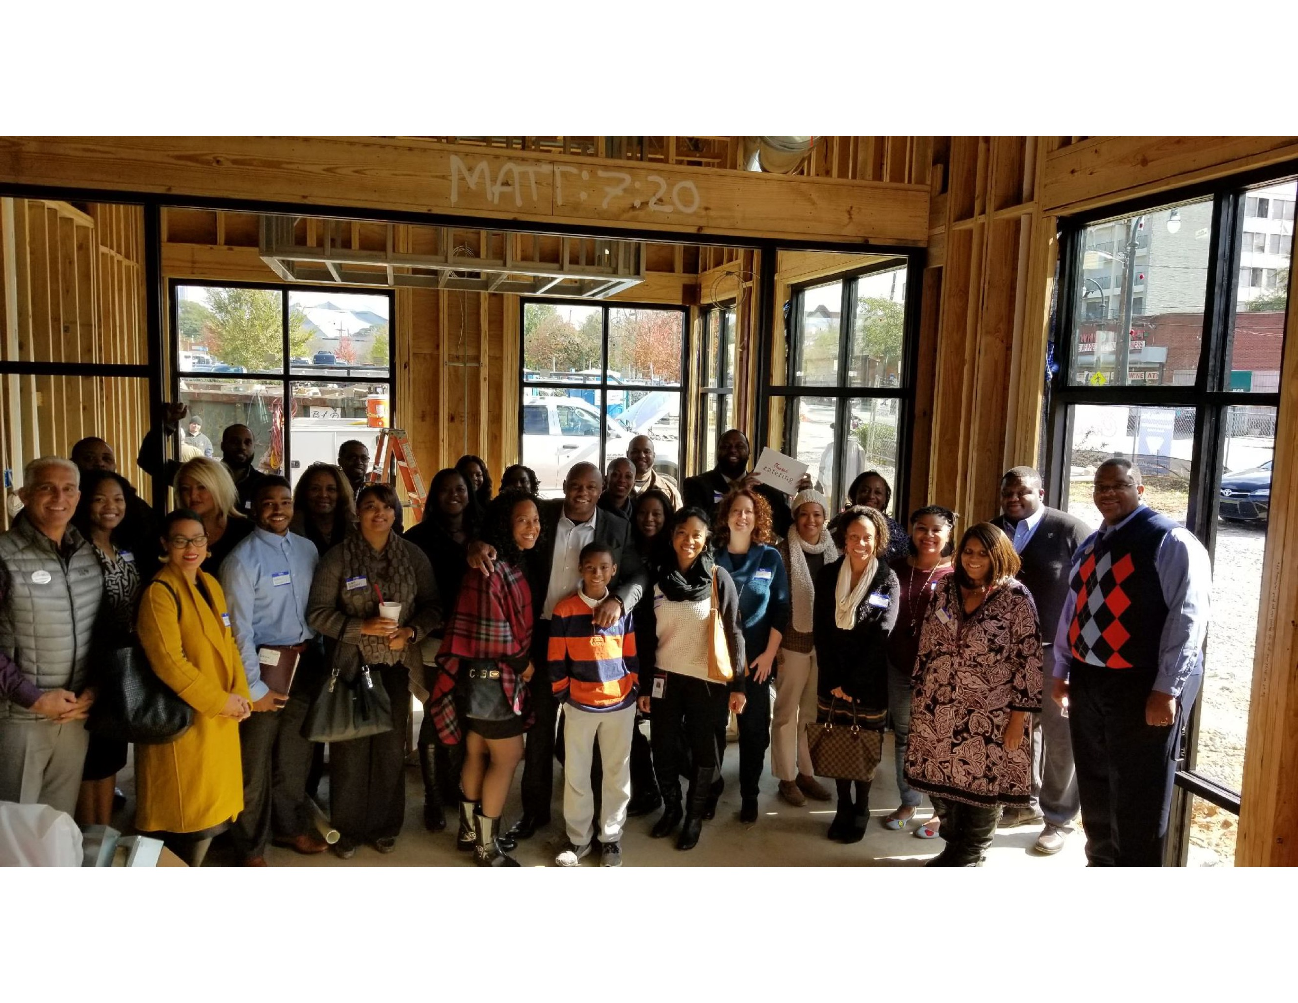

Slide 12
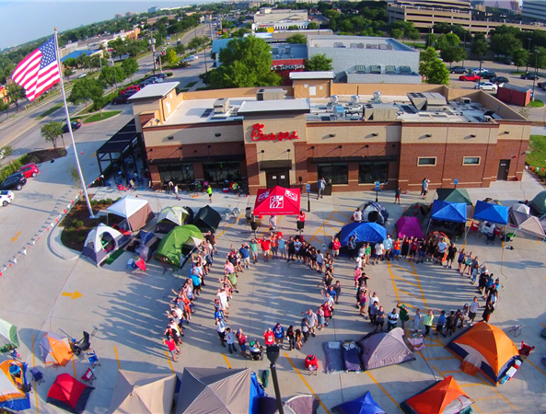
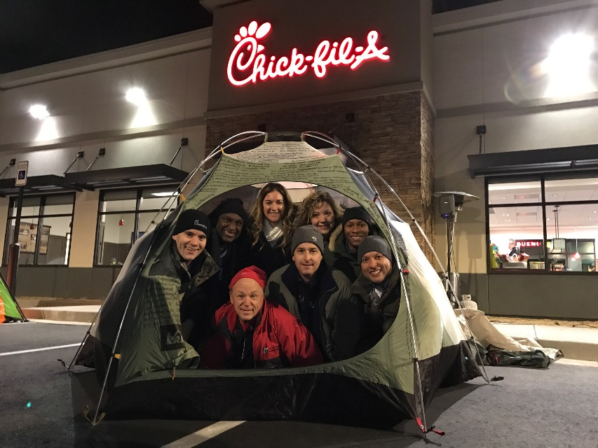

Save the date!
First 100 +
CEO Impact Day and Campout
Wednesday, January 17, 2018 – Thursday, January 18, 2018
Vine City Chick-fil-A Restaurant on Martin Luther King, Jr. Drive
Join us in supporting the Westside community by camping out with us at the grand opening of the new Chick-fil-A restaurant in Vine City.

Slide 13
Transform Westside
Summit

