Slide 1





*KIDS COUNT Data Center 2016
Poor Outcomes for Georgia Youth*
According to the Annie E. Casey Foundation, Georgia ranks 42nd in Child Well-Being
17% of 20-24 year olds are not in school
and not working (15% in U.S.)
21% do not graduate from high school in 4 years (16% in U.S.)
39% live in single-parent families
(35% in U.S.)
Success @ 25

Slide 2



Outcomes for Georgia Youth in Foster Care
There are nearly 14,000 children in foster care in Georgia,
up from 7,500 in 2011.
50% are less likely to
graduate from high school
40% have had more than
two placements
90% will most likely
not obtain a bachelor’s degree
Success @ 25

Slide 3

Outcomes for Georgia Youth Aging Out of Foster Care
519 of Georgia’s youth aged-out of Foster Care in 2015.
71% of young women
will become pregnant by age 21
3% will earn a
college degree by age 25
25% will become
homeless after age 18
Success @ 25

Slide 4


Financial Impact to Our State
On average, for every young person who ages out of foster care, taxpayers and communities pay $30,000 / year in social costs like public assistance, incarceration, and lost tax income.
A city with an average of 100 young people aging out of from foster care could estimate social costs of $3,000,000 for that one cohort.
In 2015, the cost for those aging out exceeded $15,570,000
in Georgia.
Success @ 25

Slide 5
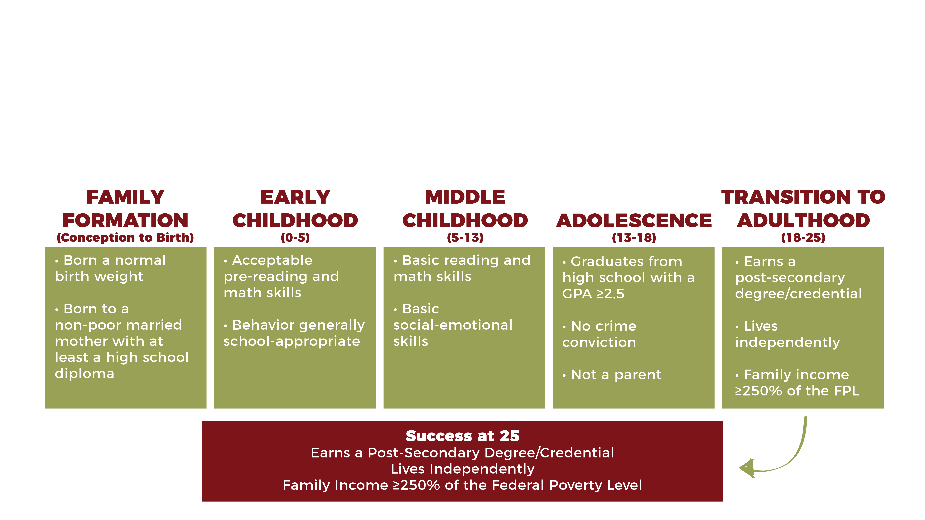
Theory of Change
Success @ 25

Slide 6
What would it take to reach Success @ 25?
A Cradle-to-Career Success Pathway
The Social Genome Project, The Brookings Institution
Success @ 25

Slide 7
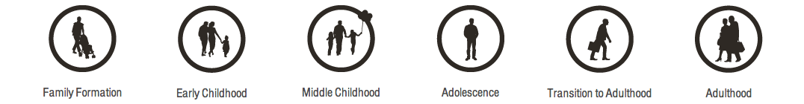
A Cradle-to-Career Success Pathway
What would it take to reach Success @ 25?
Success @ 25

Slide 8
A Cradle-to-Career Success Pathway
What would it take to reach Success @ 25?
Born to non-poor, two-parent family
Ready for school at
age 5
Core academic and social skills by age 11
Graduate HS – 2.5 GPA, no crime, no baby
Post-secondary credential
by age 25
Income = 300% of poverty level
Success @ 25

Slide 9
A Cradle-to-Career Success Pathway
What would it take to reach Success @ 25?
Born to non-poor, two-parent family
Ready for school at
age 5
Core academic and social skills by age 11
Graduate HS – 2.5 GPA, no crime, no baby
Post-secondary credential
by age 25
Income = 300% of poverty level
17%
17%
Success @ 25

Slide 10
A Cradle-to-Career Success Pathway
What would it take to reach Success @ 25?
Born to non-poor, two-parent family
Ready for school at
age 5
Core academic and social skills by age 11
Graduate HS – 2.5 GPA, no crime, no baby
Post-secondary credential
by age 25
Income = 300% of poverty level
21%
17%
Success @ 25

Slide 11
A Cradle-to-Career Success Pathway
What would it take to reach Success @ 25?
Born to non-poor, two-parent family
Ready for school at
age 5
Core academic and social skills by age 11
Graduate HS – 2.5 GPA, no crime, no baby
Post-secondary credential
by age 25
Income = 300% of poverty level
21%
36%
17%
Success @ 25

Slide 12
A Cradle-to-Career Success Pathway
What would it take to reach Success @ 25?
Born to non-poor, two-parent family
Ready for school at
age 5
Core academic and social skills by age 11
Graduate HS – 2.5 GPA, no crime, no baby
Post-secondary credential
by age 25
Income = 300% of poverty level
21%
36%
44%
17%
Success @ 25

Slide 13
A Cradle-to-Career Success Pathway
What would it take to reach Success @ 25?
Born to non-poor, two-parent family
Ready for school at
age 5
Core academic and social skills by age 11
Graduate HS – 2.5 GPA, no crime, no baby
Post-secondary credential
by age 25
Income = 300% of poverty level
21%
36%
63%
17%
Success @ 25

Slide 14
A Cradle-to-Career Success Pathway
What would it take to reach Success @ 25?
Born to non-poor, two-parent family
Ready for school at
age 5
Core academic and social skills by age 11
Graduate HS – 2.5 GPA, no crime, no baby
Post-secondary credential
by age 25
Income = 300% of poverty level
21%
36%
44%
75%
17%
Success @ 25

Slide 15
A Cradle-to-Career Success Pathway
What would it take to reach Success @ 25?
Born to non-poor, two-parent family
Ready for school at
age 5
Core academic and social skills by age 11
Graduate HS – 2.5 GPA, no crime, no baby
Post-secondary credential
by age 25
Income = 300% of poverty level
21%
36%
44%
75%
Doula
PEP
TAPP
Coaches
17%
Success @ 25

Slide 16
A Cradle-to-Career Success Pathway
What would it take to reach Success @ 25?
Born to non-poor, two-parent family
Ready for school at
age 5
Core academic and social skills by age 11
Graduate HS – 2.5 GPA, no crime, no baby
Post-secondary credential
by age 25
Income = 300% of poverty level
21%
36%
44%
75%
Doula
PEP
TAPP
Coaches
17%
Success @ 25

