Slide 1

Transform westside summit
April 20, 2018

Slide 2

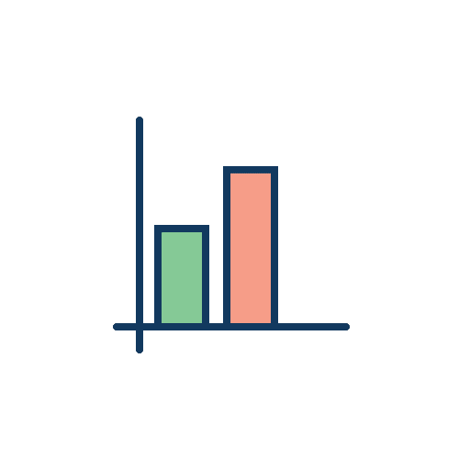

Our Mission
TechBridge breaks the cycle of generational poverty through the innovative use of technology to transform nonprofit and community impact.
We Deliver Technology
To Nonprofits
to Scale Nonprofits
    Efficiently and Effectively
to alleviate poverty
    Through Community Impact

Slide 3
















Techbridge Westside partners

Slide 4



Success requires a collective approach
SURVIVAL
Coordination of
neighborhood shelters,
food pantries, clinics
and emergency assistance providers to ensure at-risk children receive life-
saving resources.
STABILITY
Foster stable environments for local children by mapping needs to education, mentorship, extracurricular , and supportive programs.
SUCCESS
Build high-value skills, successful behaviors, and financial acumen.
Secure employment with leading firms for middle-class jobs.
Notes:
TechBridge improves communities’ ability to combat poverty by empowering the ecosystem that provides food, shelter and health (Survival,) the social programs that help families and individuals deal with crisis and achieve stability, and the knowledge, skills and income need to achieve life-long success and escape poverty. TechBridge community transformation provides the ability for local nonprofits to work better together and achieve most impactful outcomes.

Slide 5



Our vision for poverty alleviation
A United States that is able to measurably alleviate poverty, within select communities, by enabling the nonprofit ecosystem to:
DATA
Collect more meaningful data with better accuracy by improving capacity for front-line nonprofits and service providers
INSIGHT
Aggregate community data; analyze causation, trends and efficacy; and share insights with service providers, advocates and residents.
RESOURCES
Allocate goods, services and funding more efficiently and timely to the programs critical in reducing resident poverty.

Slide 6

The Westside Community Dashboard:
A Collective Approach
Sponsored by:
Powered by:

Slide 7
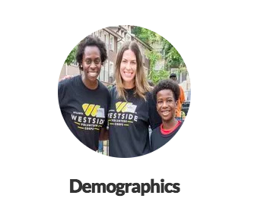
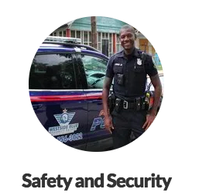
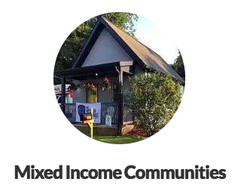
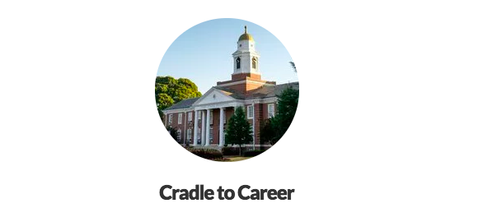

westside community dashboard

Slide 8



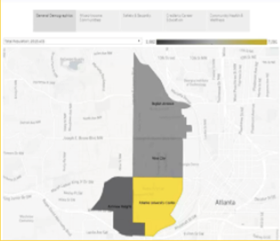
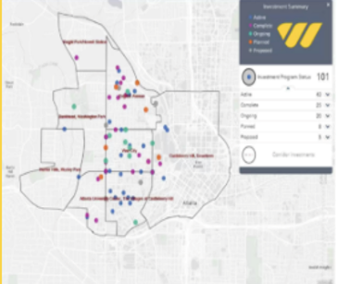
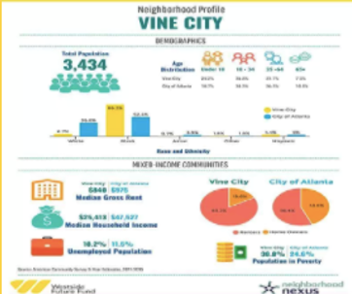
Introducing: the westside community dashboard www.westsideprogress.org
Dashboard
Progress Map
Neighborhood Infographics

Slide 9
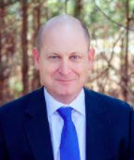
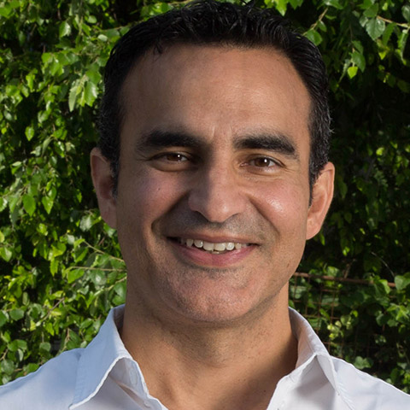
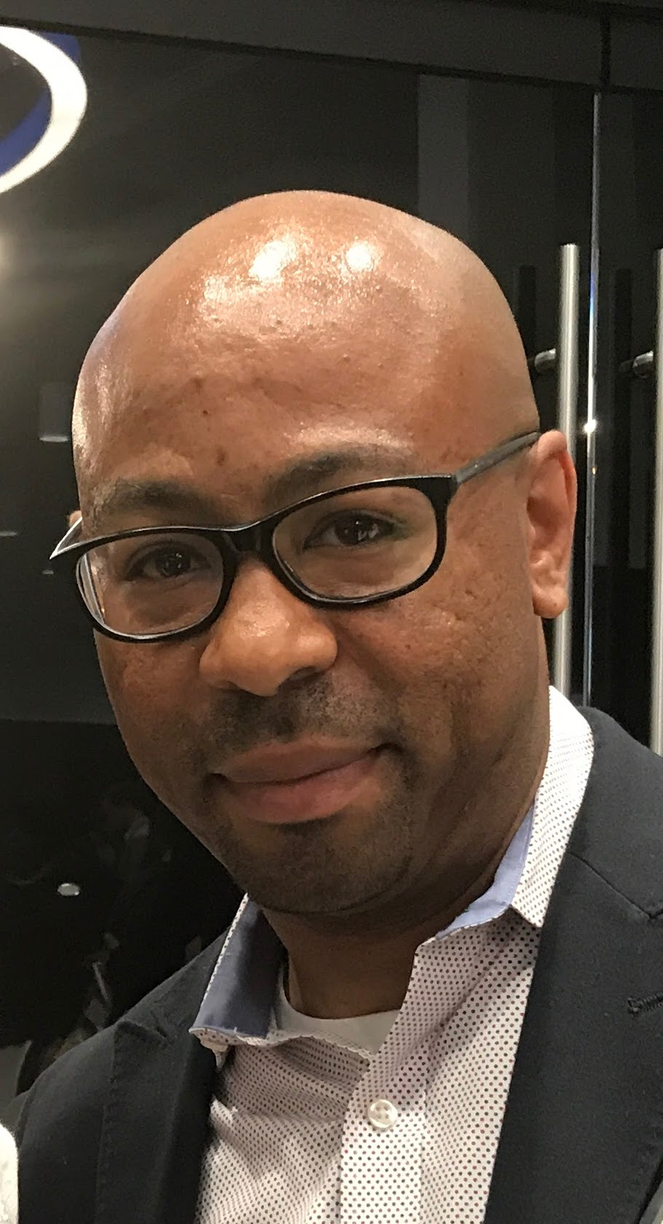
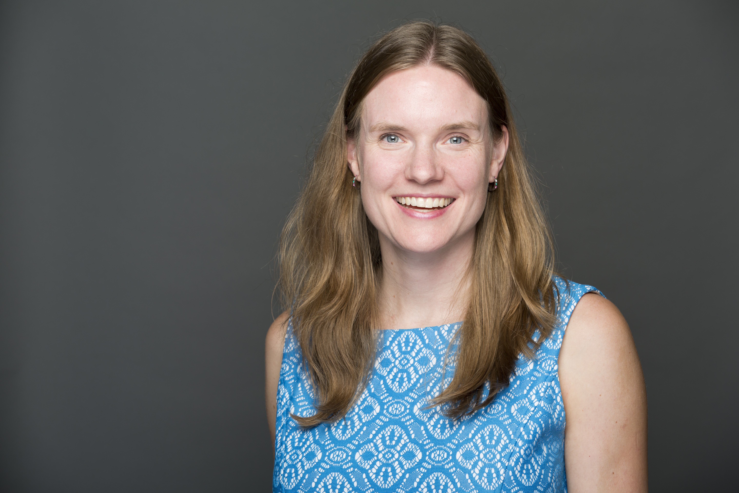
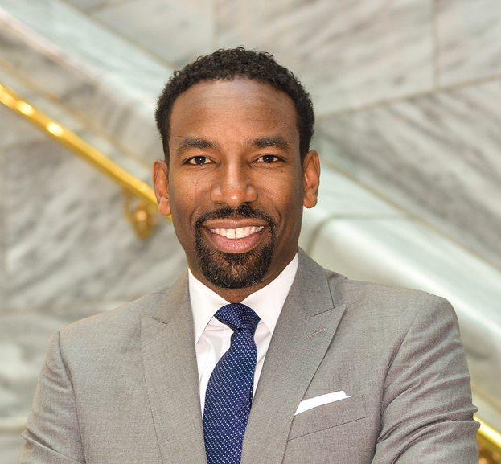

A Westside Data Story:
Where We’ve Been, Where We Are, Where We Are Going
Panelist:
John Ahmann,
Executive Director,
Westside Future Fund
Panelist:
Frank Fernandez,
VP Community Development,
Arthur M. Blank Family Foundation
Panelist:
Rodney Milton Jr.,
Asst. Director of Neighborhood Revitalization, Atlanta Department of City Planning
Panelist:
Karen Cramer,
Performance Measurement Group Leader,
TechBridge
Panelist: Karen Rogers
Director of Community Development,
Atlanta Police Foundation
Moderator:
Andre Dickens,
Georgia Community Leader,
TechBridge

Slide 10



Introducing Techbridge technology career program
Providing 18-24 year-olds with the technology, professional, and life skills to secure jobs that overcome poverty.
First cohort starting soon: At Promise Youth Center
Students
18-24 year old Opportunity Youth
From Low-Income Households
Diploma or GED
Tech Savvy
Training
4 months of technical training
1 year of employment
FREE
Financial and professional acumen
Community
Integrated platform for case management and data tracking across agencies
Located on the Westside
Investment
An investment in a student’s future
Students gain economic mobility in 3 years or less
Visit us and apply at www.techbridge.org/tcp

Slide 11
Andre Dickens
Georgia Community Leader
adickens@techbridge.org

