Slide 1
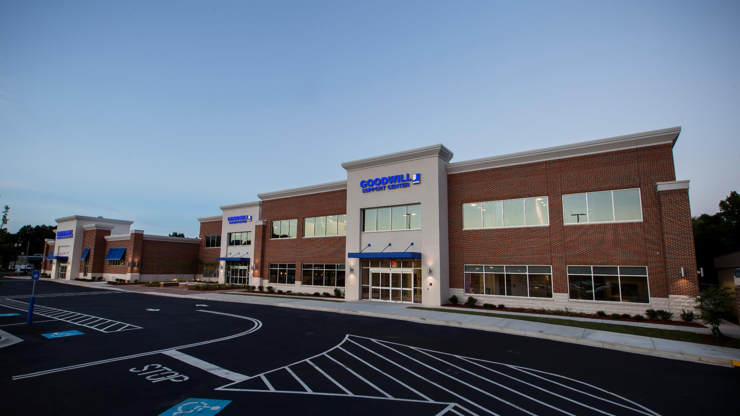
GOODWILL
OF NORTH GEORGIA

Slide 2
25% of children in Atlanta born in poverty will remain there into adulthood.
FACT:
Annie E. Casey Foundation: Changing the Odds – The Race for Results in Atlanta
Notes:
http://www.nytimes.com/2013/07/22/business/in-climbing-income-ladder-location-matters.html?pagewanted=all

Slide 3
Black men are working fewer hours (down 15.7 percent) than black men in 1979.
Black men with less education are particularly disconnected from the labor market.
FACT:
Working Harder or Finding It Harder to Work – Valerie Wilson and Janelle Jones

Slide 4
Landfill gases contribute 20% of the global environmental pollutants.
FACT:
https://www.researchgate.net/publication/278738702_Environmental_and_socio-economic_impacts_of_landfills [accessed Dec 07 2017].
United States Environmental Protection Agency

Slide 5



Impact
Economic
  We put people to work. Not just into jobs, but into better jobs. Goodwill is moving people out of poverty.
Education
  Education is the key to getting and staying out of poverty. Goodwill is helping at-risk students graduate from high school and matriculate to post-secondary education opportunities.
Environmental
  The degradation of wastes in landfills produce emissions that are potential threats to human health and the quality of the environment.
  Goodwill diverts millions of pounds of materials from landfills each year.
Notes:
Economic:
We work to place people in all kinds of jobs including those that would place workers in the middle class, the working class, and those looking for next chance or entry-level jobs
Education
26 high school partners through our Youth Employment Services (Y.E.S.) Program
98% stay in school
96% graduate
100% go to work
10 Technical college partners through our CollegeCareerCatalyst (C3) Program
With Goodwill support, students in the Technical College System of Georgia have a 85% completion rate
Without Goodwill support, students in the Technical College System of Georgia have a 25% completion rate
Environmental
48,661,757 pounds of materials diverted from landfills in 2017.

Slide 6
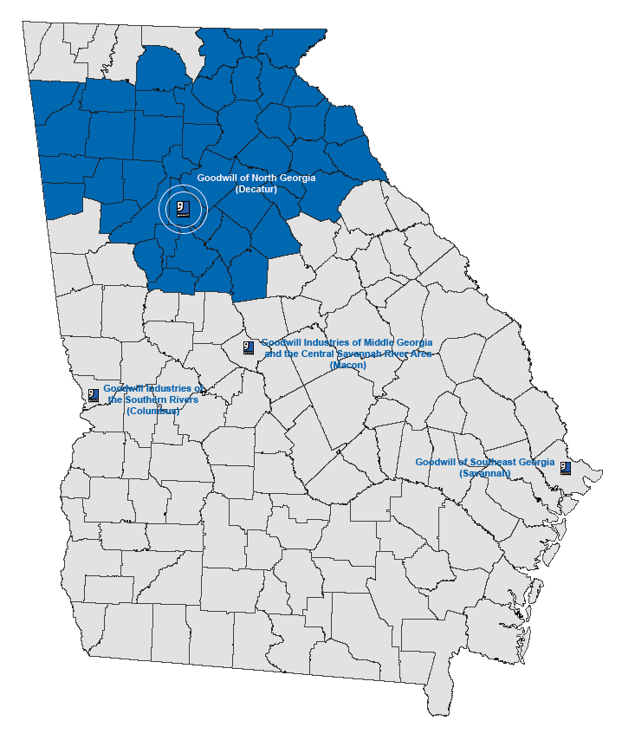
Goodwill of North Georgia
Our mission is to put people to work.
Notes:
Territory includes most of the 45 northernmost counties in the state.
Three other Georgia-headquartered Goodwills also operate in the state
Last year, we generated more than 133 million dollars in revenue in support of our mission to put people to work.

Slide 7
We serve our mission,
but we are a business…
85%
7%
4%
2%
2%
Retail Sales
Salvage
Government Grants
Foundation Support
Vocational Services and Investments
In Fiscal Year 2017, we generated more than $133 million in revenue to support our
mission to put people to work.
Notes:
Contrary to what many think, very little of our funding comes from the government.
The majority of our revenue comes from our stores through the support of our 7.4 million shoppers
Our mission is driven by the generous support of our donors and our shoppers.

Slide 8
Our role in your success…
Notes:
Goodwill of North Georgia makes significant impacts on all of this issues in our community and more.
However, we have years of experience and value to bring to your organization to forward your goals.

Slide 9


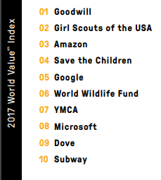
Positive Brand Alignment
Notes:
Goodwill is a brand that people know and trust.
In 2016, mission-driven brand developer enso developed the World Values Index
This index is used to measure how people rank companies and nonprofits on their perceived mission or purpose—namely the extent to which brands stand for something other than making money, whether they align with what people care about, and if these brands are worth publicly supporting.
In both the 2017 and 2016 rankings, Goodwill came in #1
In Goodwill you will have a partner with impeccable brand recognition and respect

Slide 10
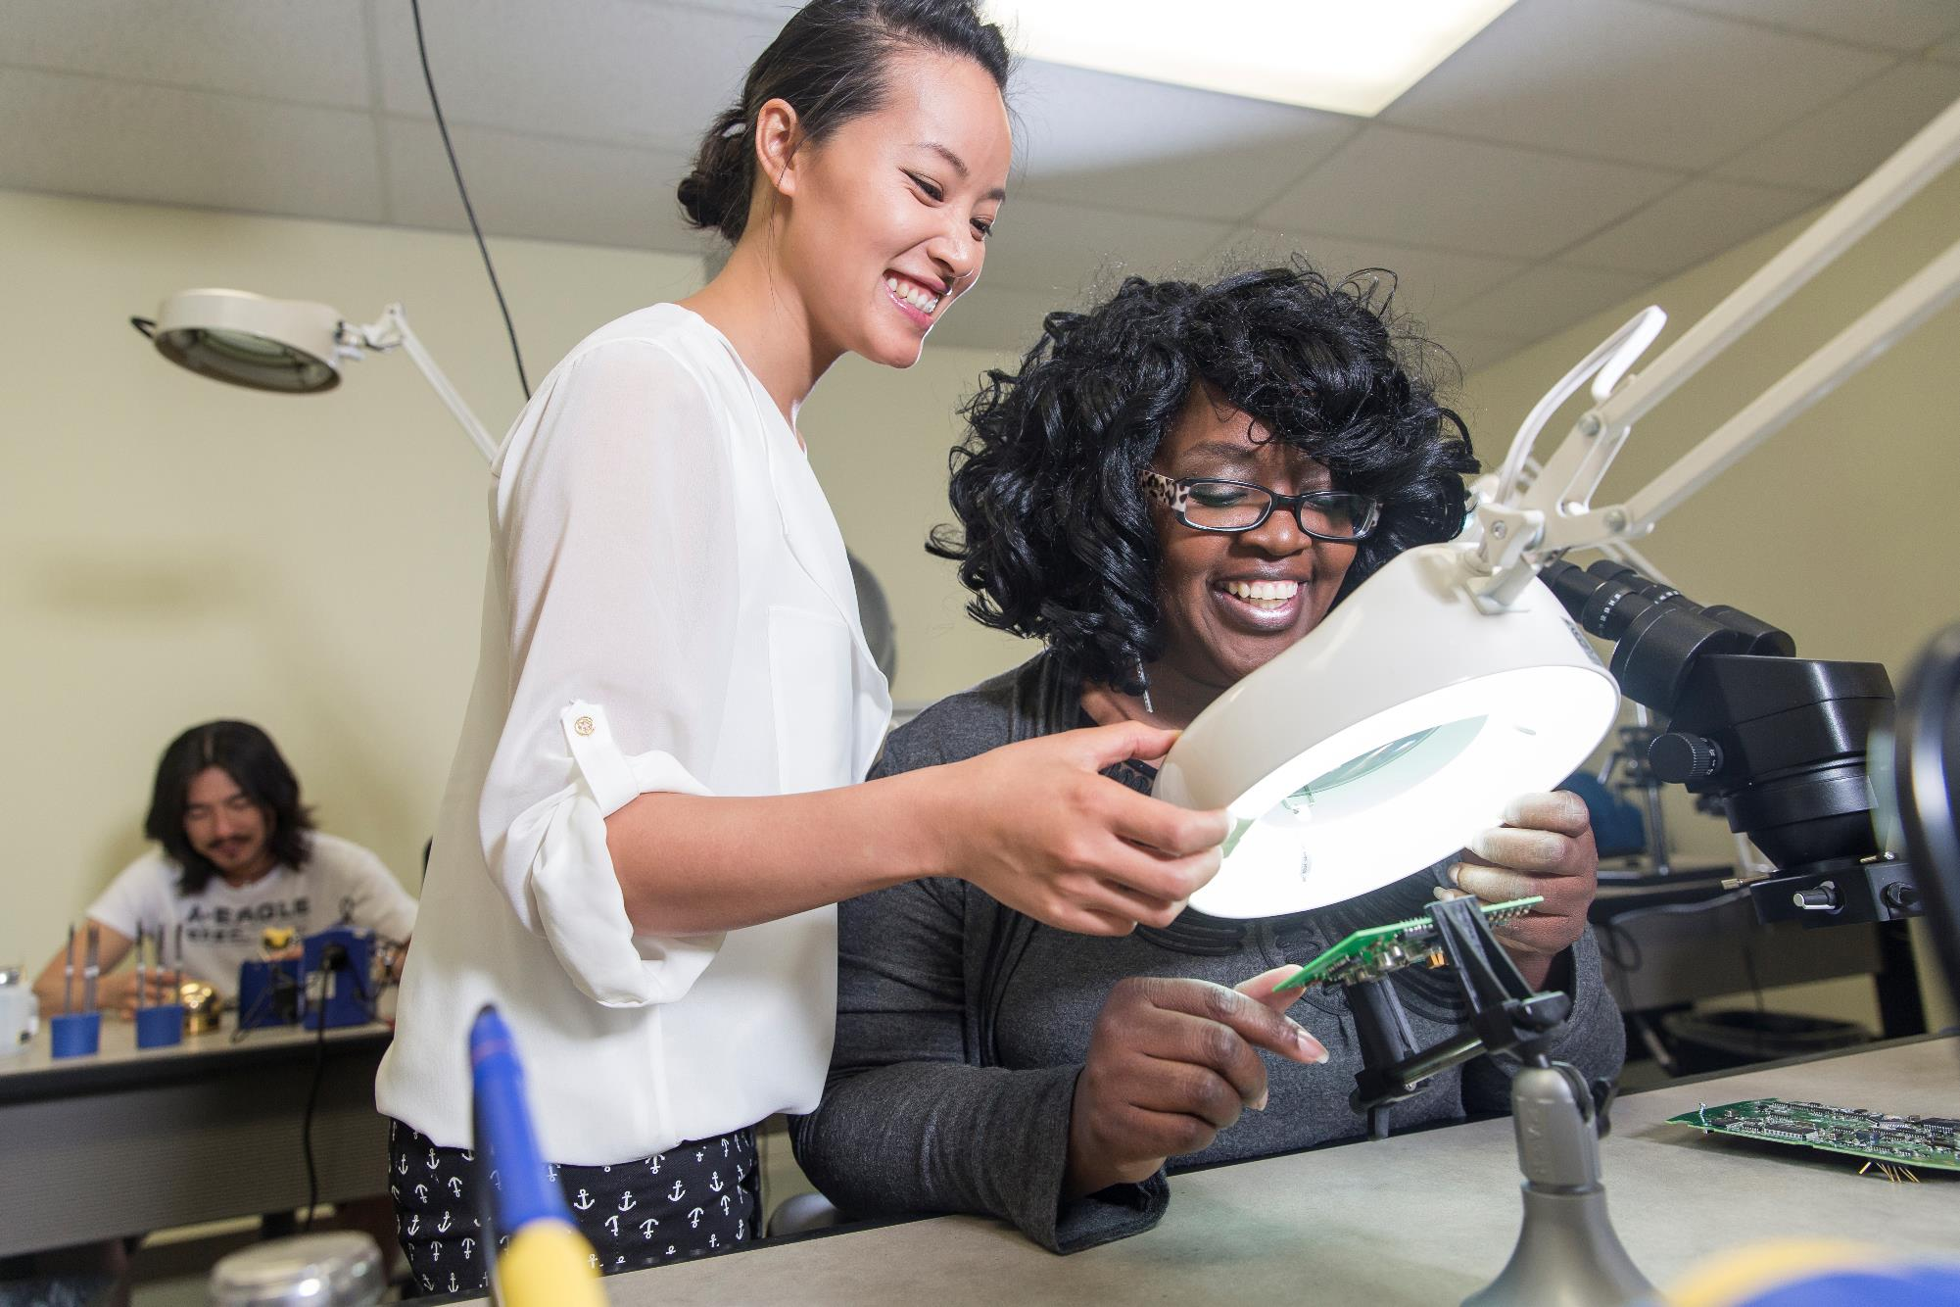
Workforce Development
24,188 people put to work
13 free-to-the-public career centers
Targeted and hands-on training programs in growth fields including: Construction, welding, hospitality, logistics, facilities maintenance and more.
Notes:
Goodwill of North Georgia is a powerhouse when it comes to getting people ready to work
We partner with more than 5,000 companies across the metro area to meet our mission goals to place 24,000 people into jobs this year.
We operate 13 free-to-the-public career centers offering:
Résumé development and interview skills
Computer skills classes
Veterans programs
In addition to our brick and mortar career centers, we have our virtual career center careerconnector.org where people can access our resources 24/7 no matter where they are

Slide 11
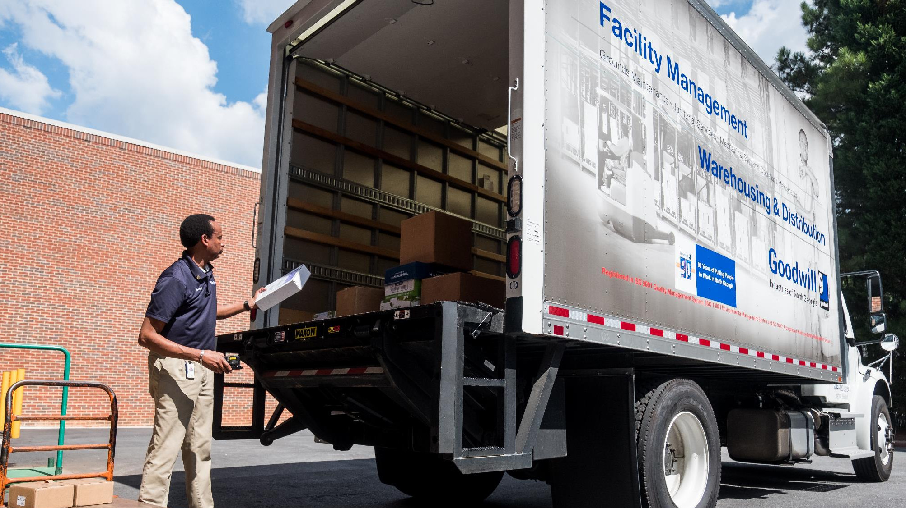
Proven Track Record
3.3 million square feet of space cleaned daily
200 employees, many with documented disabilities that would make it difficult to find competitive employment
Decades-long contracts with some of Atlanta’s most visible facilities
Notes:
Finally, our facility services department, working through contracts with some of Atlanta’s most recognizable organizations, cleans more than 3.3 million square feet of office space every day
The 200 employees working on these contracts have disabilities, many quite severe, that would make it challenging for them to find competitive employment outside of Goodwill
We have held these contracts for decades because of our top-notch staff, un-matched service and the ability to serve our mission through our facilities contracts at locations like the Jimmy Carter Presidential Library, the IRS and the CDC.

Slide 12
Goodwill and the Westside

Slide 13
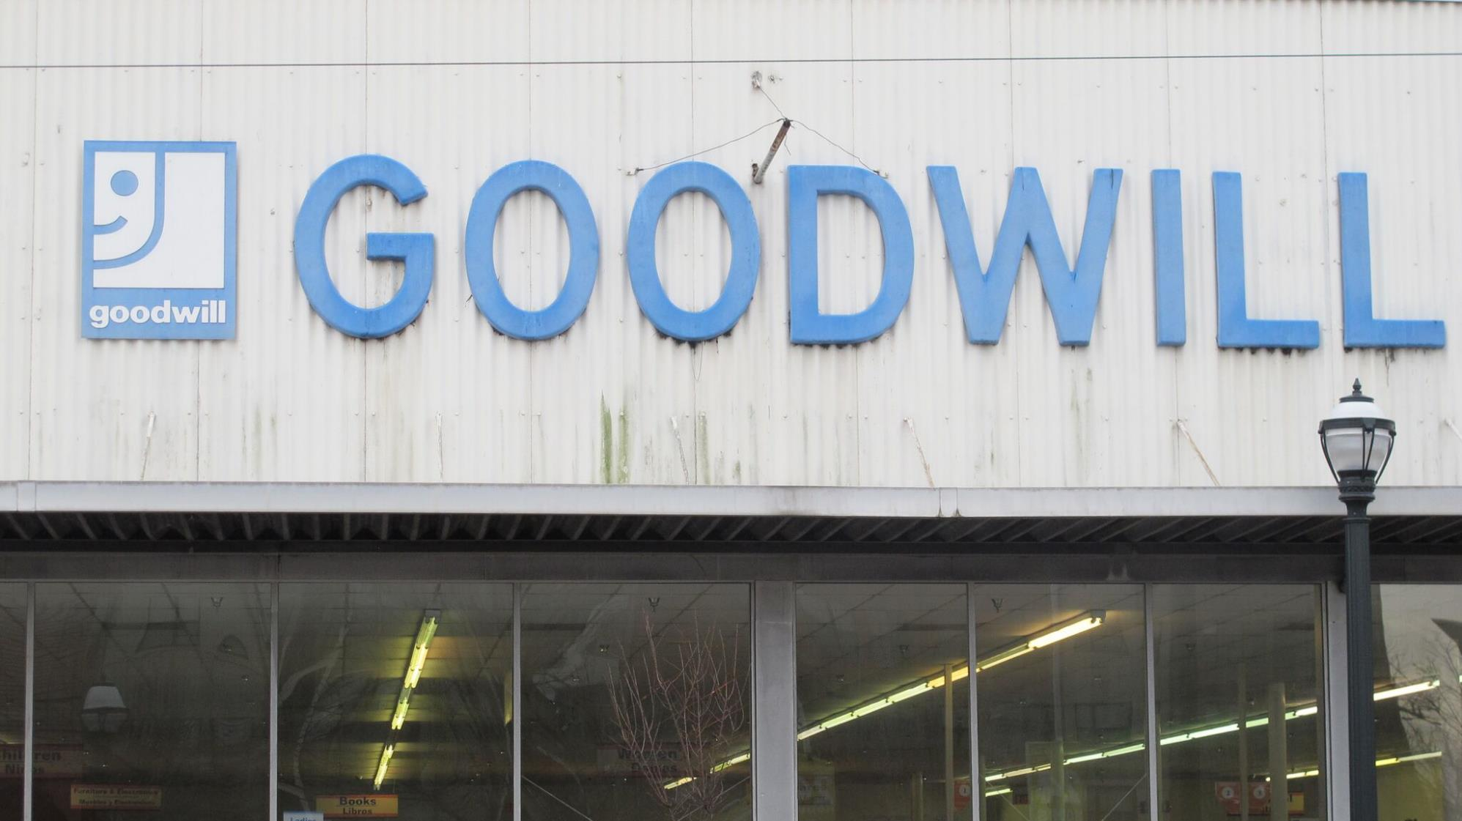
Our West End location is our oldest store, opened in October of 1973.
Notes:
Just a few miles from here - in the West End – is our oldest store.
Our West End store is our oldest store we currently operate.
Last year, more than 27,000 people who live in and around Westside communities made a donations to our West End store.
If you’ve visited our store, you might appreciate the “vintage” sign on the building.

Slide 14
Goodwill served nearly 3,000 people and connected more than 1,100 people with work in the Westside and surrounding neighborhoods over the last three years
Notes:
While we don’t have a brick and mortar Career Service presence yet, we are looking for the right location
In addition to our skills training program, residents attended workshops, GED classes, and ESL classes
Even without the physical space, we are serving members of this community
Westside residents, through Goodwill, have found work at more than 500 employers, including CSX, Bank of America, DHS, and UPS

Slide 15



Program Spotlight
Notes:
New Technology Career program in partnership with TechBridge
Open to 18-24 year olds – recruiting efforts are focused on low-income youth who live on the Westside and in surrounding neighborhoods
4-month program with evening/weekend classes
Committed employer partners offering positions with a $20/hour average
Employer partners include Accenture, Georgia Tech, Insight and Salesforce

Slide 16




Growing the
Mission
Corporate Giving
Employee Giving
Donation
Drives
Advocacy
Notes:
Strategic workforce development partnerships are a focus for us, particularly in communities where the need for our service has increased in recent years
We encourage you to partner with us – share the Goodwill story – and of course, donate your unwanted items to Goodwill!

Slide 17
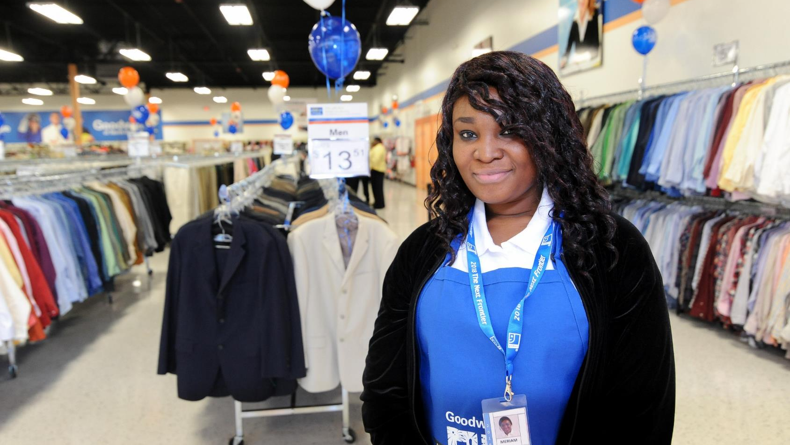
We are making an impact in the community & we are ready to do more.

Slide 18
Goodwill of
North Georgia
THANK YOU

